Slide 1


Management in the
Age of Artificial Intelligence
#AI #managersforEU
Seminar
25 May 2019
Mainz

Slide 2


Welcome
Greetings by Roland Leroux
Greetings by Michael Ebling
and
Opening remarks by Ludger Ramme
#AI #managersforEU

Slide 3
Agenda
9.00 | Registration
9:30 | Greetings by Dr. Roland Leroux (President of ULA)
9:35 | Greetings by Michael Ebling (Mayor of Mainz)
9:40 | Opening remarks by President of CEC
9:50 | Presentation of European Managers Panel results by Jean-Philippe Steeger (Policy and Communication Officer, CEC)
10:10 | Keynote speech How artificial intelligence impacts labour and management By Dr. Gerlind Wisskirchen (Vice Chair for Multinationals of the IBA Global Employment Institute, Partner CMS Germany)
11:00 | Break
11:15 | Panel discussion AI fact check: high ambitions and nothing behind? The state of play on the field With Dr. Gerlind Wisskirchen (Vice Chair for Multinationals of the IBA Global Employment Institute Partner CMS Germany), Andrea Penza (Federmanager, Italy), Eleonora Peruffo (Eurofound), Guy Masmonteil (EWC of Engie)
12:30 | An example from the field: How can oil technology be applied to the green shift through AI? By Tor Haehre (Lederne NO)
12:45 | Wrapping-up session
13:00 | Lunch
#AI #managersforEU

Slide 4
European Managers Panel
How far is the technological development?
What are the motives for the techn. implementation?
Which kind of leadership guides their implementation?
Which consequences for working conditions?
Are ethical considerations raised?
#AI #managersforEU

Slide 5
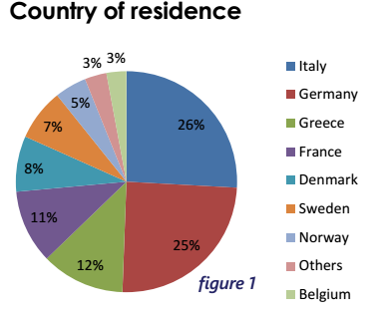
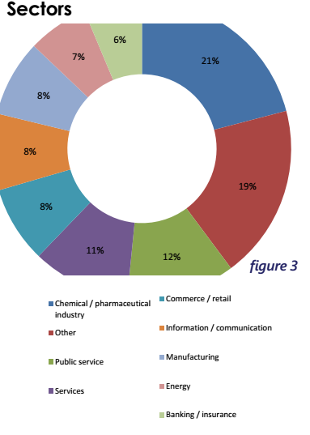
European Managers Panel
Total of 350 participants out of
1400 panelists
#AI #managersforEU

Slide 6
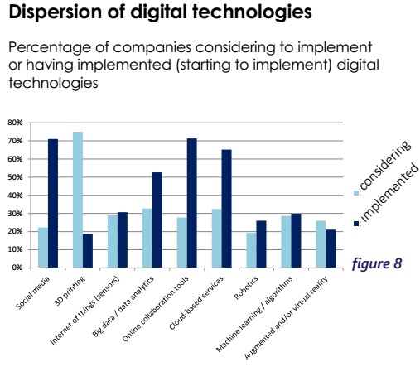
European Managers Panel
#AI #managersforEU

Slide 7
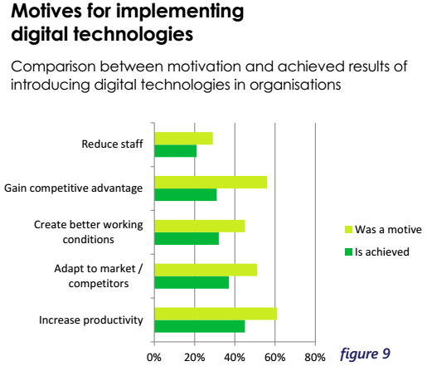
European Managers Panel
#AI #managersforEU

Slide 8
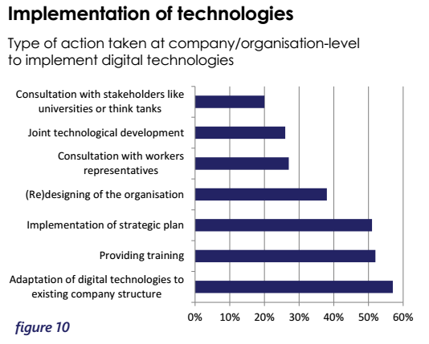
European Managers Panel
#AI #managersforEU

Slide 9
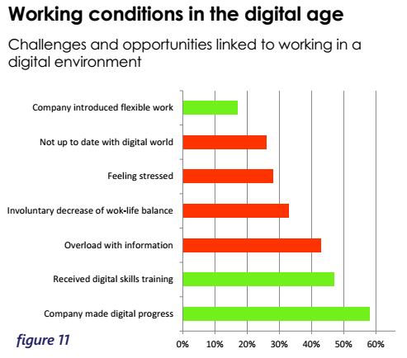
European Managers Panel
#AI #managersforEU

Slide 10
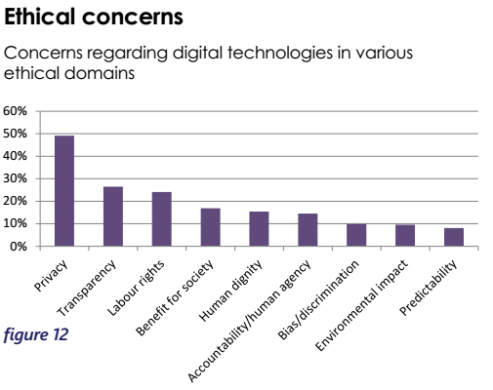
European Managers Panel
#AI #managersforEU

Slide 11
Where are we today?
Acceleration and polarisation
Business considerations dominate
Lack of knowledge
Global competition: future of the stakeholder model
Global regulation
Ethics: setting the scene
#AI #managersforEU

Slide 12
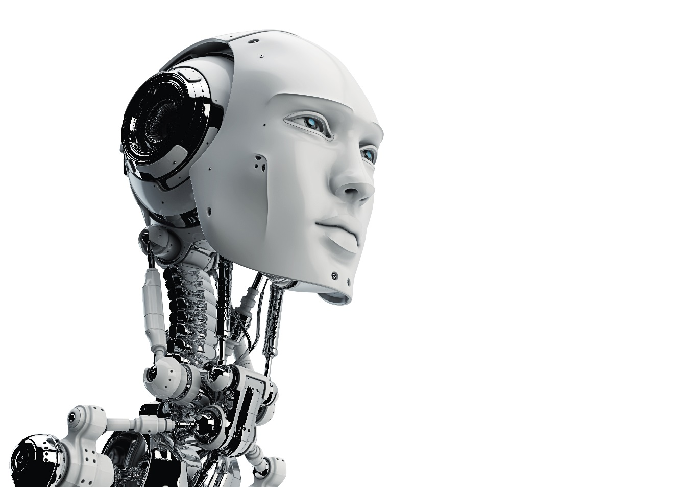
Note:
To read about the content of the presentation, please consult the script for the presentation of Dr. Gerlind Wisskirchen, available on
www.cec-managers.org
How Artificial Intelligence (AI) Impacts
Labour and Management
CEC European Managers
Management in the Age of AI
Employment, Economics and Ethics
Mainz, May 25, 2018
Dr. Gerlind Wisskirchen
CMS Germany

Slide 13
CEC SEMINAR
Management in the Age of Artificial Intelligence
Eleonora Peruffo,
Eurofound Research Assistant
Mainz, Friday 25 May18

Slide 14
How is the digital age affecting work and employment?
Three vectors of change (technology clusters with different effects, yet interrelated):
AUTOMATION
Advanced Robotics
Digitisation of processes
Internet of things
3d printing
Virtual/augmented reality
Crowd employment/ platform work
Coordination by Platforms
Artificial Intelligence
Replacement of labour
Work process reorganisation
Management and work organisation
Notes:
To interpret the current wave of technological change Eurofound has classified technologies into 3 different driver:
Automation of tasks: replacement of labour input by machine input for some types of tasks within the production process.
Digitization of processes: use of sensors and rendering devices to translate parts of the physical production process into bits, and vice-versa.
Coordination by platforms: use of digital networks to coordinate economic transactions in an algorithmic way.
In the report on Game changing technologies in manufacturing in Europe, part of the future of manufacturing in Europe (FOME) programme, Eurofound looked at specific technologies in a 10 years horizon. These technologies are:

Slide 15
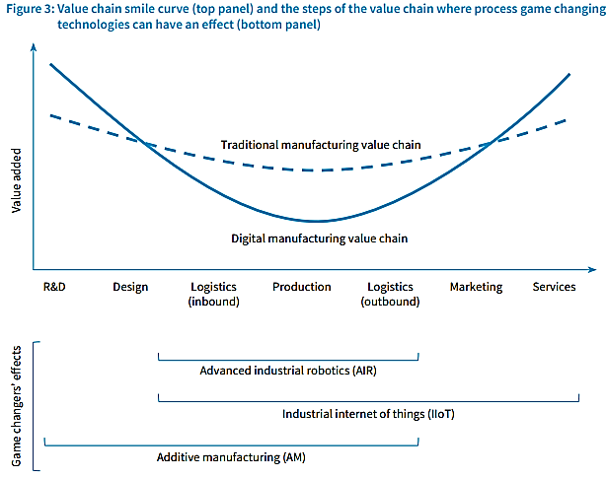
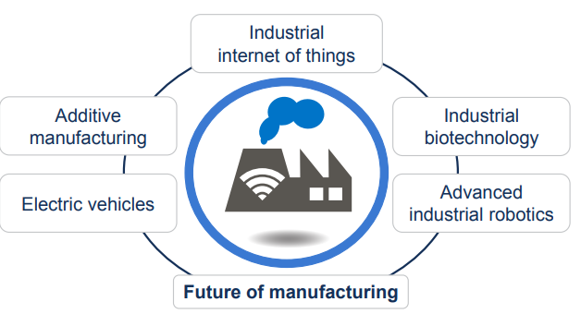
Game changing technologies in manufacturing
Skills upgrading
Growing importance of data scientists and teamwork at management level
Control replaced by algorithms
Business models of tech companies applied to traditional sectors- what are the consequences?
Overcoming geographic barriers
Notes:
AIR, IOT, AM, EV, Biotech.
These changes are likely to accentuate an existing trend which has seen value added in manufacturing expand at either end of the product lifecycle – initial design and R&D at one end, and marketing and post-sales service at the other – and away from the physical mass production process itself. They also imply a further shift in employment demand in manufacturing away from traditional production line work to increasingly higher skilled profiles, including specialisations such as industrial data scientists, encryption experts and network security analysts. Demand for the combination of engineering and data/statistical skills in particular will grow strongly. The specialist nature of many of the game changing technologies will, however, increase the importance of project or teamwork, as well as good management, implying a growing need for ‘soft’ communication.
Example
Increased IT and data intensity, possibly more team work or more multi-disciplinary teams and less manual labour, also has implications for managers. The departments or activities that they oversee, and the staff they facilitate, will become more diverse yet entangled. Interviewees mentioned that managing AM may have similarities with managing creative industries, IT companies and traditional manufacturing companies.
New tasks will emerge like loading and unloading machines, filling material into the production machines and removing (support) material from the fabricates. This may become a job in itself, though machine unloading will probably be soon automated as some products (metal car parts) can become rather heavy.
Other notes:
Continued structural decline in EU manufacturing? Most GCTs are human labour-replacing in some respect, so probably yes.
Occupational upgrading within manufacturing already visible – more engineers, more managers, fewer production line workers. GCTs will intensify this trend.
Reshoring – occurring but with limited employment gains
Emerging jobs: DATA … network security, industrial data analyst, big data etc in combination with traditional engineering profile
benefits: potential declines in hazardous human work
Issues: intrusive monitoring of worker performance driving work intensification, including privacy concerns
… rogue robots, the dangers of AI unleashed
… the psychological impact of algorithms supplanting human agency
WC implications tend to be quite technology specific, eg:
Additive manufacturing: fewer mechanical moving parts (+) but high temperature printer nozzles, high voltage arcs, small particle toxicity (all potential -)
Implications of the GCTs for social dialogue has received limited attention so far
But social partners have been active in initiatives such as Germany’s Industrie 4.0 (also Arbeit 4.0)
New tech firms tend to have fewer, more highly qualified, employees, to have more individual employment relationships, lower worker representation – a challenge for unions

Slide 16


Management in the Age of Artificial Intelligence
Andrea Penza
Mainz, 2018 May 25th

Slide 17
The digital Revolution Paradigm
The three main pillars :
Introduction of innovative digital technology
Build competence and digital skill
Innovation and revolution in redefining industrial process
Eco-system made of devices, machines, people and process
Full change management
Top-down approach
Leadership value

Slide 18

The technology revolution
Internet of Things
Big Data and Analytics
Robotic
Artificial Intelligence
Industry 4.0 Sharing economy
Sustainability
Augmented Reality Smart….Smart…Smart Additive Manufacturing

Slide 19
Industry 4.0
COLLABORATION AGREEMENT
FEDERMANAGER
CONFINDUSTRIA DIGITALE
for Digital Innovation Hub (DIH)
(Confindustria & Economical Development Ministry promotors)

Slide 20
Industry 4.0 in Italy
ENABLED FACTORS
CULTURE
DIGITAL COMPETENCES
E-LEADERSHIP
ADVANCED TECHNOLOGICAL INNOVATION

Slide 21
Industry 4.0
COLLABORATION AGREEMENT
Expert Managers for temporary time in Small-Medium Enterprise in order to address the digital transformation
process within the company
Competence skill built and certificated
Expert Professionals coming from professional associations

Slide 22






Competence and skill:
Digital Innovation Hub e Competence Center I4.0
Digital Innovation Hub
Competence Center Industry4.0
Features:
Selected DIH distributed on Confindustria premises within the country
Bridge between industry, research and finance
Research Centers
Features:
Few and selected national Competence Centers
Strong involvement of excellent University Centers and strong private players
Contribution of selected stakeholders (e.g. research, start-up,,..)
Focus of centers on specific and complementary technology scope
Legal model and adequate management competences
Mission:
Training and awareness on Industry 4.0
Live demo on innovative technologies and access to best practices on Industry 4.0 scope
Technological Advisory for SME on Industry 4.0
Launch and acceleration of innovative projects with a strong technological development
Support to the experimentation and production of new technologies in Industry 4.0 scope
Coordination with european Competence Centers
15
Industrial
Players
Start-up
Mission:
Address companies on existing opportunities coming from Industry 4.0
Support on activities of planning innovative investments
PMI
Incubators
CC
CC
Address towards Competence Center Industry 4.0
Support for the access of public and private financing instruments
Mentoring towards companies
Interation with european DIH
Public
Institutions
Government
CC
University
Associations
Cluster
Investors
Fonte: MIUR

Slide 23
Industry 4.0
COLLABORATION AGREEMENT
Expert Managers for temporary time in Small-Medium Enterprise in order to address the digital transformation
process within the company
Competence skill built and certificated
Expert Professionals coming from professional associations

Slide 24
Industry 4.0
From Industry 4.0 Program
to
Impresa 4.0
Smart Business, Smart work

Slide 25
Thank you!!!
Andrea Penza
andrea.penza@gmail.com
Member of Federmanager
Industry 4.0
President & CEO INTRATEL s.r.l

Slide 26
Panel debate
AI fact check: high ambitions and nothing behind?
1. Where do we stand?
2. What has been done?
3. What can we do?
#AI #managersforEU

Slide 27
How can high tech oil and gas technology be applied for the green shift in a global perspective?
Tor Haehre,
political advisor,
Lederne, Norway

Slide 28
Norwegian government:
Being a long term exporter of oil, gas and LNG, Norway has a responsibility to be among the green shift- leaders
Norway has for decades played a major and leading role in developing high tech petroleum technology, both offshore and onshore, which can be applied in the green shift change

Slide 29
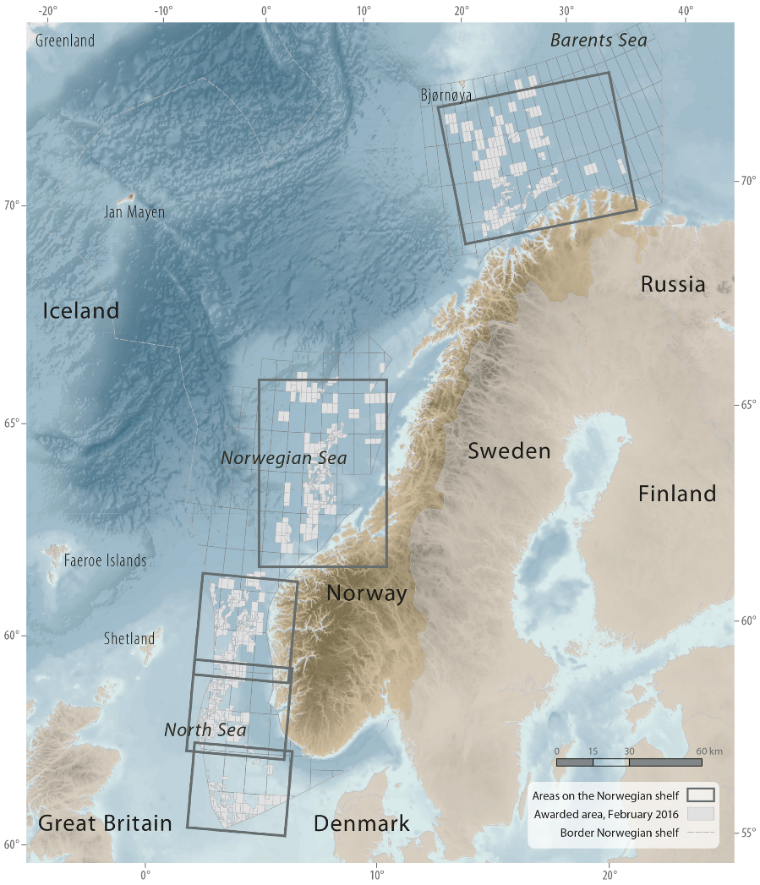
Norwegian government:
Oil and gas offshore areas

Slide 30
Norwegian government:
The green shift must take place within a period of 30 to 50 years
During the same period the world population will increase by at least 50 %
At the same time more people must be lifted out of poverty. Energy access is essential
The global middle class is expected to rise from about 400 million people today to 1. 2 billion in only about 15 years

Slide 31
Norwegian government:
One of the measures is reducing emissions in the transport sector. The Norwegian Environment Agency has shown in the low emissions report that there is great potential for being able to achieve this in 2030
The entire sector can be free of fossil fuels in 2050. Through a policy in which cars with low emissions have lower taxes than cars with high emissions, a green shift is being promoted in the transport sector
In 2017 almost 27 per cent of all new passenger cars sold in Norway are electric cars that do not emit greenhouse gases. However…in some extent there is a question about the origin of electricity and the storage / re-use of batteries

Slide 32
Norwegian government:
The technology centre for CO₂ capture initiatives at Mongstad is unique in the world. It can play an important role in testing and phasing in CO₂ capture technologies
The Intergovernmental Panel on Climate Change also emphasises how vital CO₂ capture technologies are to the chance we have of reaching the two degrees target

Slide 33
Norwegian government:
The goals for the green shift in Norway are based on the Government platform, on the goal that Norway shall be a low-emission society in 2050, on strengthening the Climate Agreement and on the Government's aim of safeguarding prudent management of nature as a basis for future growth and welfare
A green shift is part of the work for sustainable development

Slide 34
Key word:
REMOTE CONTROL
RELATED TO SEARCHING FOR AND THE PRODUCTION OF OIL AND GAS

Slide 35
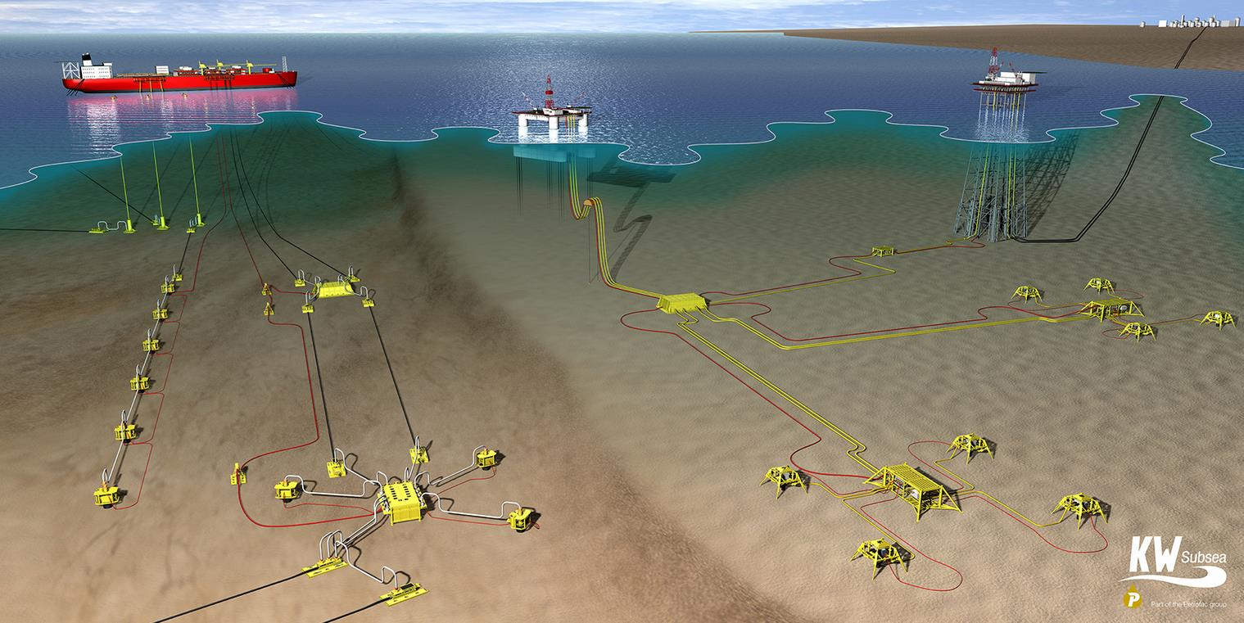
Implementation of subsea remote oil and gas production control

Slide 36
How can petroleum technology be applied for non-petroleum activities?
Robotics Advances for Precision Farming
Sub-sea industry remotely operated robots might be further developed to make themselves useful in European agriculture. EU announces funds for development and demonstration of smart robot technology to ensure high precision in modern agriculture. The robots will be able to operate in rough terrain, have sensors for monitoring of both animals and plants living conditions, and could contribute to the proper care of crops

Slide 37
How can petroleum technology be applied for non-petroleum activities?
CCS (Geological storage pilots)
EU has stated a commitment to reduce 80% greenhouse gas emissions by 2050. This requires the development of a commercial mature CCS technology with geological structure storage. Research and innovation projects will be designed under "real life" conditions, and will subsequently develop and demonstrate best practices for the entire CCS value chain, including transport infrastructure for CO2, state control to prevent gas leakage, and the education of professionals and operators. The announcement is relevant for employees in the oil sector, geologists, seismologists and geophysicists in academia and industry

Slide 38
How can petroleum technology be applied for non-petroleum activities?
EGS (enhanced geothermal systems) in different geological conditions
The EU Commission asks for an innovation project to test different geothermal systems that deliver electricity and / or heat. The aim is increased productivity of the reservoir in different geological formations according to cost price. The announcement is appropriate for environments related to drilling and wells

Slide 39
How can petroleum technology be applied for non-petroleum activities?
Border Security: autonomous systems and control systems
Border surveillance, both at sea and on land, will be introduced preferably at EU's external borders. EU has asked for an innovation project on technology that can enhance border surveillance by developing unmanned installations more robust, and being more operational suitable in demanding physical environments, both by sea surface, in the water column, and on land. The announcement is relevant to a variety of environments that develops self-propelled and remote controlled devices for advanced operations

Slide 40
How can petroleum technology be applied for non-petroleum activities?
Safer waterborne transport and maritime operations
In general, EU will solve a whole range of challenges. Among these are new types of vessels and equipment design, which implies a clear risk reduction for both people and equipment, thereby increasing operability, fire safety and better conditions for monitoring operations and transport offshore under extreme external conditions. Mathematical simulations, cost-benefit calculations and better rescue and evacuation conditions are also in demand. The EU will spend money both on this and on related maritime research themes.

Slide 41
How can petroleum technology be applied for non-petroleum activities?
Multi-use of the oceans marine space, offshore and near-shore: Enabling technologies
EU asks for new technology being adapted to many types of exploitation of marine resources (renewable energy, farming, mineral extraction, transport and others). This technology shall be conducted simultaneously within the geographical boundary waters. This requires new types of platforms that can serve for several maritime activities simultaneously. Previously, EU has funded some concept development for such devices. Now there is a need for research and innovation that takes this further to specific technologies that can be tested, and providing both environmental and commercial benefits. The announcement is relevant for the maritine cluster associated with sub sea- and offshore activity.

Slide 42
Summary
Petroleum technologies, that have been developed for decades both offshore and onshore under rough and extreme weather conditions, have already been applied to a wide range of non-petroleum activities
EU, and several countries individually, has requested for further implementation of these technologies being adapted for a wide range of «green» industries
But…there will still be petroleum production, particularly gas production, for decades. Europe and the world increasingly demand for energy, and gas is among the cleanest energy source
The former Norwegian minister of oil and energy, Tord Lien, stated: «The people who shall close petroleum production in Norway has not yet been born»

Slide 43
Management in the
Age of Artificial Intelligence
#AI #managersforEU
Seminar
25 May 2019
Mainz

