Slide 1


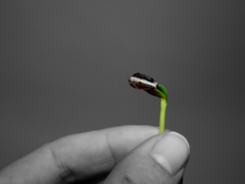
Sustainable leadership for a world in transition
The changing role of the managerial profession
17 June 2019, Brussels
#SustainableLeadership

Slide 2


Agenda
Welcome by CEC President Ludger Ramme
Introduction and presentation of the “Sustainable Leadership Guidelines”
Panel debate and input speeches on sustainable leadership for Europe
- Martin Rich, Future Fit Foundation
- Martin Porter, University of Cambridge Institute for Sustainable Leadership
- Ebba Öhlund, Deputy Secretary General of CEC European Managers
Networking drinks and snacks (Kamilou)
#SustainableLeadership

Slide 3
Welcome
Ludger Ramme
President of CEC European Managers
#SustainableLeadership

Slide 4
Where we are today
Single capital growth
Systemic economic risks
Global competition
Structures impeding innovation
Fail fast, fail often
“Diversity fatigue”
Biodiversity loss
Global heating & extr. weather
Depletion of resources
Loneliness, depression, burn-out
“Technical” skill bias
(Un)meaningful work
Inequalities
Labour rights
New forms of employment
#SustainableLeadership

Slide 5
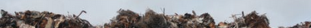
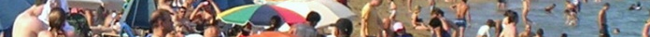


« We can’t solve problems with the same kind of thinking we used when creating them. »
Albert Einstein
Linear thinking
Silo-thinking
Non-purposeful thinking (incl. quantity)
= Ignoring neuroscientific evidence:
social and emotional factors
#SustainableLeadership

Slide 6
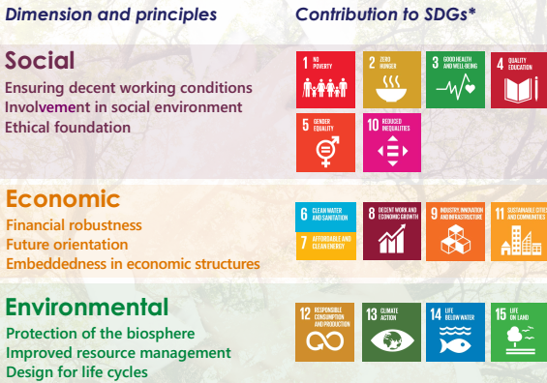
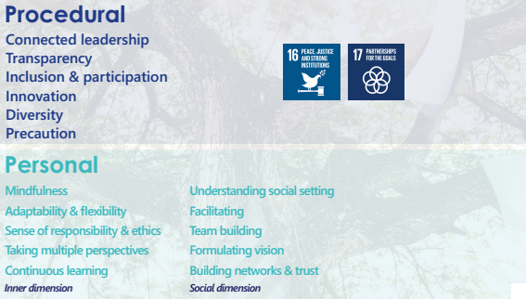
Sustainable Leadership Guidelines
The « what »
The « how »
The future needs facilitators for the sustainable development of skills, processes, structures and outcomes = a new managerial standard
#SustainableLeadership

Slide 7
Path-way
design
Circular & sharing economy
Long-term orientation
Triple Bottom Line
Emergent network structures
Precaution & slow developm.
Inclusion and participation
Biosphere/habitat protection
Regeneration
Lifecycle design
Decent work
Social investment
“Rooted ethics”
Mindfulness
Social & emotional skills
Continuous learning
#SustainableLeadership

Slide 8
“Sustainability management in the EU – do we need a revolution or an evolution?”
Martin Rich, Future Fit Foundation
Martin Porter, University of Cambridge Institute for Sustainable Leadership
Ebba Öhlund, Deputy Secretary General of CEC European Managers
#SustainableLeadership

Slide 9
Rewiring the economy – how to mainstream sustainability in the EU
Input speech by
Martin Porter
University of Cambridge Institute for
Sustainable Leadership
#SustainableLeadership

Slide 10

Martin Porter
CISL Brussels, Executive Chair
SUSTAINABILITY LEADERSHIP
FOR A WORLD IN TRANSITION
Where are we today?

Slide 11
Agenda
How Sustainable Are We?
CISL’s Rewiring the Economy
The European Agenda for Sustainability
What this Means for Companies – the Sustainability Shift

Slide 12
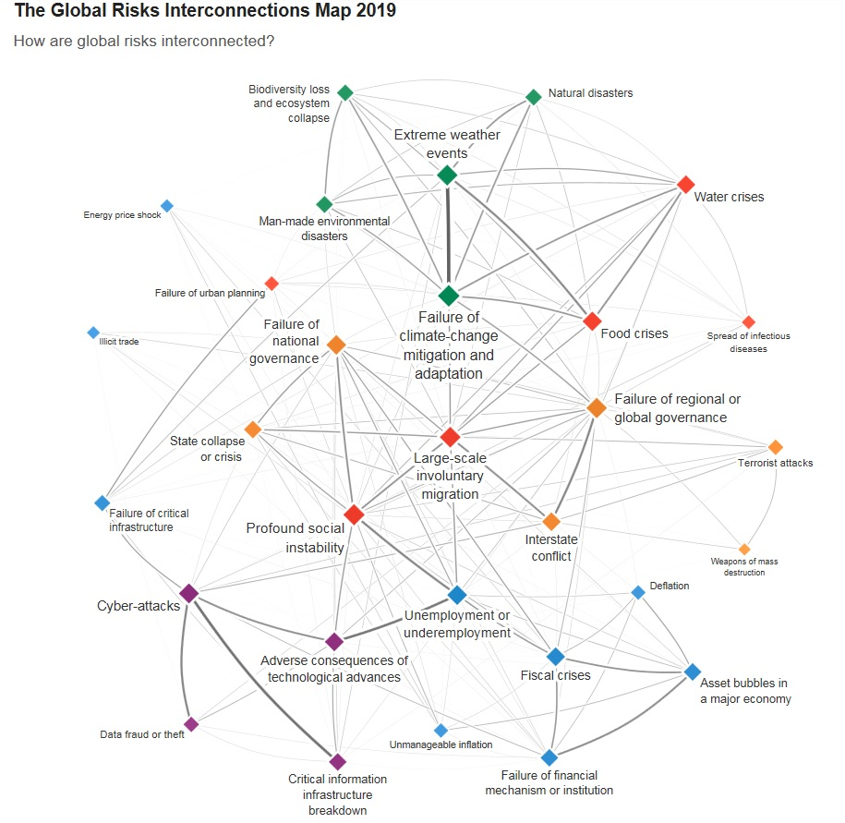
How Sustainable Are We?
Notes:
This is the global risk interconnectedness map 2019 from the WEF
- environmental issues are now the biggest and most likely risks
- social risks remain high, inequality key
- narrow economic issues less important than the system overall
Climate – we are on a +3 degree pathway
Circularity – Circle Economy estimate we are only 7% circular, 93% linear
Biodiversity – species decline, mass extinction.
Reason for the planetary boundaries becoming more obviously relevant, as they are at risk of being breached. Anthropocene.
Progress on economic and social and technology, whilst appreciable, are not sustainable absent the supporting environment/planet – Donut economics
Climate Emergency – immediate and urgent action necessary to become sustainable rather than unsustainable.

Slide 13
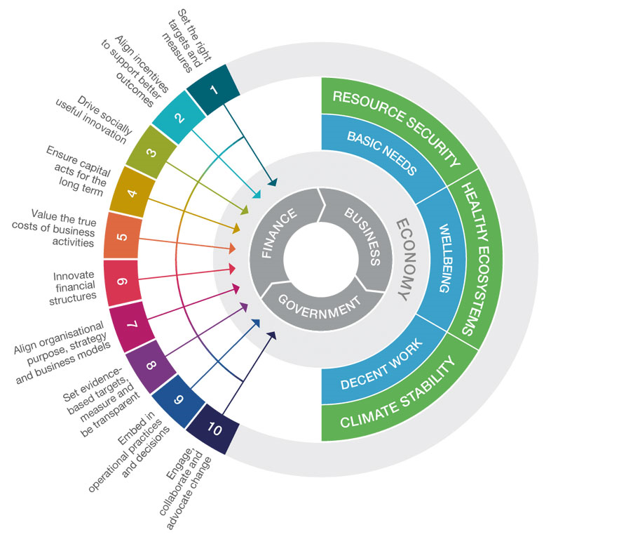
Rewiring the Economy
Notes:
Core distinctive role: enabling sustainability leadership
Building capacity and ability to lead on sustainable development in both the public and private sectors, through provision of world-class education and training for individuals through to support on development of strategy and engagement for companies.
Built on leading academic and practitioner understanding of latest scientific knowledge and real-world experience of the current state of the planet, its society and economy, a clear and shared vision of the key elements necessary for the relationship between them to be sustainable, and the pursuit of development pathways to enable a successful transition.
NEED – a clear point of view around the (four?) stages of the sustainability journey that a company/organisation must take and how we can help differently at each stage:
acceptance of the need to change but otherwise business as usual
partial engagement and action in certain priority areas
holistic approach with greater ambition and an overall strategy
A transformational approach fully embracing the transition and its implications
Theory of change
enabling leadership in business and government through independent facilitation grounded in cutting edge and highly respected thought-leadership (and drawing also on that from outside of CU) can drive a virtuous cycle of change in two key constituencies of stakeholders involved in a complex system-level transition – the private and public sectors.
Governments and public policy-makers establish market rules and expectations which will be adapted and improved to drive the transition when private sector players, the business and financial communities, themselves support these changes. Creating the conditions for leadership in each constituency and enabling collaborative activities which re-enforce the connections and synergies between the two therefore supports the transition to sustainability.
CISL delivery mechanism: organisation, strategy and goals
are developed and pursued through a matrix of content-focused centres of expertise and collaborative platforms (Centre for Sustainable Finance, Centre for Business Transformation and Centre for Policy and Industrial Economy Transition) with cross-cutting services (Executive education, advisory, organisational support, engagement platforms…).
Strategic goals are set to be consistent with the SDGs in three inter-related key dimensions of sustainable development – climate, the natural environment and societal well-being.
Priorities for programmes and activities are set within theses in areas of significant potential for improvement and where the role of public and private offers immediate interest. They are currently focused around industrial systems, agriculture, food and land-use and the relationship between business and society more broadly.

Slide 14
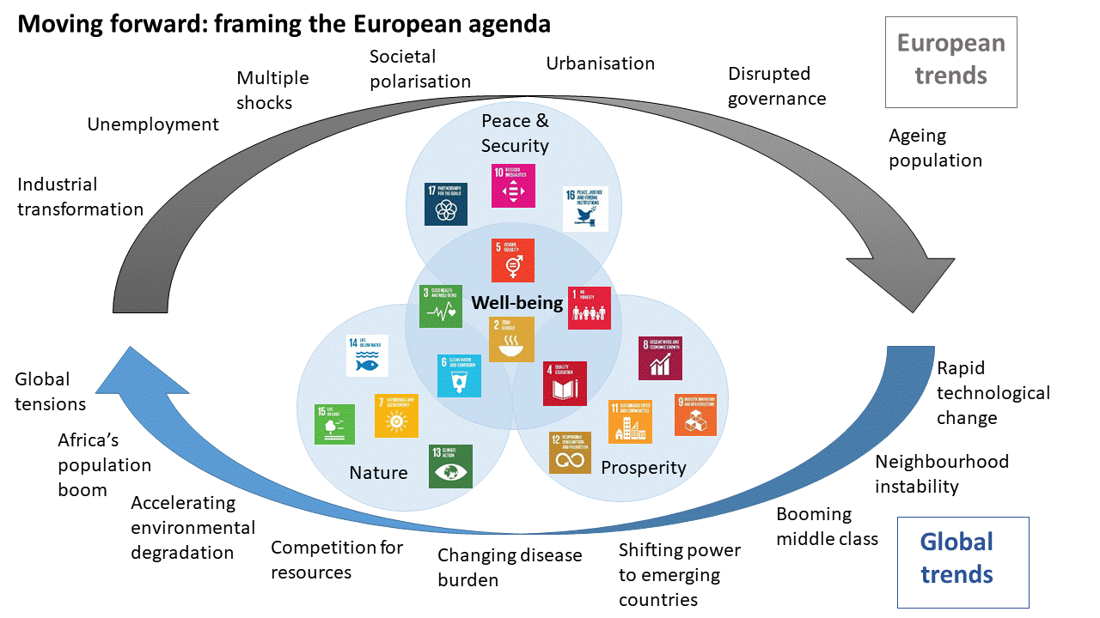

Slide 15





The Sustainability Shift
FROM
TO
Purpos
And
Engagement
nvironmental
compliance within the silo of risk management
ustainability
ocial
Responsibility within discretionary budget line and delegated below C-suite
Business
Strategy
Fiduciary
overnance to comply with mandatory regulatory requirements
Builds brand loyalty –customers buy products or services which drives top-line results
overnance and finance
XXXXXXXXXXXXX

Slide 16
How to make management and corporate leadership fit for the future
Input speech by
Martin Rich
Future Fit Foundation
#SustainableLeadership

Slide 17
What is future-fitness?
A Future-Fit® Society will protect the possibility that humans and other life
can flourish on Earth forever.
Environmentally restorative
Socially just
Economically inclusive

Slide 18
What would a Future-Fit Society look like?
Environmentally restorative, socially just, economically inclusive…
Energy is renewable
and available to all
Water is responsibly sourced and available to all
Waste does not exist
Natural resources are managed to safeguard
communities, animals and ecosystems
The environment is
free from pollution
People have the capacity and
opportunity to lead fulfilling lives
Our physical presence protects the
health of ecosystems and communities
Social norms, global governance and economic growth
drive the pursuit of future-fitness

Slide 19
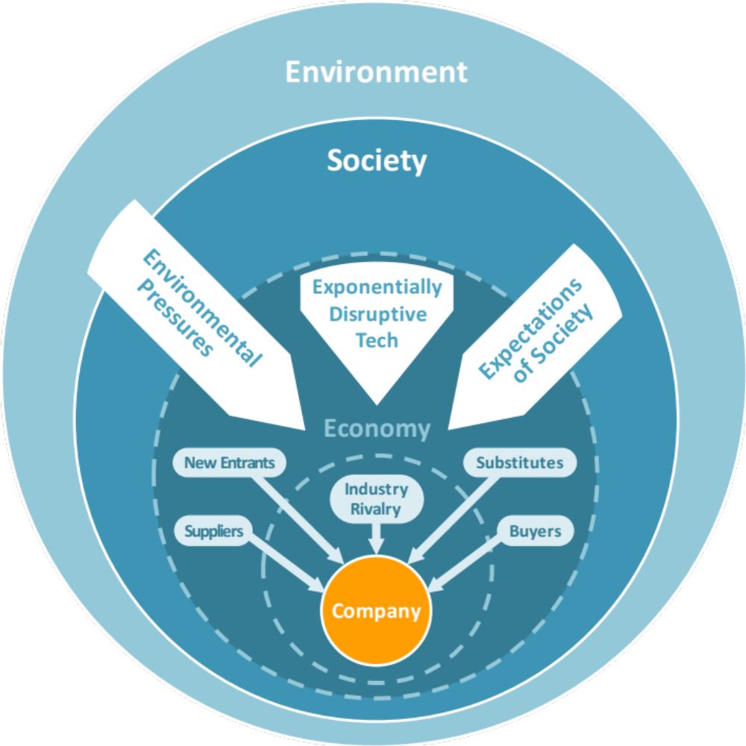
A manager’s role:
Disrupt or be disrupted
From Porter’s 5 Forces…
…to Future-Fit’s 8 Forces

Slide 20
Future-Fit’s 8 Forces
Questions every manager
needs to ask…
What societal needs
do we address?
NOT What do we sell?
What do we actually do to
address these needs? What
are our core competencies?
How can we leverage what we
have and evolve what we do
to capitalize on these macro-forces?

Slide 21
What pressures will disrupt your business?
ENVIRONMENTAL PRESSURES | EXPECTATIONS OF SOCIETY | EXPONENTIALLY DISRUPTIVE TECH
Global warming and extreme weather Plastics and toxicants in nature Habitat and biodiversity loss Water scarcity Land degradation Ocean acidification Ecosystem collapse Competition for land and natural resources | Automation vs Jobs Mass economic migration Growing inequality gap Power shift from nations to cities and companies ‘Free’ services (user attention and data is the product) Short-term incentives (e.g. for CEOs, politicians) Degrading trust in experts, institutions Rapid population growth, changing demographics | Additive manufacturing Artificial intelligence Autonomous road vehicles Big data Blockchain Digital agriculture Gene editing Internet of things The microbiome New (augmented & virtual) realities Next generation robotics Unmanned aviation systems
Could someone with no legacy obligations, sufficient money, and knowledge of your industry, meet
the same societal needs as your business… but in a Future-Fit way?
Notes:
[NEXT SLIDE]

Slide 22
A practical tool
Positive impact
Direct
business
impact
Indirect
business
impact
Every business must
eliminate its own negative impact
by avoiding all actions
that undermine wellbeing or degrade the environment
Negative impact

Slide 23

Energy
Energy is from renewable sources
Water
Water use is environmentally responsible and socially equitable
Natural Resources
Natural resources are managed to respect the welfare of ecosystems, people and animals
Pollution
Operational emissions do not harm people or the environment
Operations emit no greenhouse gases
Products emit no greenhouse gases
Products do not harm people or the environment
Presence
Operations do not encroach on ecosystems or communities
Waste
Operational waste is eliminated
Break-Even Goals
What every company
must strive to do
to avoid slowing down
society’s progress
toward future-fitness
Products can be repurposed
People
Community health is safeguarded
Employee health is safeguarded
Employees are paid at least a living wage
Employees are subject to fair employment terms
Employees are not subject to discrimination
Employee concerns are actively solicited, impartially judged and transparently addressed
Product communications are honest, ethical, and promote responsible use
Product concerns are actively solicited, impartially judged and transparently addressed
Drivers
Procurement safeguards the pursuit of future-fitness
Financial assets safeguard the pursuit of future-fitness
Lobbying and corporate influence safeguard the pursuit of future-fitness
The right tax is paid in the right place at the right time
Business is conducted ethically

Slide 24
A practical tool
Positive impact
Any business may
create positive
impact itself
by taking action
to foster wellbeing or
restore the environment
Any business may
amplify the positive impact of others
by helping them take action
to foster wellbeing or
restore the environment
Direct
business
impact
Indirect
business
impact
Every business must
eliminate its own negative impact
by avoiding all actions
that undermine wellbeing or degrade the environment
Any business may
reduce the negative
impact of others
by helping them avoid actions that undermine wellbeing or degrade the environment
Negative impact

Slide 25
Energy
Others depend less on non-renewable energy
More people have access to energy
Water
Others contribute less to water stress
More people have access to clean water
Natural Resources
Others depend less on inadequately-managed natural resources
Pollution
Others generate fewer greenhouse gas emissions
Greenhouse gases are removed from the atmosphere
Others generate fewer harmful emissions
Harmful emissions are removed from the environment
Presence
Others cause less ecosystem degradation
Positive Pursuits
What any company
may choose to do
to help speed up
society’s progress
toward future-fitness
Ecosystems are restored
Others cause less damage to areas of high social or cultural value
Areas of high social or cultural value are restored
Waste
Others generate less waste
Waste is reclaimed and repurposed
People
More people are healthy and safe from harm
People's capabilities are strengthened
More people have access to economic opportunity
Individual freedoms are upheld for more people
Social cohesion is strengthened
Drivers
Governance is strengthened in pursuit of future-fitness
Infrastructure is strengthened in pursuit of future-fitness
Market mechanisms are strengthened in pursuit of future-fitness
Social norms increasingly support the pursuit of future-fitness

Slide 26

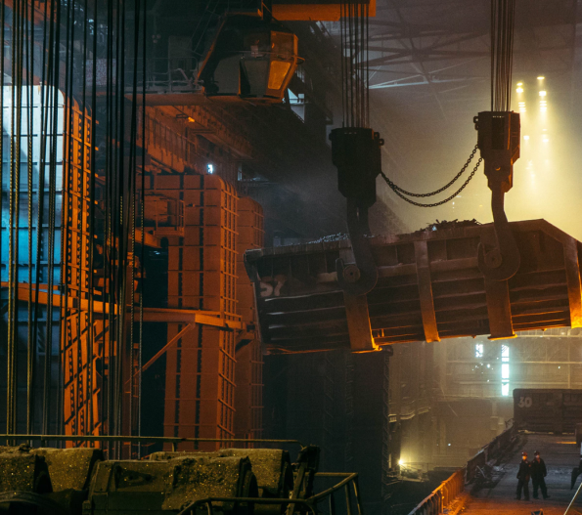

Conclusion
The manager as a…
Industrial process
manager (< 20th century)
Master craftsman (< 19th century)
Networker (tomorrow?)
#SustainableLeadership

