Slide 1


The Voice of European Managers
Webinar
Designing Artificial Intelligence
for People, Planet and Prosperity

Slide 2

Agenda
1. Welcome by Maxime Legrand, President of CEC European Managers
2. Introduction: “State of the Art and Potential of Artificial Intelligence in European workplaces”
By Jean-Philippe Steeger, Policy and Project Officer of CEC European Managers
3. Presentation by Nicolas Blanc: rethinking governance and design of Artificial Intelligence systems
Nicolas Blanc is National Delegate for Digital and AI at CFE-CGC; OECD expert on AI; member of CEC working group on Digitalisation and AI
4. Open exchange with participants

Slide 3

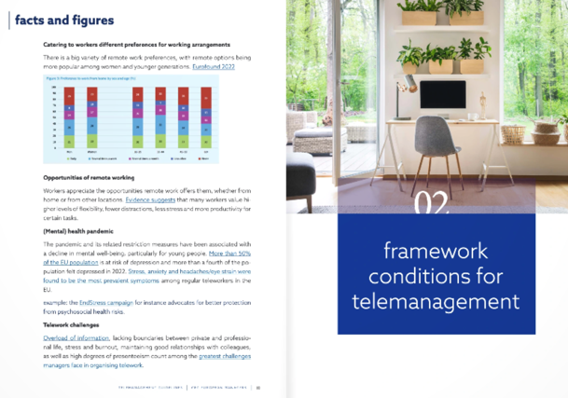
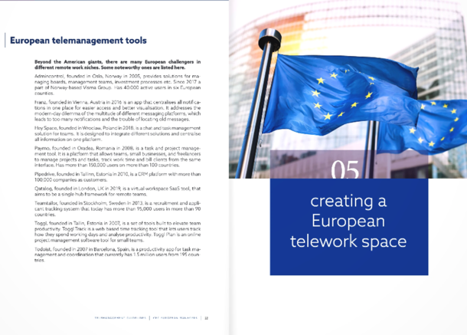
Out now! cec-managers.org
/telemanagement

Slide 4
The Voice of European Managers
Introduction
State of the Art and Potential of Artificial Intelligence in European workplaces
by Jean-Philippe Steeger
Policy and Project Officer
CEC European Managers

Slide 5

“As society becomes increasingly automated by robots and artificial intelligence systems, one of the ways forward for humanity will be to physically merge with machines.”
Elon Musk

Slide 6
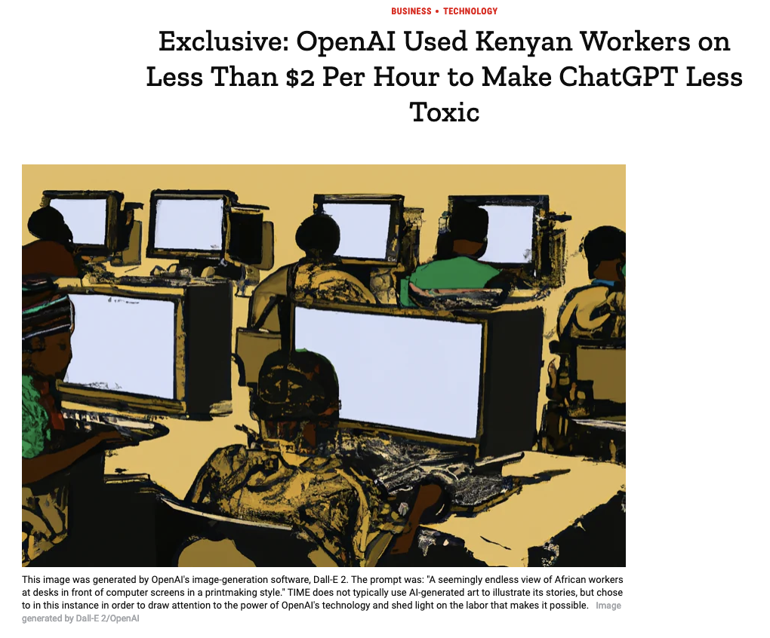
Open AI:
„Our mission is to ensure that artificial general intelligence benefits all of humanity“
Daily task for 50 000 subcontracted workers:
categorising cases of „child sexual abuse, bestiality, murder, suicide, torture, self harm, and incest.“
Source: TIME, 18 January 2022

Slide 7
The Voice of European Managers
Purposeful AI by humans
How can we unlock the potential of AI to contribute to
a positive impact on economy, society and nature?

Slide 8
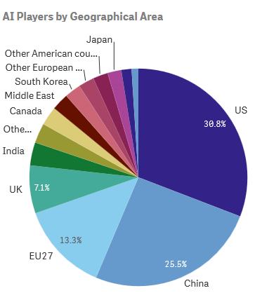
State of the Art: facts
EU economy
Decentralised, SME-dominated economic structure
EU investments: in 2019, the EU invested up to €9 billion in AI (40-45% of the annual investment target) of which 53% were spent on skills development
Majority of actors from private sector
predominance of US and Chinese actors
EU strengths in AI Services and Robotics
and in terms of AI R&D
source: AI Watch Index 2021 (EU JRC)
Managers about AI
60% of EU managers say increase of productivity is main motive for technology introduction (1)
50% of managers think there is a lack of competence working with AI (2)
49% are concerned by privacy issues (1)
43% feel overloaded with information (1) and
est. 25 – 50% burnout rates (Eurofound)
18% of managers say that their workplace uses tailored
AI-based systems or tool (2)
8% of leaders excel in complexity management (3)
7% of managers say their organization has a strategy on using AI at the workplace (2)
sources:
(1) European Managers’ Panel 2018
(2) “AI Beyond the hype” report covering survey among 5000 managers, Ledarna 2020
(3) Sustainable Leadership in Europe report 2020

Slide 9
AI Leadership in a VUCA world
EU’s AI development beyond state-controlled or monopolistic market approaches
EU AI Act: criticality, legal sandboxes, life cycle auditing
Unclear how AI can contribute to SDGs
Environment
(economic, social, natural)
Business AI ecosystem
Workplace
incl. Technological systems
Leadership
Unequal access to infrastructure,
capital, talent and innovation capacity
Concentration of value distribution
Role of networks: hubs, alliances, joint ventures etc.
Siloed and linear logic of value creation
Lack of competence development on AI development
Workplace cultures lack innovation capacity: role of
stress, lack of agency, traditional leadership etc.
Often unclear purpose and strategy for developing
and using AI in workplaces
Leaders underperform on complexity management,
systems thinking and interpersonal skills
Governance and accountability unclear

Slide 10
The Voice of European Managers
Benchmarking your leadership
How can we design Artificial Intelligence systems for a positive impact on people, planet and prosperity?

Slide 11
What’s missing from this AI answer?
How can we design Artificial Intelligence systems for a positive impact on people, planet and prosperity?
“1. Incorporating ethical considerations into the design of AI systems, such as ensuring that the systems do not perpetuate bias or discrimination.
2. Ensuring that AI systems are transparent and explainable, so that their decision-making processes can be understood and evaluated by stakeholders.
3. Ensuring that AI systems are secure and protect sensitive data, to prevent unauthorized access or misuse of personal information.
4. Developing and implementing a governance framework that ensures the alignment of AI with sustainability goals, including the involvement of stakeholders and the implementation of monitoring and reporting mechanisms.
5. Enabling accountability for AI systems, by identifying the individuals or organizations responsible for the design, deployment, and operation of the AI systems.”
^{source: Open AI, ChatGPT}

Slide 12
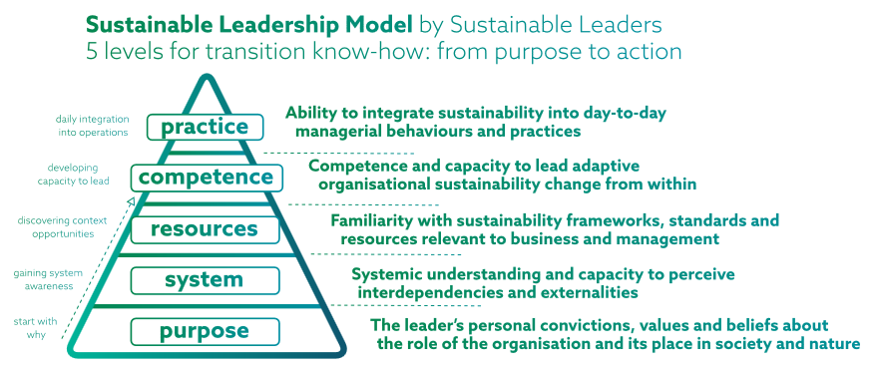
What’s missing from the AI response: leadership
1. Vision and purpose for developing AI (why and what for?)
→ will resonate with clients, citizens, workers etc.
2. Ability to navigate complexity and deliver impact
→ designing for positive impact on people, planet, prosperity
3. Activating context-dependent resources
→ creating fertile framework conditions for purposeful AI, incl.
effective and responsive governance like social dialogue
^{4. Developing capacity to lead}
→ promoting leadership development and workforce skills
5. Integrating AI into workflows
→ customizing AI according to purpose and context

Slide 13
Today’s AI landscape
Exploitative: Data practices are exploitative, and they fail to produce the potential social value of data, protect individual rights and serve communities.
Shortsighted: Political and administrative institutions have struggled to govern data in a way that enables effective enforcement and acknowledges its central role in the data-driven systems.
Disempowering: Individuals lack agency over how their data is generated and used, and there are stark power imbalances between people, corporations and states
Rethinking AI development
Transforming infrastructure into open and interoperable ecosystems.
Reclaiming control of data from dominant companies.
Rebalancing the centres of power with new (non-commercial) institutions.
Ensuring public participation as an essential component of technology policymaking.
Source: Ada Lovelace Institute

Slide 14
The Voice of European Managers
presentation
Rethinking governance and design of Artificial Intelligence systems in workplaces
with Nicolas Blanc

Slide 15
What is AI?
Artificial Intelligence and the World of Work

Slide 16
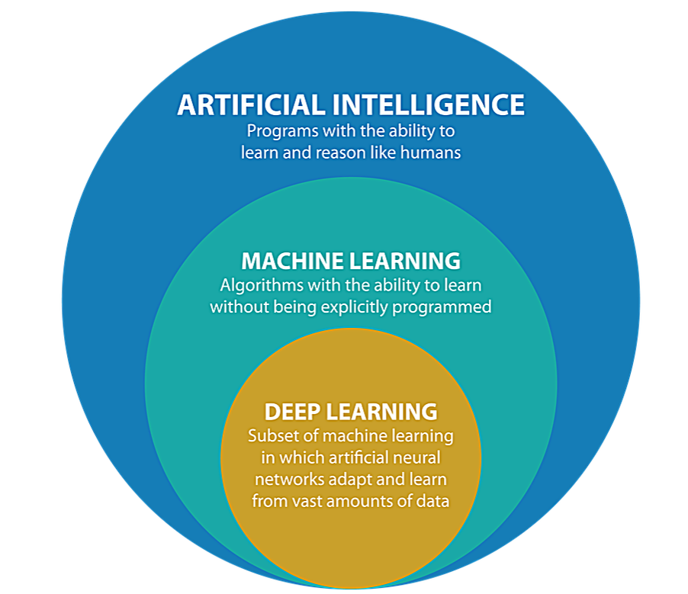
AI, better than a Definition, a Chart

Slide 17

Machine learning : learning with Data

Slide 18

Deep Learning: learning with more data

Slide 19
ML : a quick reminder
 | Machine Learning | Deep Learning
Training DataSet | Small | Large
Your own features | Yes | No
Number of classifiers | Yes | No
Training time | Short | Long
Sustainability | Yes | No

Slide 20
ML : reminder for questions
Questions to ask :
About Transparency (What?)
  What kind of data do you use ? (quality)
  What among of data do you use ? (quantity)
  What kind of strategy of ML do you use ?
About Explainability (How?)
  Could you explain your results for a worker? ( art. 21: “Right to object”- GDPR)
  Have you check your data for biases? (bullet 44: High data quality- AI Act to come)
  Could you delete some datas from workers in your training model? (Art. 17 “Right to be forgotten”- GDPR)

Slide 21
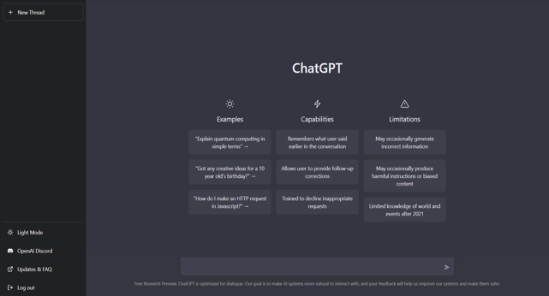
Example ChatGPT
It means ChatBot + Generative Pre-trained Transformer
Generative Pre-trained Transformer (last version is GPT-3) is is a natural language processing to produce human-like text created by OpenAI (created by Elon Musk)
A transformer is a deep learning model
A Generative Pre-Trained because it can generate human-like texts based on a given text-based input.

Slide 22
Example ChatGPT
Sustainable ? NO
  The model has 175 billion parameters compared with GPT-2’s already vast 1.5 billion. And with language models, size really does matter.
  GPT-3, OpenAI's sophisticated natural language model, used 1.3 Gw and produced metric 552 metric tons of carbon dioxide emissions. This is roughly equivalent to driving a car 1.3 million miles - in one hour!
Ethical ? NO
  “Workers:”OpenAI Used Kenyan Workers on Less Than $2 Per Hour to Make ChatGPT Less Toxic” (Time 2023/01/18)
  Copyright: Who owns the generated text? the user who asks the question? the engineers who designed the model? The same for generated images and models trained from real images of human authors
Job killers? NO

Slide 23
AI: exemples in workplace? only ML technologies
01
Hire People
ATS : Applicant Tracking System
Interviews : ICMS Talent Management
02
Manage People
Workforce Planning: SkyHive
Training: Axonify
03
Control People
Office 365 : productivity score
AI to detect attrition

Slide 24
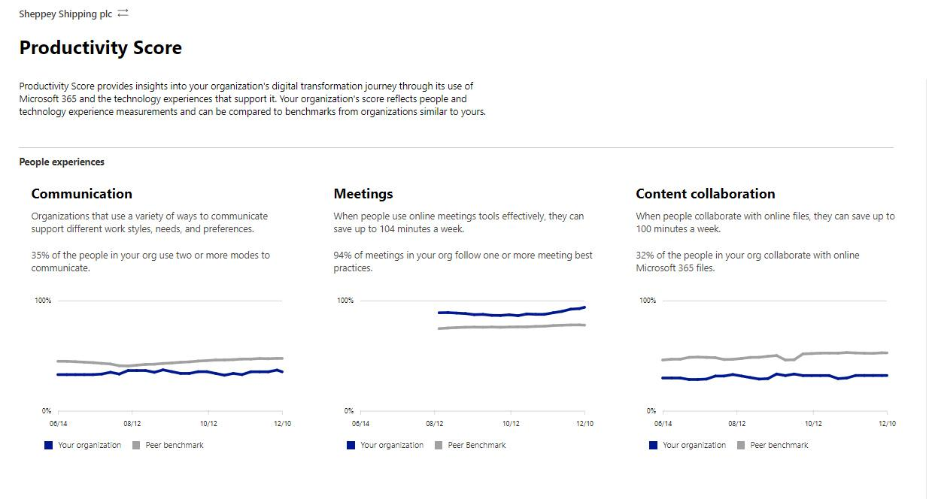
AI for Algorithm Management ?

Slide 25
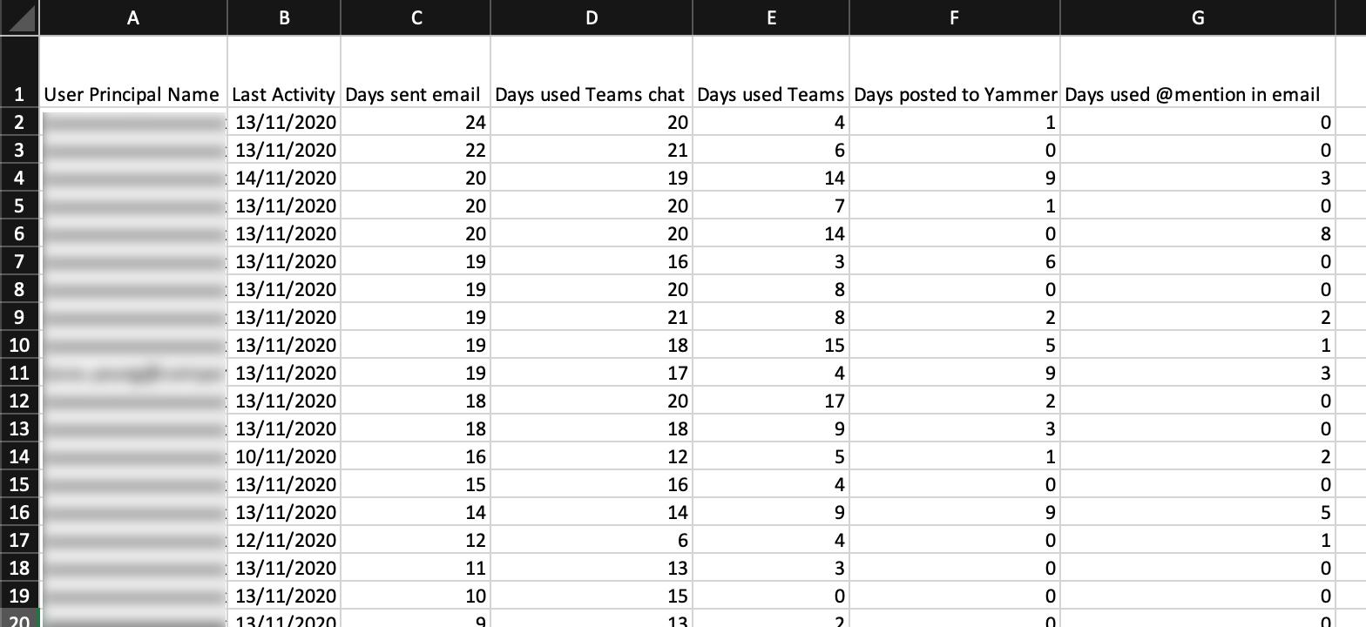
AI for Algorithm Management ? Yes, it can

Slide 26
AI : We need regulation, where are we?
01
World: UNESCO, Montreal
Ethical Issues
Soft Law
02
Europe : AI Act
Business Approach(time to market)
Approach by the level of Risk
Hard law but auto-assessment
03
Company: Charters
Ethical issues
Only for customers
Soft law
Notes:
World: Unesco, Montreal
Europe : AI Act
Local : charter in ciompany
= TOP DOWN regulation

Slide 27
AI: not enough, we need a bottom up regulation for the Workers
01
European Framework Agreement on Digitalisation
European Approach
Trustworthy AI
02
SECOIADEAL
European Approach
Recommandations on AI and Social Dialogue
Added Value & Skills
03
ETUI
Studies on AI at the workplace
ETUI Game on AI

Slide 28
AI and YOU? UP TO YOU
- Where are you in terms of AI development?
- How were you implied in AI value creation and governance?
- How would you describe the value AI offers to your organization?
- How do you use AI in workplace (HR, performance management, team management) in world of work?
- How does it contribute to achieving your business objectives?
- Where do you see the competence needs?

Slide 29
AI: To go further
https://medium.com/@harish_6956/the-difference-between-artificial-intelligence-machine-learning-and-deep-learning-b68cdf684633
https://www.weforum.org/agenda/2020/10/ai-jobs/
https://www.montrealdeclaration-responsibleai.com/
https://unesdoc.unesco.org/ark:/48223/pf0000381137_fre
https://www.etuc.org/fr/node/19184
https://secoiadeal.eu/
https://www.company-net.com/productivity-score-in-microsoft-365-what-you-need-to-know/

Slide 30
The Voice of European Managers
Thank you.
cec-managers.org

