Slide 1



An initiative by

Slide 2
Creating sustainable and attractive workplaces
Sustainable Leaders’
Summit 2022
#SLS22
sustainableleaders.eu

Slide 3
Creating sustainable and attractive workplaces
Welcome
Maxime Legrand
President of CEC European Managers
#SLS22
sustainableleaders.eu

Slide 4

Creating sustainable and attractive workplaces
Sustainable Leadership and the
Future-Fit Organisation
Jacob Mayne
Managing Partner
NEW ANGLES
#SLS22
sustainableleaders.eu

Slide 5
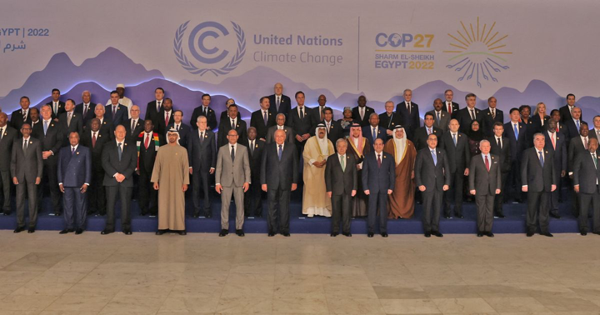

An urgent global need for Sustainable Leadership
#SLS22

Slide 6
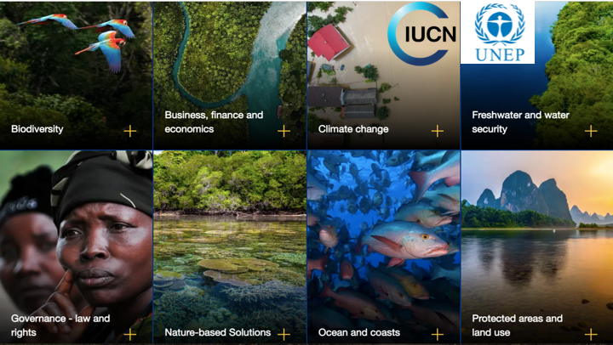


Slide 7



The “leadership gap” between ambition and reality
Ambition
Reality
Urgent need for:
knowledge
skills
support
incentives
Only 18% of EU company managers have had training in sustainability
Ambition for more sustainable actions is growing
But systemic sustainability challenges are insufficiently addressed in daily work of managers
Majority of managers in the EU today are untrained in sustainability and ill-equipped
to transform organizations and workplaces
Embarking managers on the Transition can unleash great potential to reinvent business models
(CEC EM Research report: Sustainable Leadership In Europe, 2020)
#SLS22

Slide 8
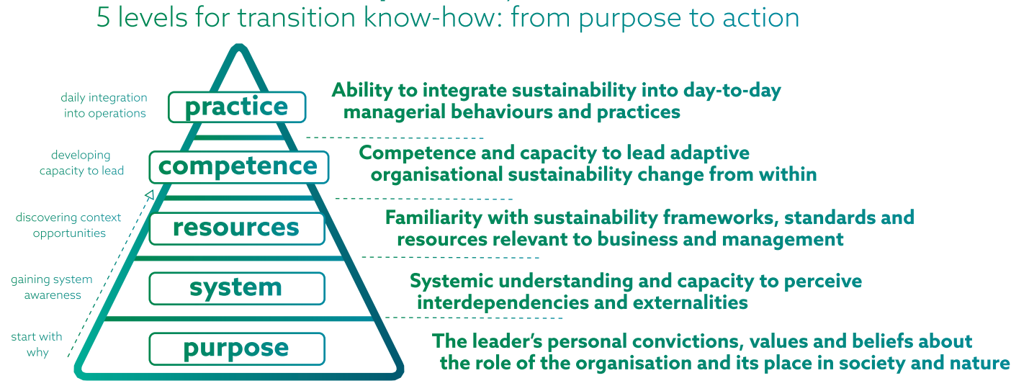
Sustainable Leadership Development Model
#SLS22

Slide 9
Sustainable Leaders Development Programme
3 half-day webinars to lay the Foundation
Webinar 1
Webinar 2
Webinar 3
Sustainable Leaders Development Model
Sustainability Knowledge
for Business
Keys for Embarking People on Transition
- My leadership story
- Why conventional leadership is not enough
- EU managers study
- Model’s 5 dimensions
- Real-life examples
- Redefining business success
- Global overshoot
- Planetary boundaries & doughnut economics
- Systems & ecosystems
- SDG’s as the global positive impact roadmap
- Materiality in your company’s value chain
- Emergent change
- Adoption of innovation
- Leading transitions
- Crossing the desert
- Milk & honey for allies
- Realities of pioneering
- Pitching to first followers
- Starting from convictions
#SLS22

Slide 10
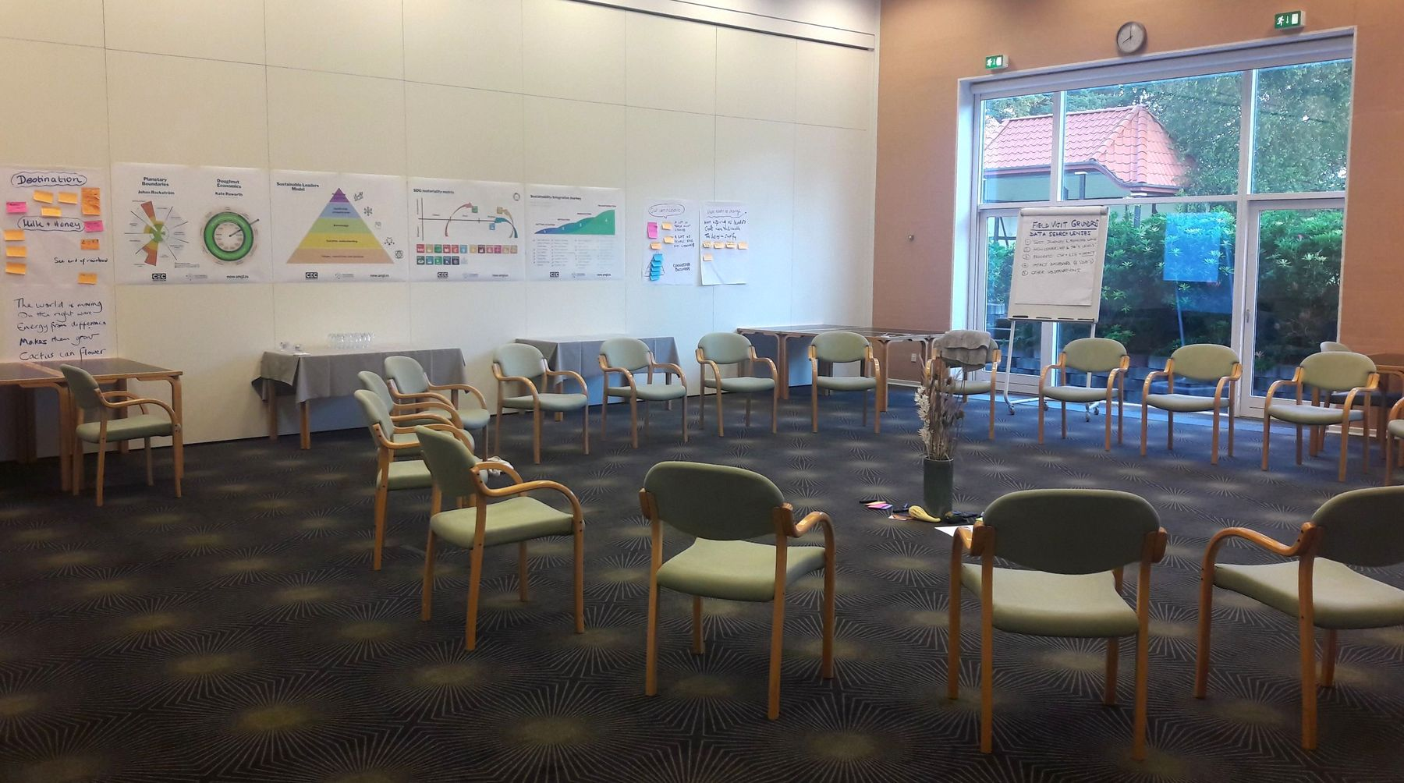
#SLS22

Slide 11
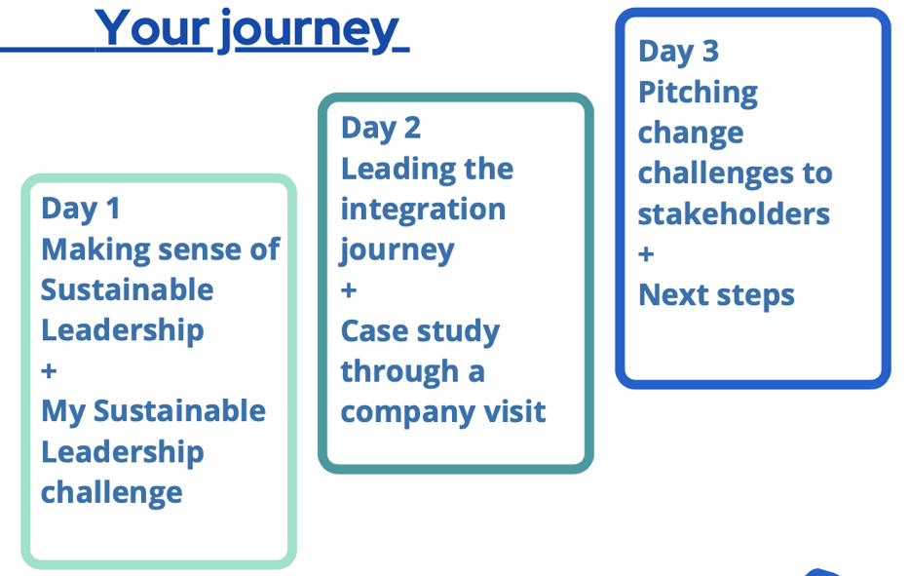
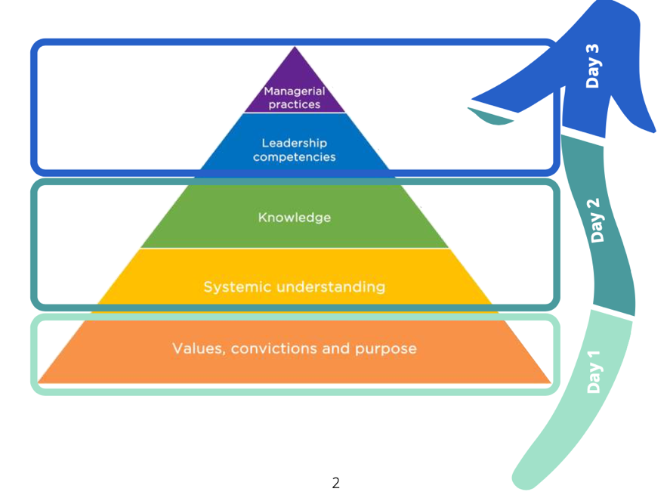
Sustainable Leaders Development Programme
3-day Residential Co-construction Workshop
#SLS22

Slide 12
Participants’ feedback
"I WISH EVERY MANAGER IN EUROPE COULD PARTICIPATE IN THIS PROGRAMME !"
Nayla Glaise,
President Eurocadres
“Beyond my expectations!
High-quality facilitation and exceptional positive energy.”
“This training should be mandatory in all workplaces.”
“This inspired me to trigger in concrete terms the change in my organisation.”
“Motivating, a revival of confidence and very inspiring”
Workshop participants in
Denmark, Slovenia, Germany, Switzerland
#SLS22

Slide 13
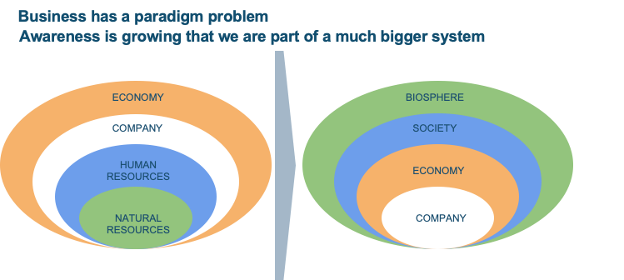
#SLS22

Slide 14
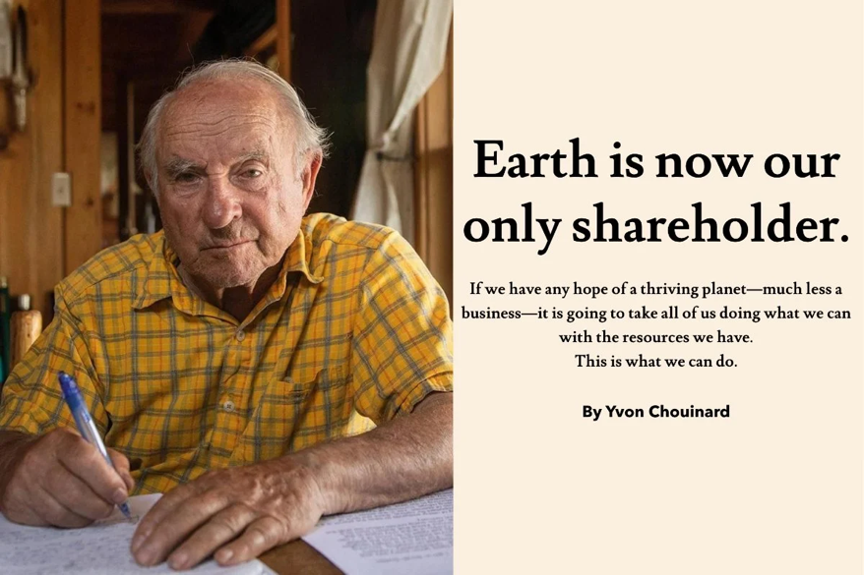
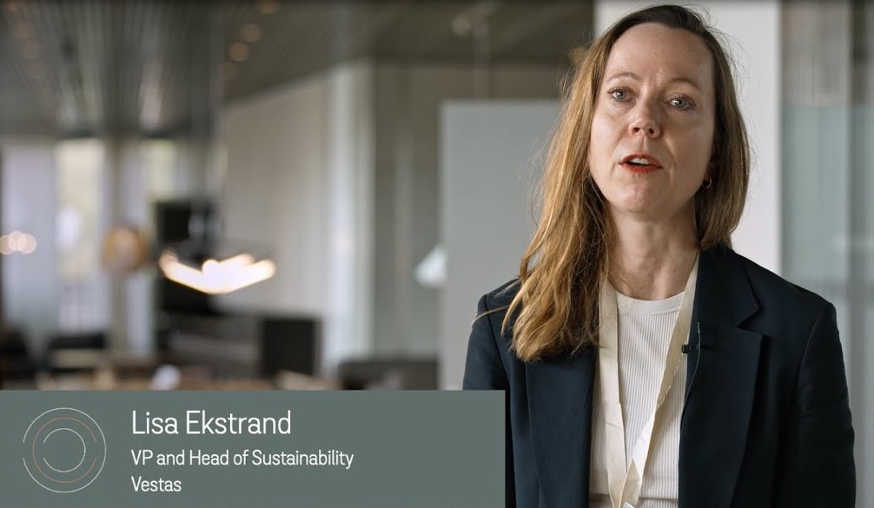
Sustainable leaders modelling the new paradigm
YVON CHOUINARD - PATAGONIA
LISA EKSTRAND - VESTAS
#SLS22

Slide 15
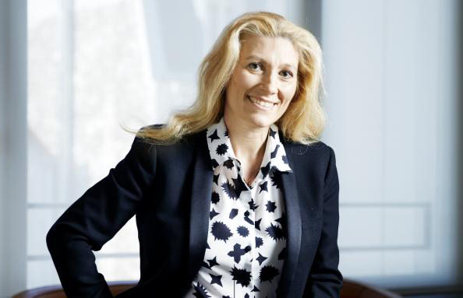
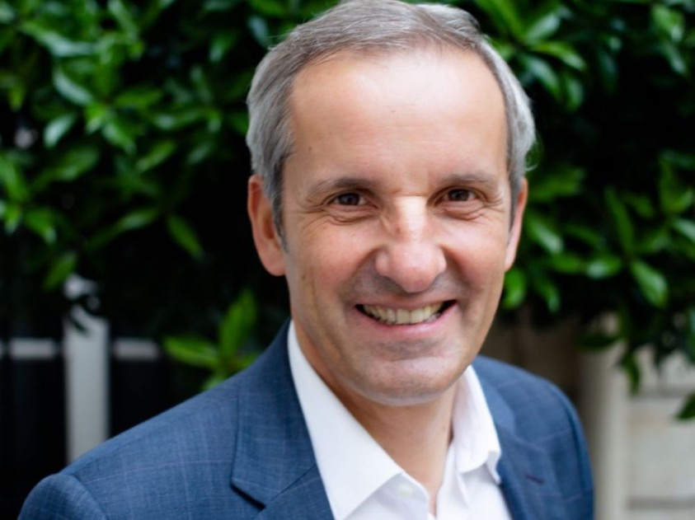
Sustainable leaders modelling the new paradigm
MARIE-CLAIRE DAVEU - KERING
PASCAL DUMERGER - MAIF
#SLS22

Slide 16

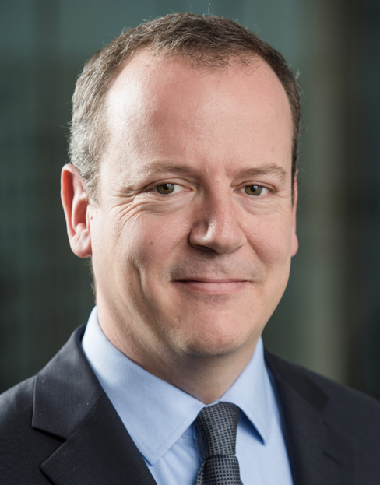
Paul Milcent
BNP Paribas
#SLS22

Slide 17
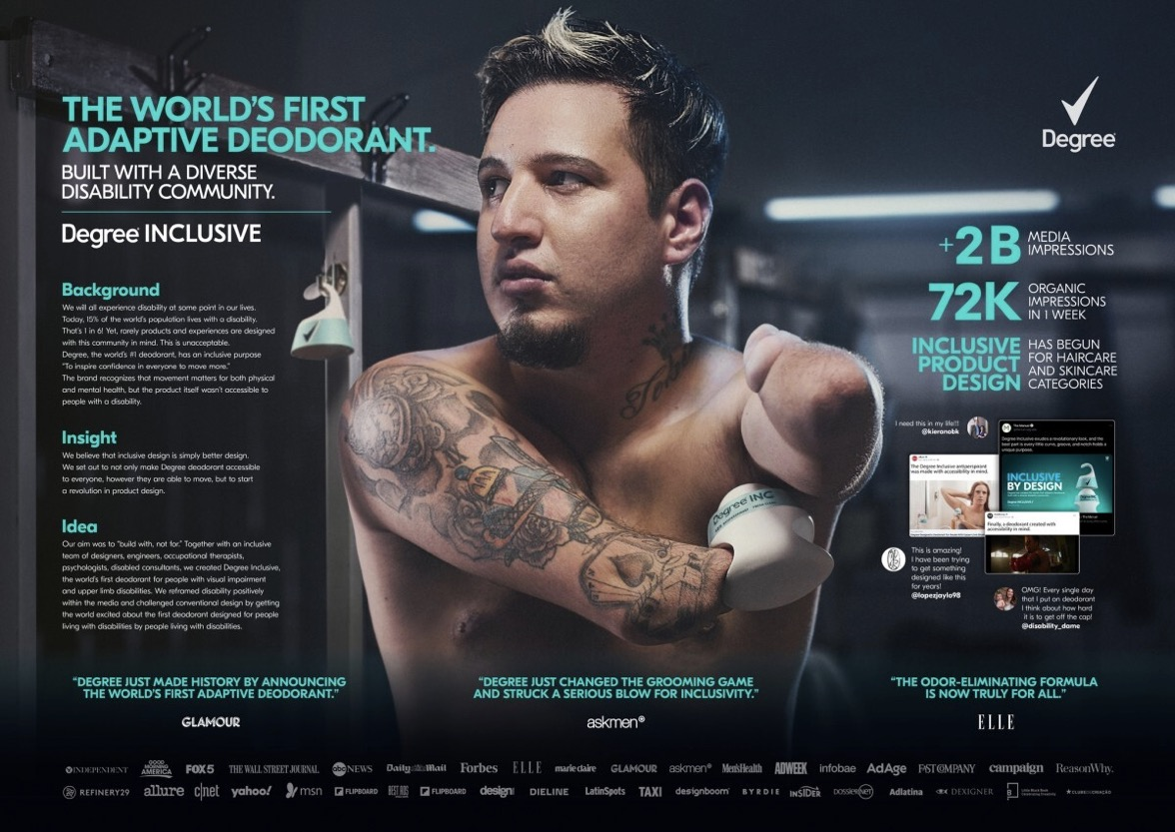
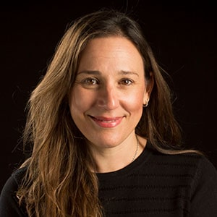
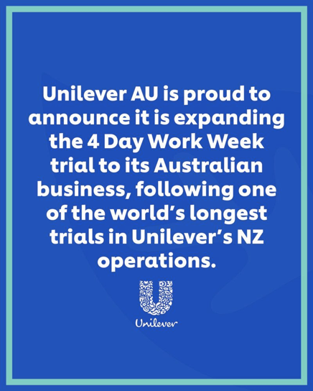
Nicky Sparshott
CEO Unilever ANZ
#SLS22

Slide 18
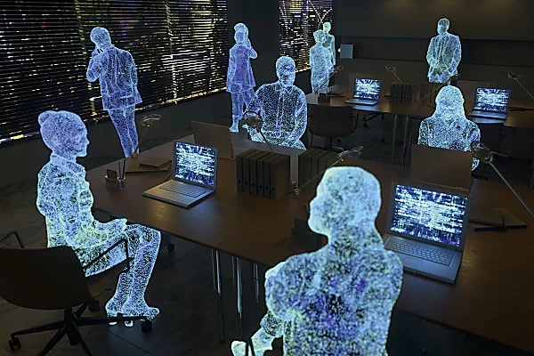
#SLS22
SFR - Metaverse
Notes:
SFR - Metaverse

Slide 19
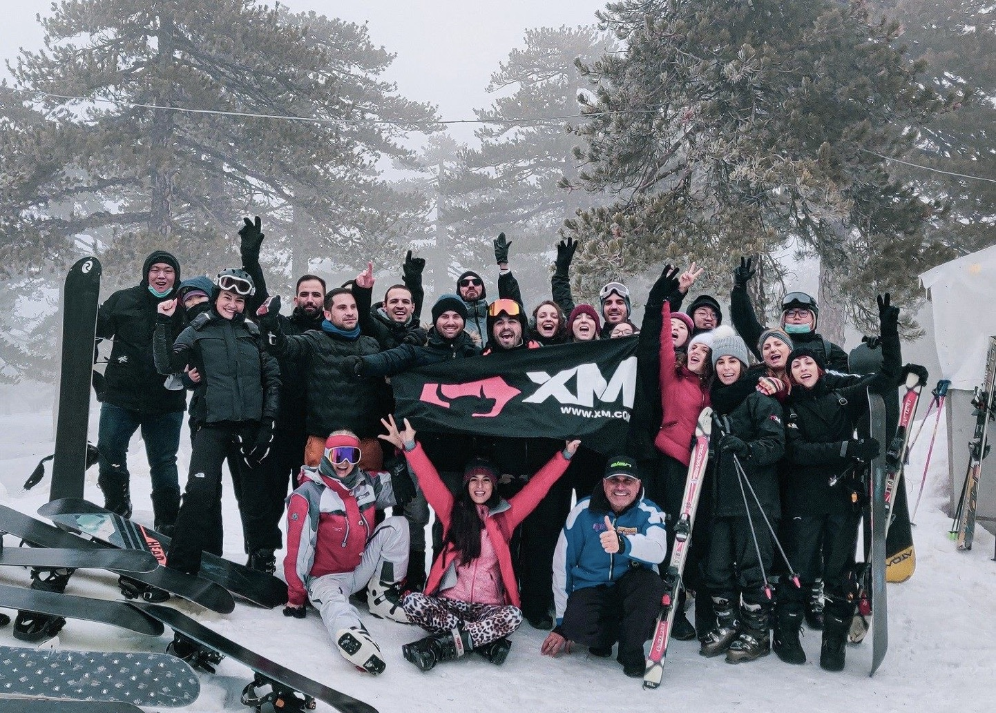
#SLS22
XM Cyprus
Notes:
XM Cyprus

Slide 20

#SLS22

Slide 21
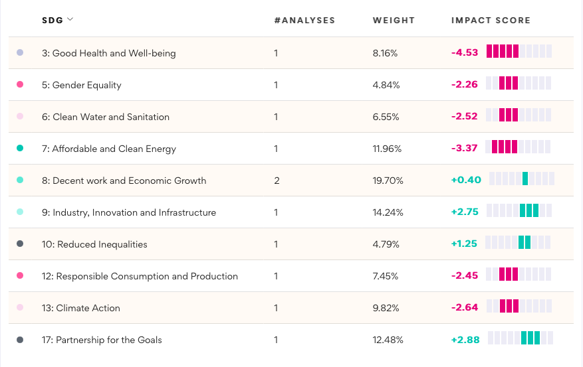
Deutsche Post / DHL SDG impact scores
Happy employees and impact performance may not be the same thing!
Data: Impaakt website 29 November 2022
#SLS22

Slide 22







Sustainable Leadership and the Future-Fit Organisation
Govern-ment (general interest)
Social Business(for-profit)
Social dialogue
Private
Sector
(for-profit)
Civil society
(non-profit)
#SLS22

Slide 23






SL potential looking forward
A Sustainable Leaders
Community
could contribute to
multiple dimensions of the Transition
The Sustainable Leaders Summit could become the annual rendez-vous for a thriving Community of Practice for managers leading the Transition
#systemic understanding #shared upskilling
#leadership co-development #impact culture
#business model innovation
Redefiningbusiness success
Workplace re-design
Common impact standards
#SLS22
Notes:
Climate-KIC (Climate innovative initiative)
ACR+ (Association of Cities and Regions for a circular economy)
EIP (European Innovation Partnership on raw materials)
CSR Europe (European Business Network for CSR)
CEC European Managers
Sustainable Leaders

Slide 24

Now let’s hear from you!
-What are the features you look for in a “future-fit organisation”?
-Is there a “sustainable leader” you admire, or who inspires you?
-Other reactions or comments that come to mind?
#SLS22

Slide 25
Creating sustainable and attractive workplaces
Panel
How can we develop more attractive and sustainable workplaces in Europe?
- François Hommeril, CFE-CGC
- Silvia Pugi, ManagerItalia
- Wim Gabriels, Erasmus Student Network
moderation: Torkild Justesen
#SLS22
sustainableleaders.eu

Slide 26
Creating sustainable and attractive workplaces
Group discussions:
back to purpose
Jean-Philippe Steeger
CEC European Managers
#SLS22
sustainableleaders.eu

Slide 27

Why are you here today?
#SLS22
sustainableleaders.eu

Slide 28
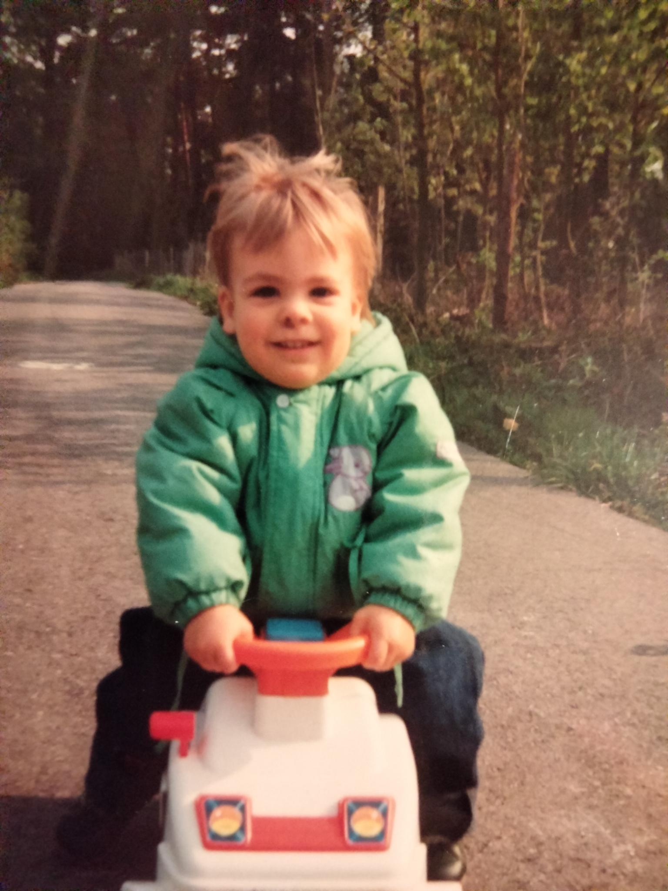

Slide 29
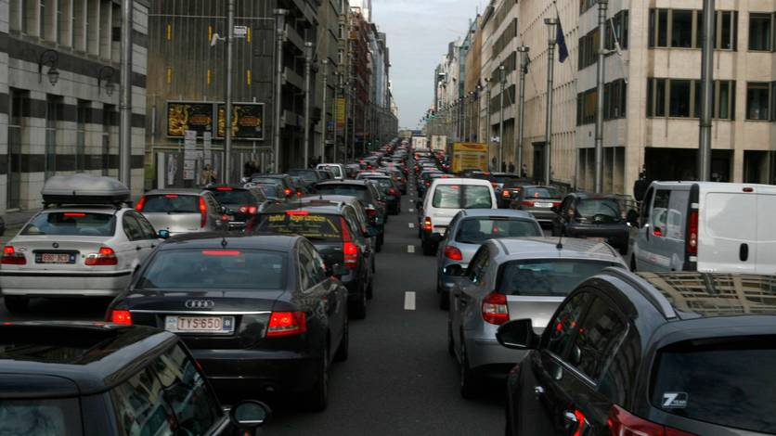
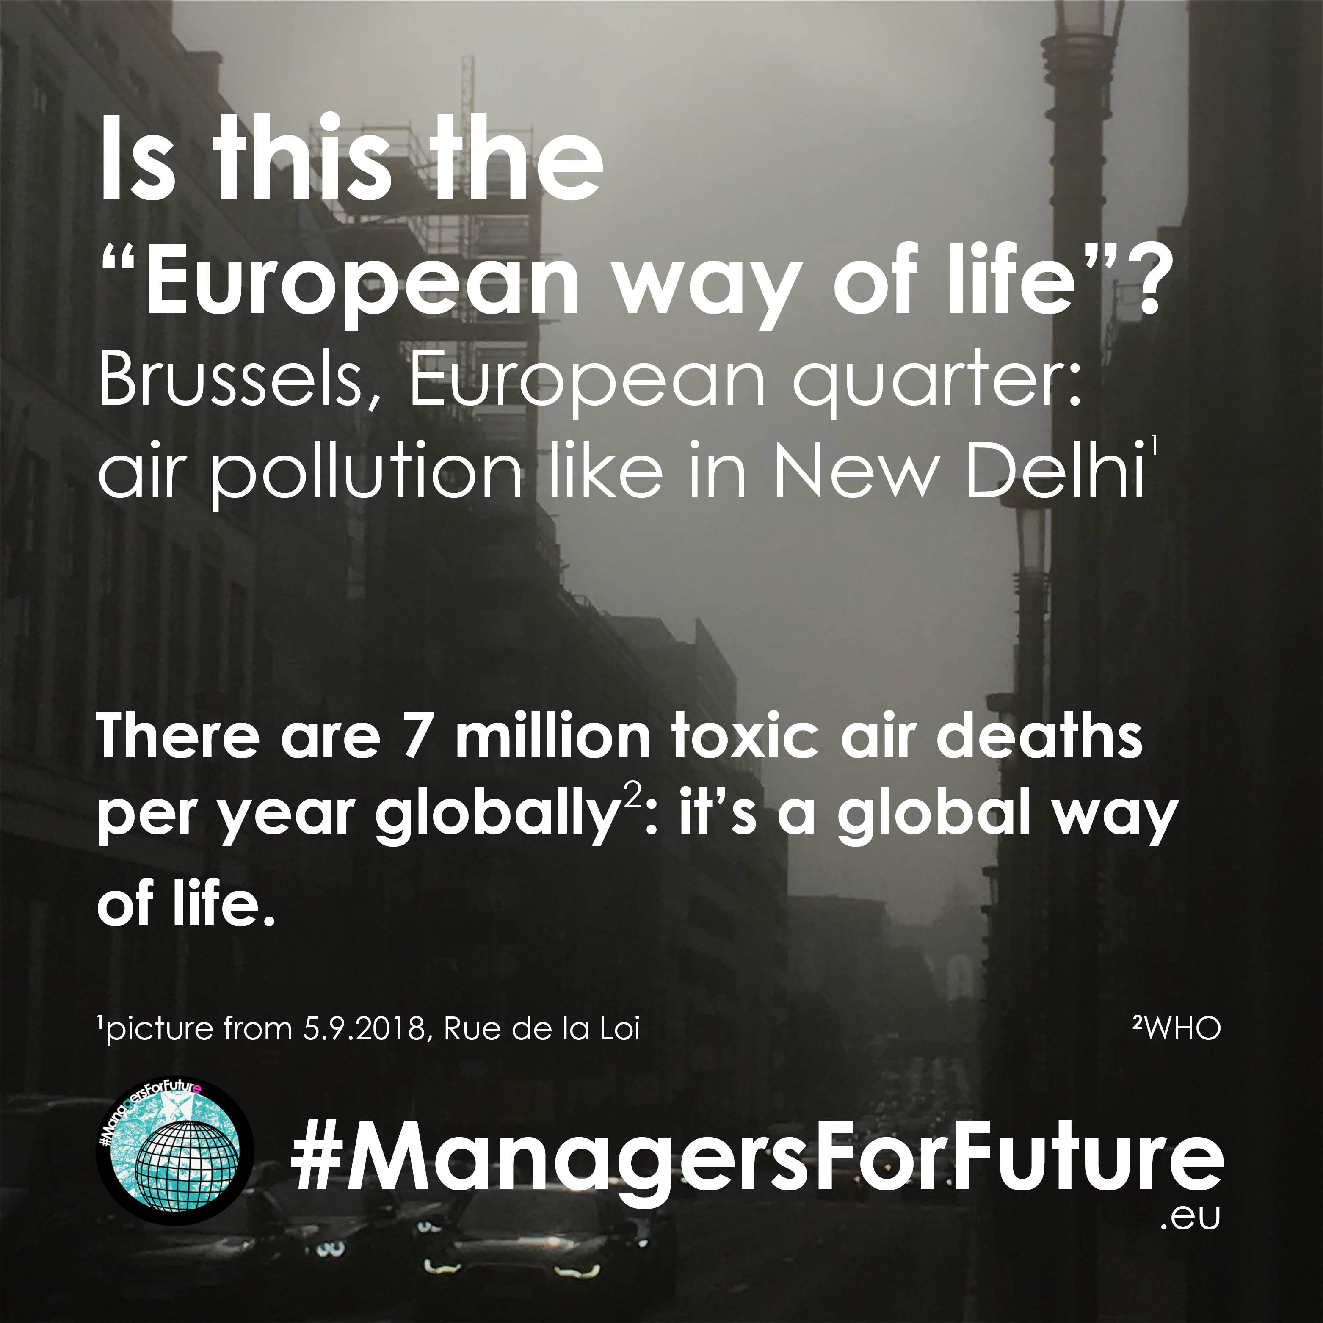
Where are you today?

Slide 30

Where are you today?
#SLS22
sustainableleaders.eu

Slide 31
A broken world of work
13% employees finding their work meaningful (USA)
60% leaders feeling used up (EU)
50% managers in France experienced burnout (France)
#SLS22
sustainableleaders.eu

Slide 32
Opening the door to purpose
94% millenials that want their skills to benefit a cause (USA)
35% managers sharing sustainable values (EU)
82% employees saying work impacts happiness (France)
#SLS22
sustainableleaders.eu

Slide 33
Break-out sessions
5 + 15mins: How aligned do you feel to your deep-felt purpose at work and where do you see potential
to connect more to it?
5 + 15mins: How and with whom can you partner up to create more fertile conditions for healthy, inclusive and thriving workplaces?
#SLS22
sustainableleaders.eu

Slide 34
Creating sustainable and attractive workplaces
Panel
Sustainability and the new world of work
– Christiane Misslbeck, Danish Employers
– Maxime Legrand, CEC European Managers
– Esther Lynch, ETUC
moderation: Matteo Matarazzo
#SLS22
sustainableleaders.eu

Slide 35
Creating sustainable and attractive workplaces
Keynote
Leadership for thriving workplaces
Michelle Holliday
#SLS22
sustainableleaders.eu

Slide 36



LEADERSHIP FOR THRIVING WORKPLACES
2 December 2022

Slide 37



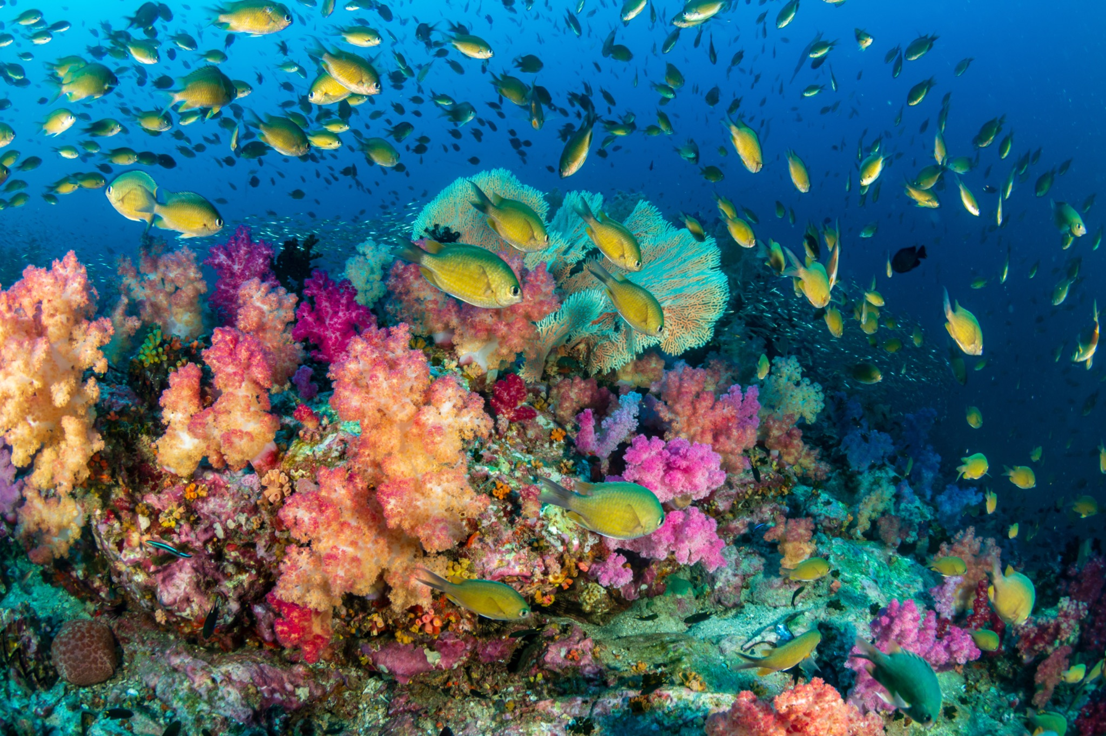
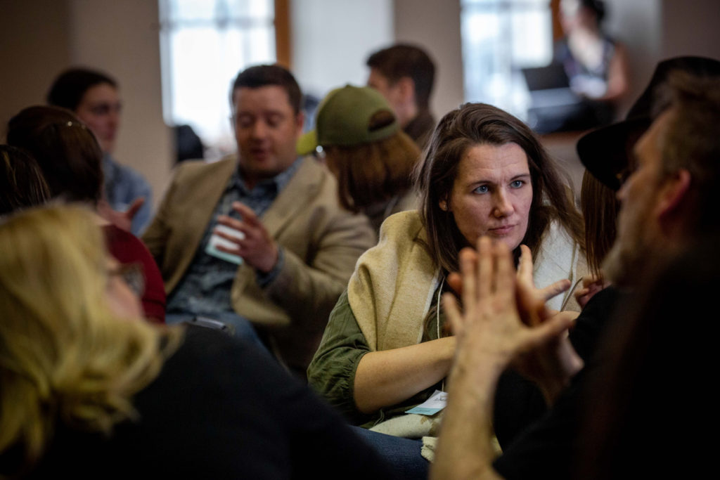
my path
brand strategy
organizational development
living systems/thrivability
the art of hosting

Slide 38

my path
brand strategy
organizational development
living systems/thrivability
the art of hosting

Slide 39

in the machine story, the organization’s only purpose
is productivity and profitability

Slide 40

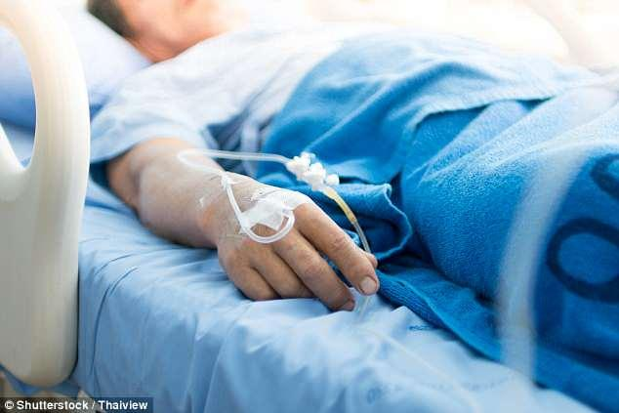
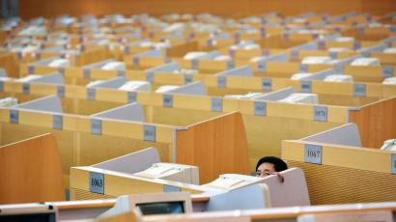
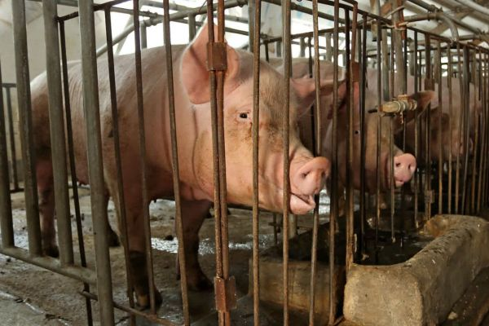
this story has shaped every aspect of our lives
how we structure learning
how we approach health
how we grow food
how we structure work

Slide 41
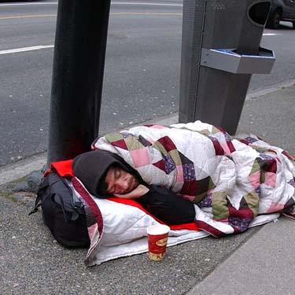
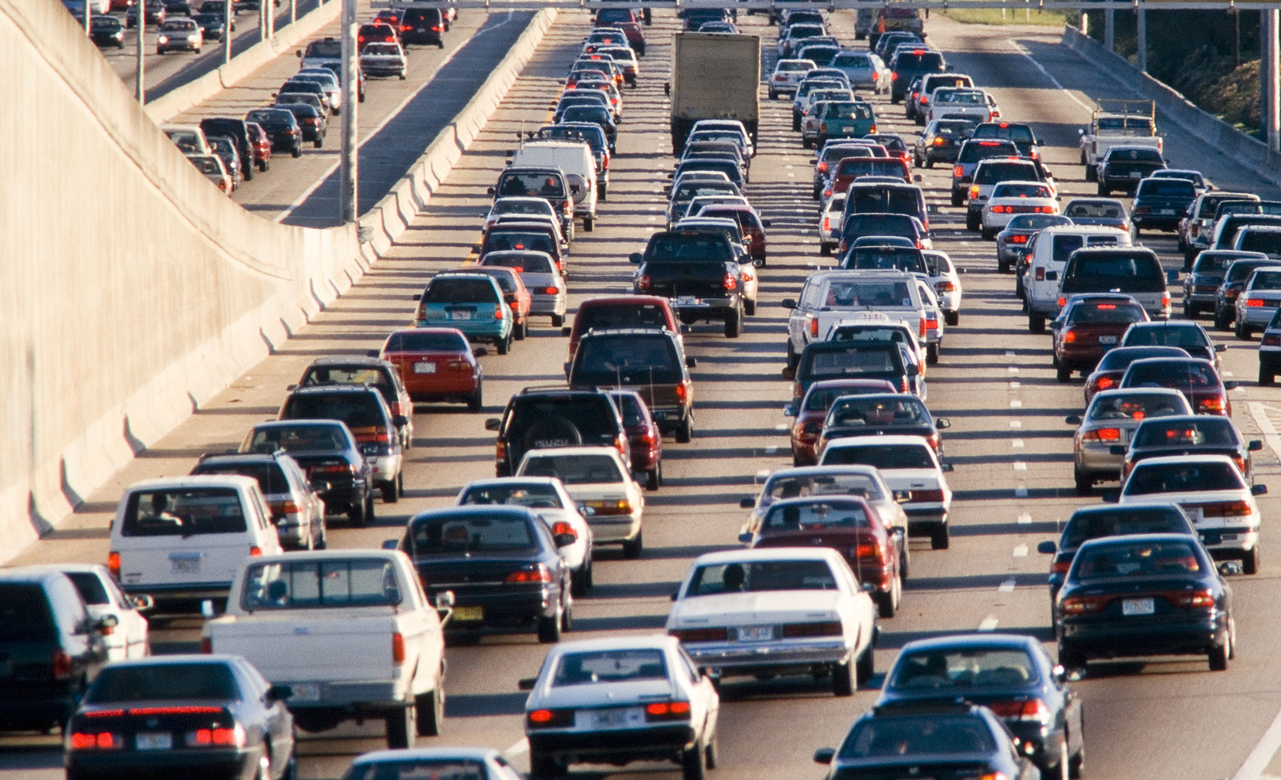
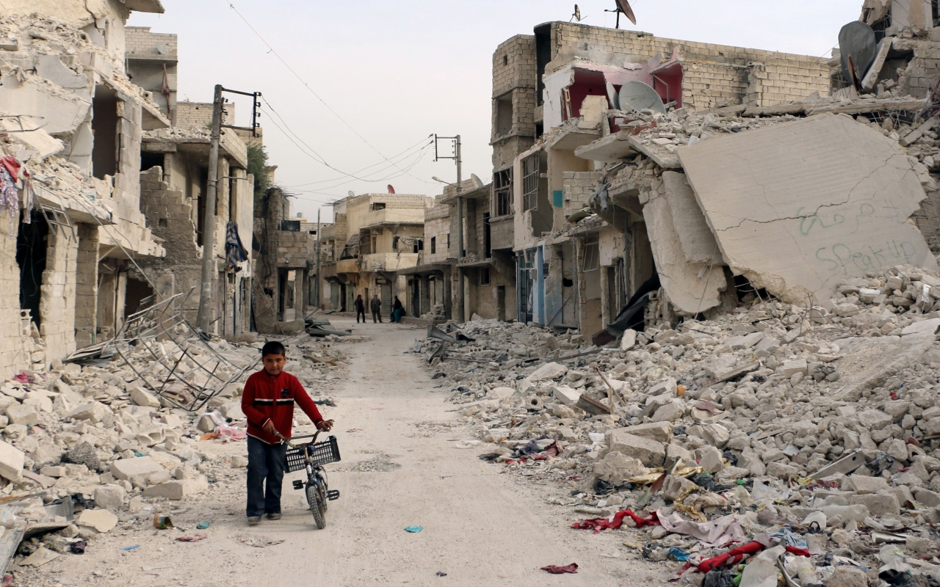
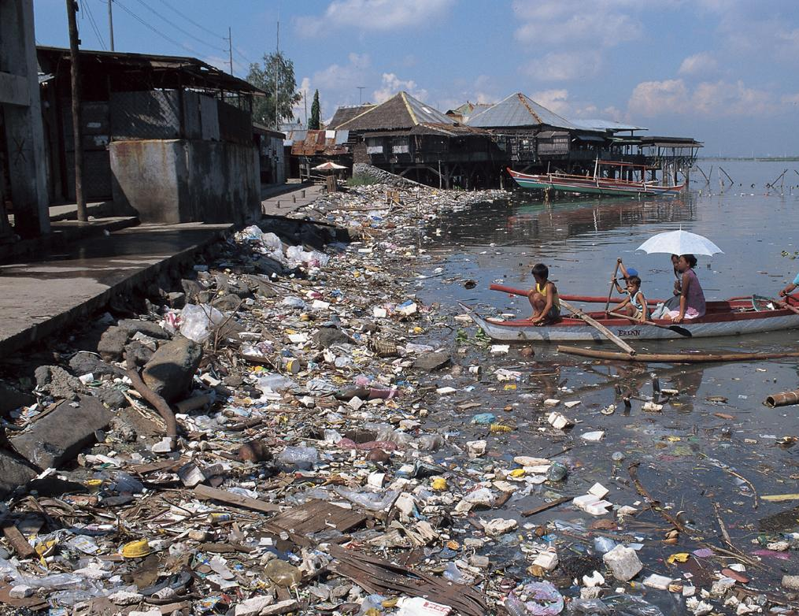
the machine story has led
to all kinds of problems
Notes:
41

Slide 42

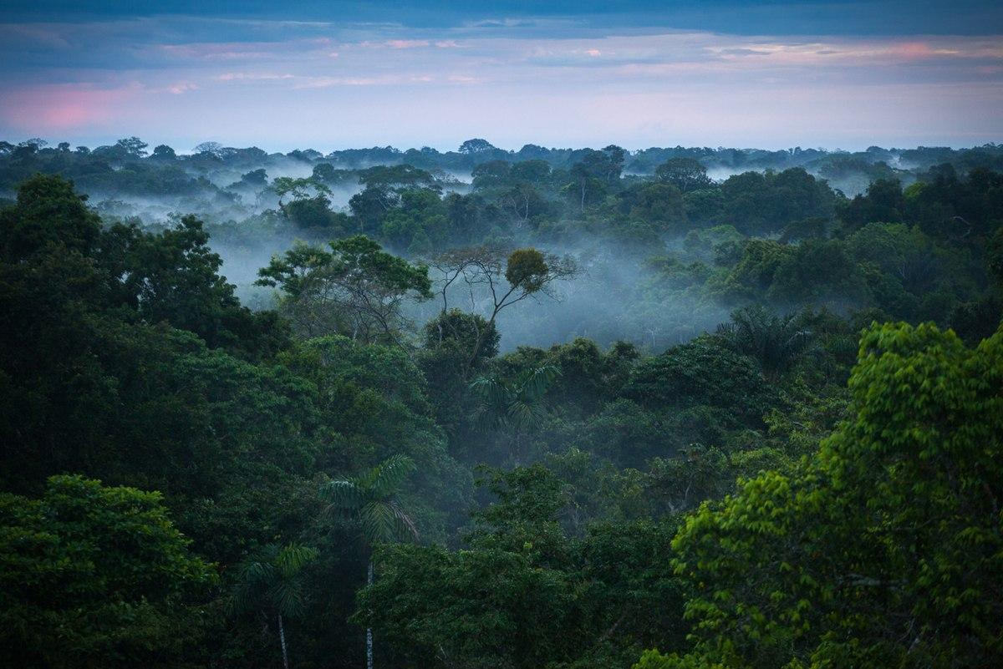
shifting how we see the world
as a machine
as a living ecology

Slide 43

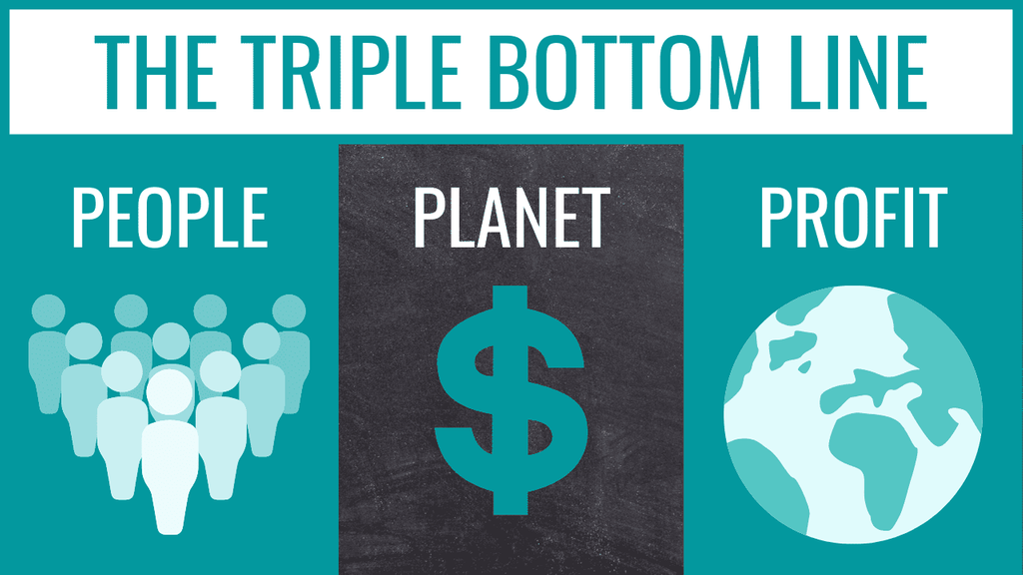
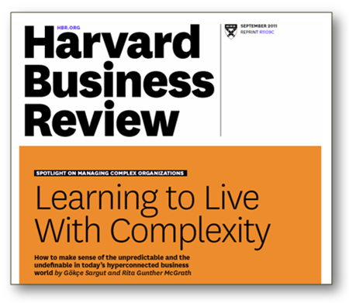
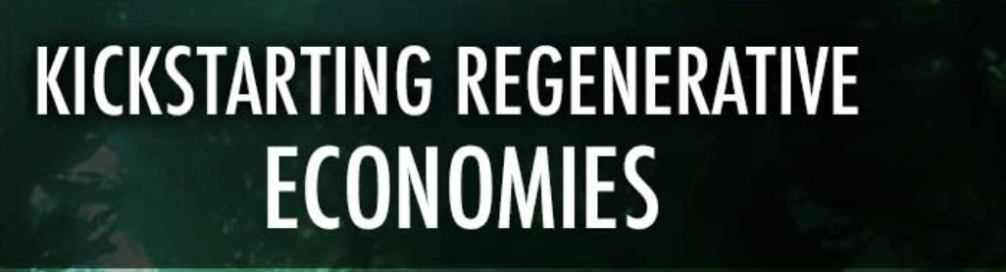






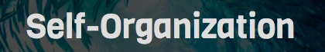
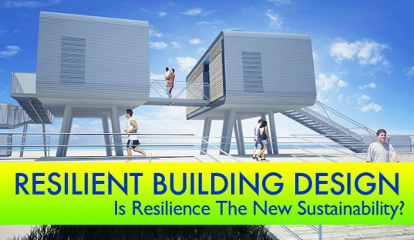
an explosion of new vocabulary and approaches

Slide 44
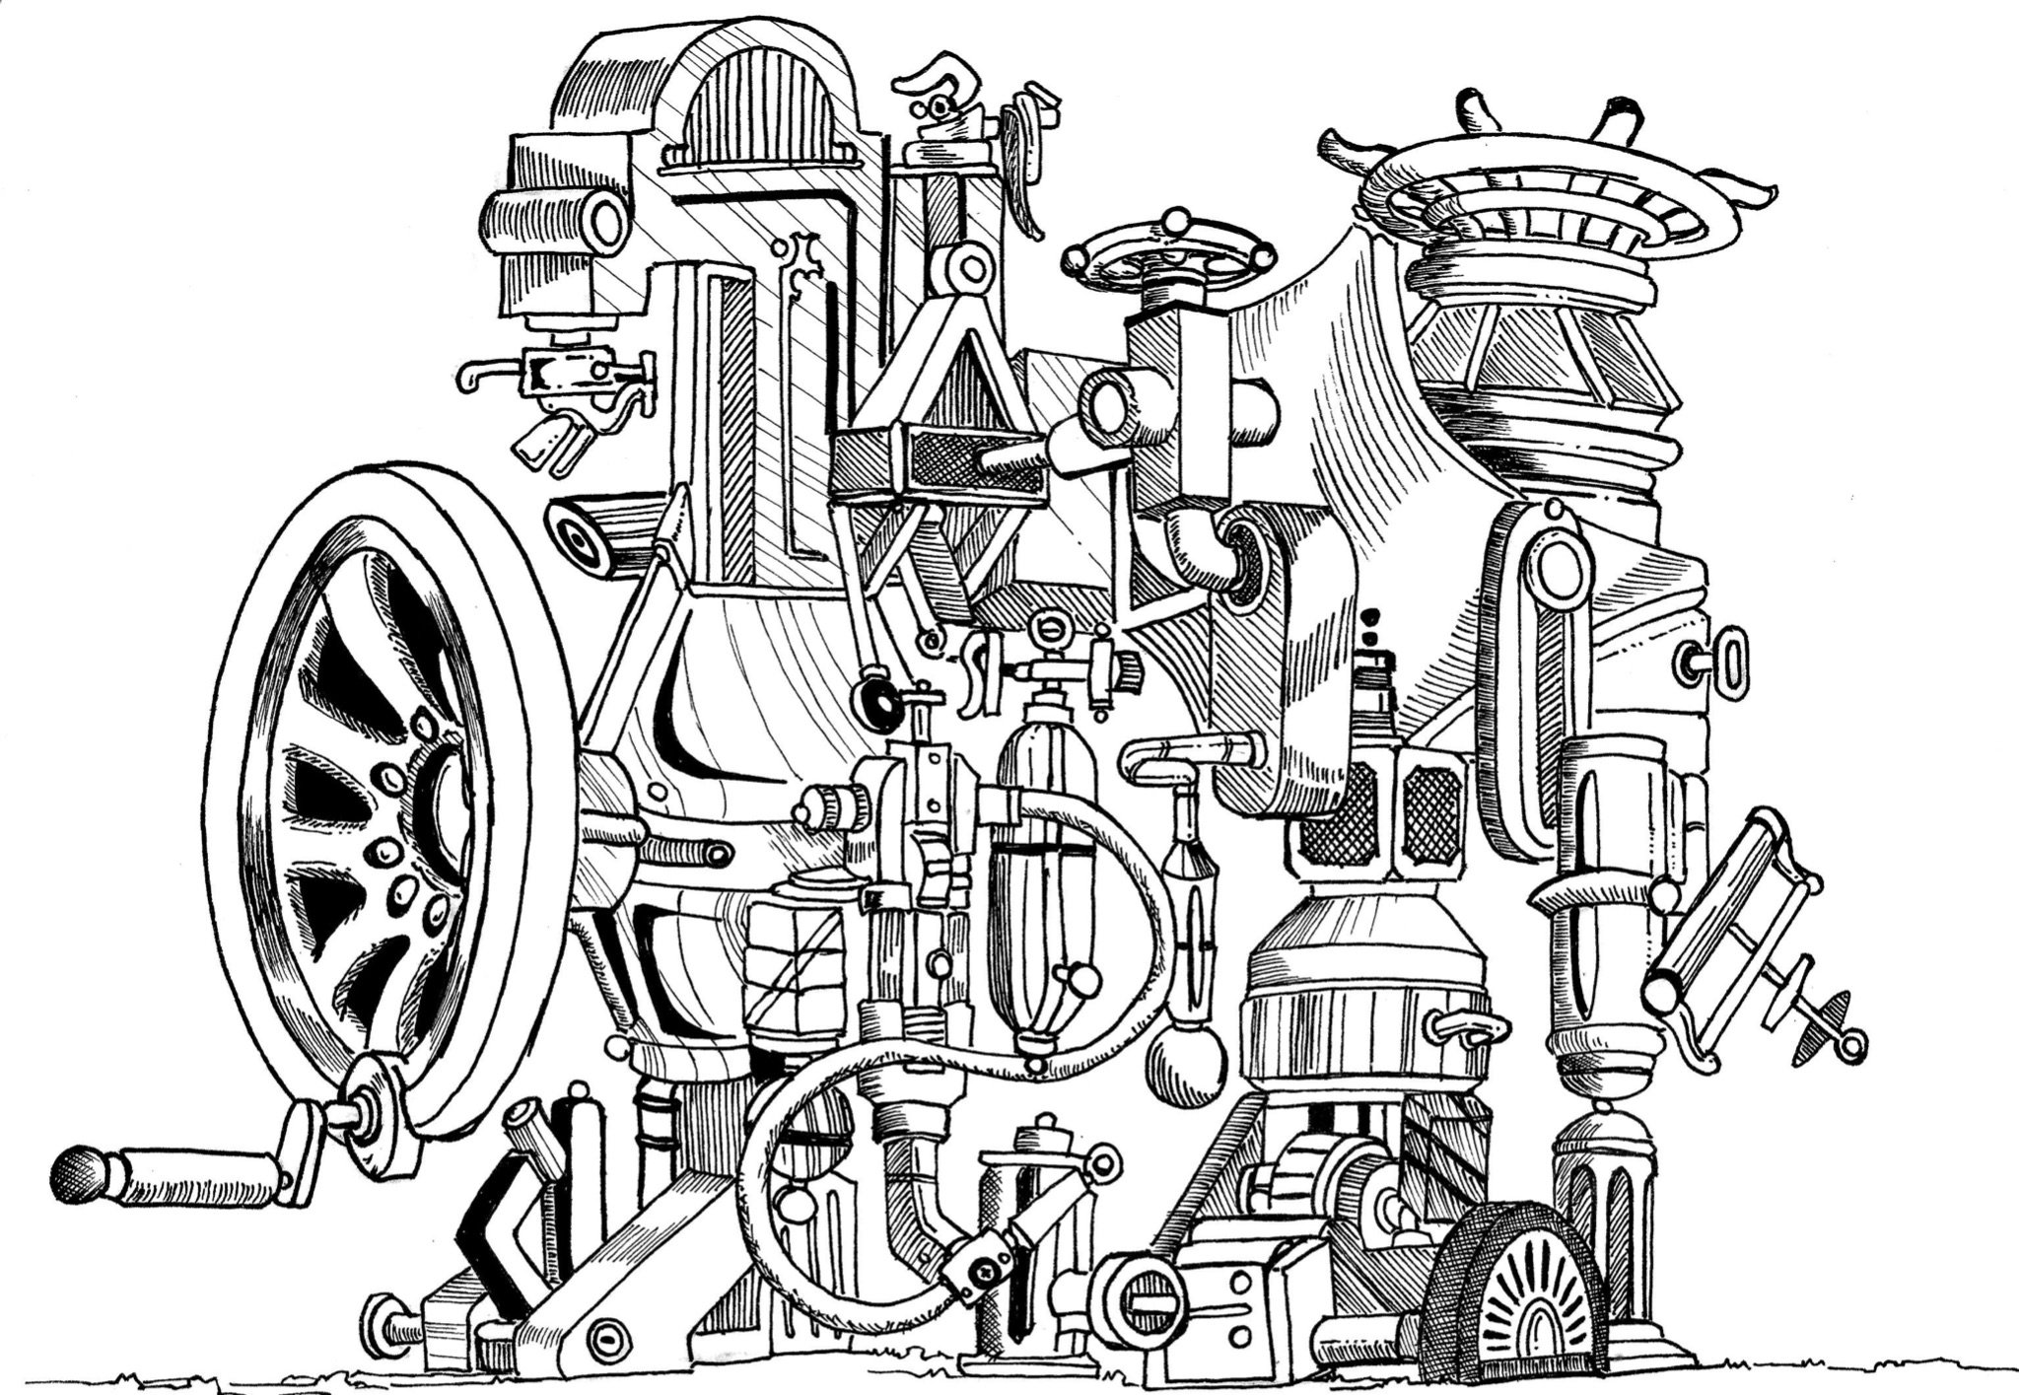

Slide 45
thrivability
the informed intention & practice of enabling life to thrive

Slide 46



universal design principles
parts
relationship
whole
life!

Slide 47


from drivers of a simple machine...
to stewards or gardeners of something complex, emergent and alive

Slide 48
universal design principles in human contexts
parts → passion
relationship → practice
whole → purpose
life → stewardship

Slide 49
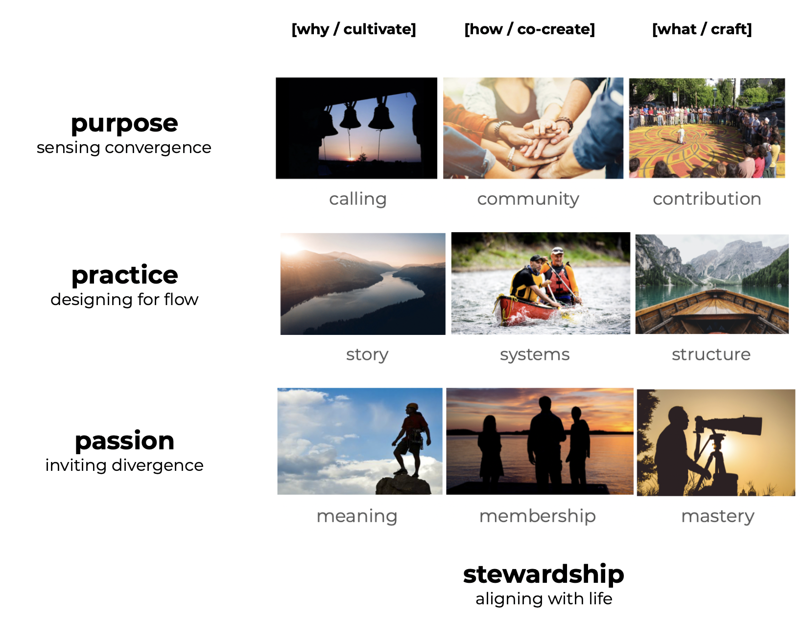
the practice of thrivability
vital conversations for co-discovering & co-designing the fertile conditions for system thrivability
purpose
whole
practice
relationship
passion
parts
stewardship
aligning with life
© Michelle Holliday
michelleholliday.com

Slide 50
the practice of thrivability
vital conversations for co-discovering & co-designing the fertile conditions for system thrivability
purpose
whole
practice
relationship
meaning
membership
mastery
How can our own life stories be enriched by this project?
What gives each of us a sense of belonging?
How can we grow more of that through this project?
What talents do we each contribute?
What would we love to learn?
passion
parts
stewardship
aligning with life
© Michelle Holliday
michelleholliday.com

Slide 51
the practice of thrivability
vital conversations for co-discovering & co-designing the fertile conditions for system thrivability
heroic cause
community
contribution
What is the calling or wisdom
we can serve through this project?
How are we connected in conversation and co-creation
with those we’re serving?
What is our product or service?
What constitutes excellence?
purpose
whole
practice
relationship
meaning
membership
mastery
How can our own life stories be enriched by this project?
What gives each of us a sense of belonging?
How can we grow more of that through this project?
What talents do we each contribute?
What would we love to learn?
passion
parts
stewardship
aligning with life
© Michelle Holliday
michelleholliday.com

Slide 52
the practice of thrivability
vital conversations for co-discovering & co-designing the fertile conditions for system thrivability
heroic cause
community
contribution
What is the calling or wisdom
we can serve through this project?
How are we connected in conversation and co-creation
with those we’re serving?
What is our product or service?
What constitutes excellence?
purpose
whole
story
systems
structure
What is the story we’re living out together with this project? What would we love the next chapter to be?
How can we design for the flow of relationship
and responsiveness?
What is the lightest possible structure
to support our work and learning now?
practice
relationship
meaning
membership
mastery
How can our own life stories be enriched by this project?
What gives each of us a sense of belonging?
How can we grow more of that through this project?
What talents do we each contribute?
What would we love to learn?
passion
parts
stewardship
aligning with life
© Michelle Holliday
michelleholliday.com

Slide 53




Slide 54
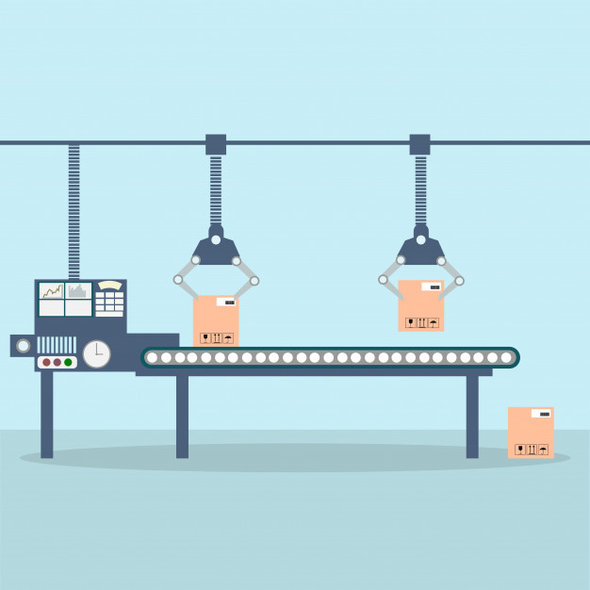


“managing the tourist destination”
“cultivating the
hosting community”

Slide 55
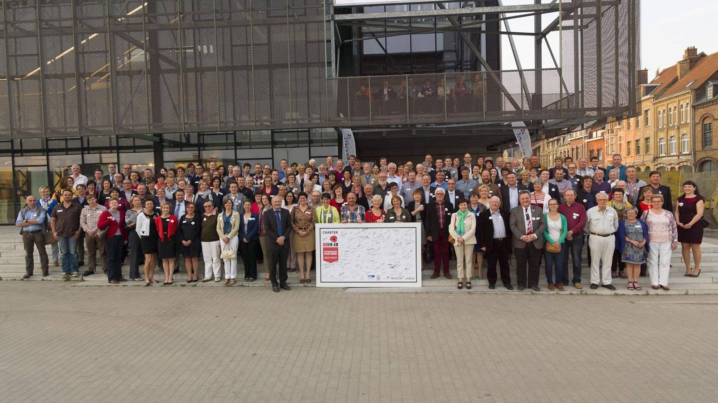

Slide 56


research & development (R&D)
general & administrative (G&A)
(people, finance, operations)

Slide 57
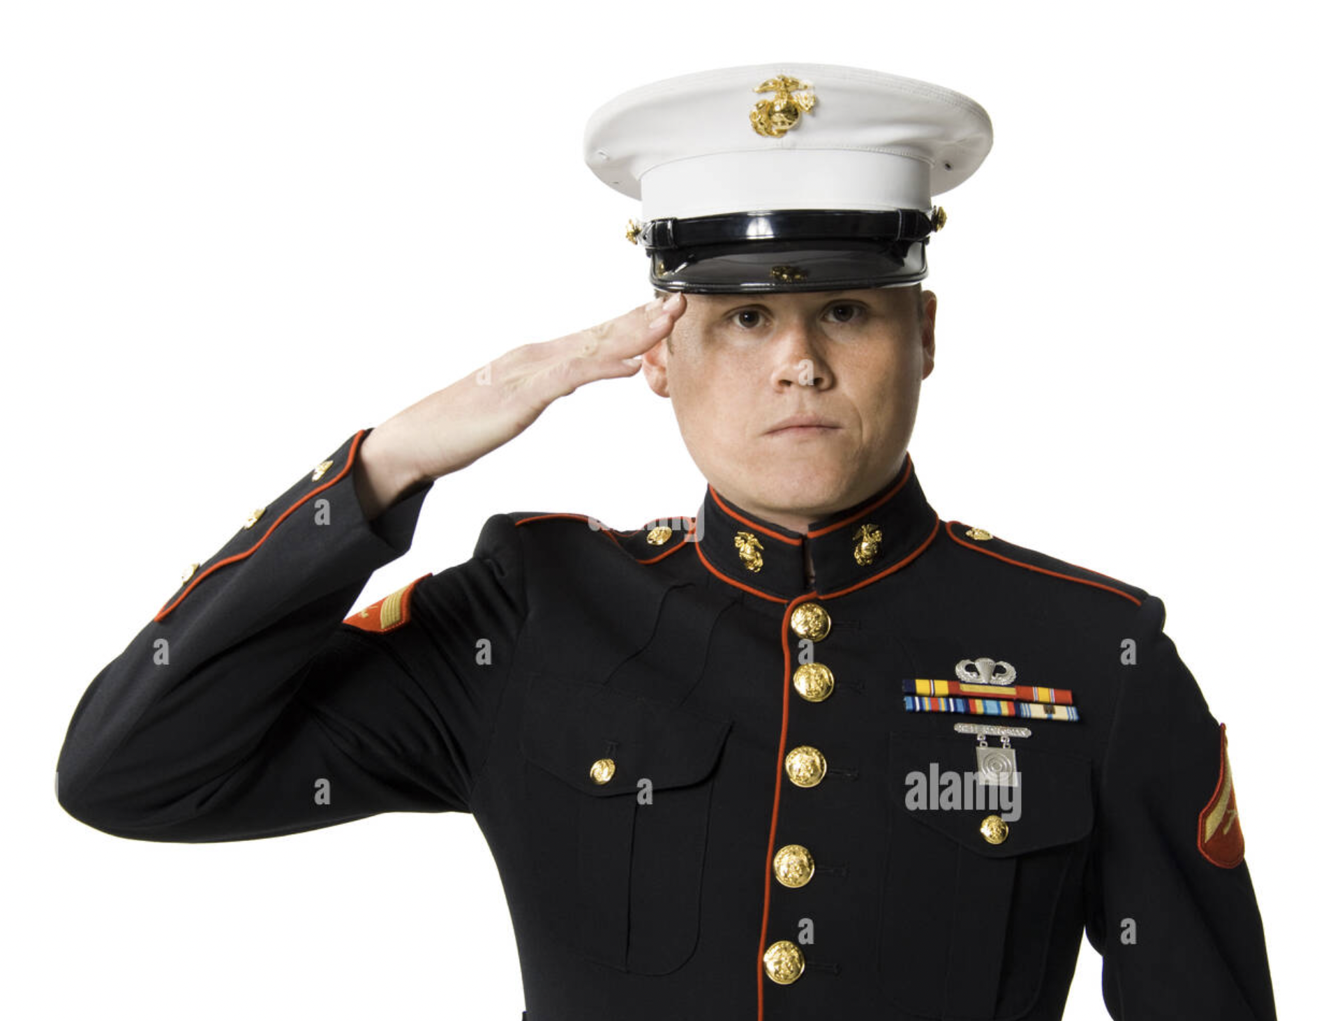
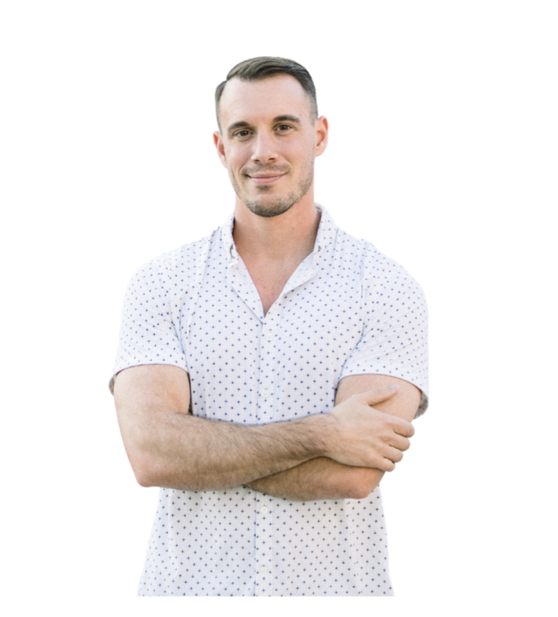
2 faces of the machine story
“command & control”
hierarchy
prediction & planning
best practices
rigid career ladder
silos
“agile tech start-up”
speed & scale
autonomy
rapid iteration
incremental improvements

Slide 58
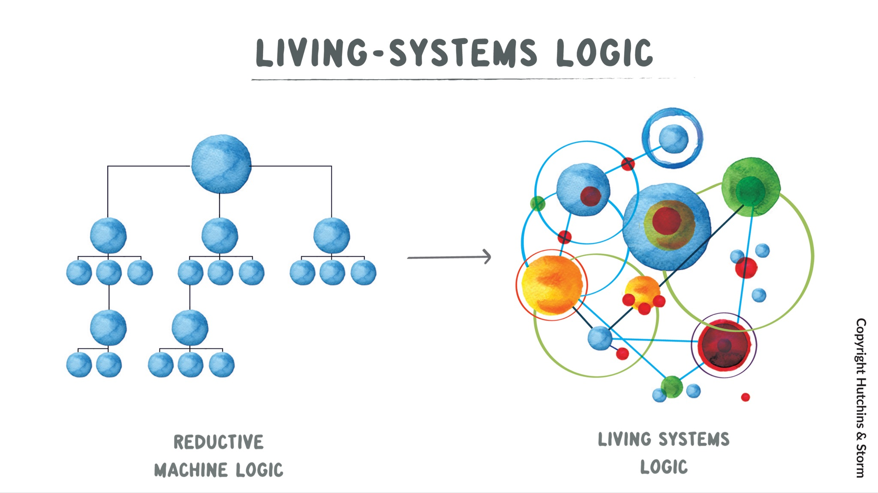
general & administrative (G&A)
stewardship
finance
people
operations
finance
people
operations
illustrations copyright Laura Storm & Giles Hutchins, Regenerative Leadership

Slide 59
mini practice grounds
talent acquisition
head of finance
onboarding
finance
payroll
people
offboarding
operations
purchasing
all employeees
inventory management

Slide 60
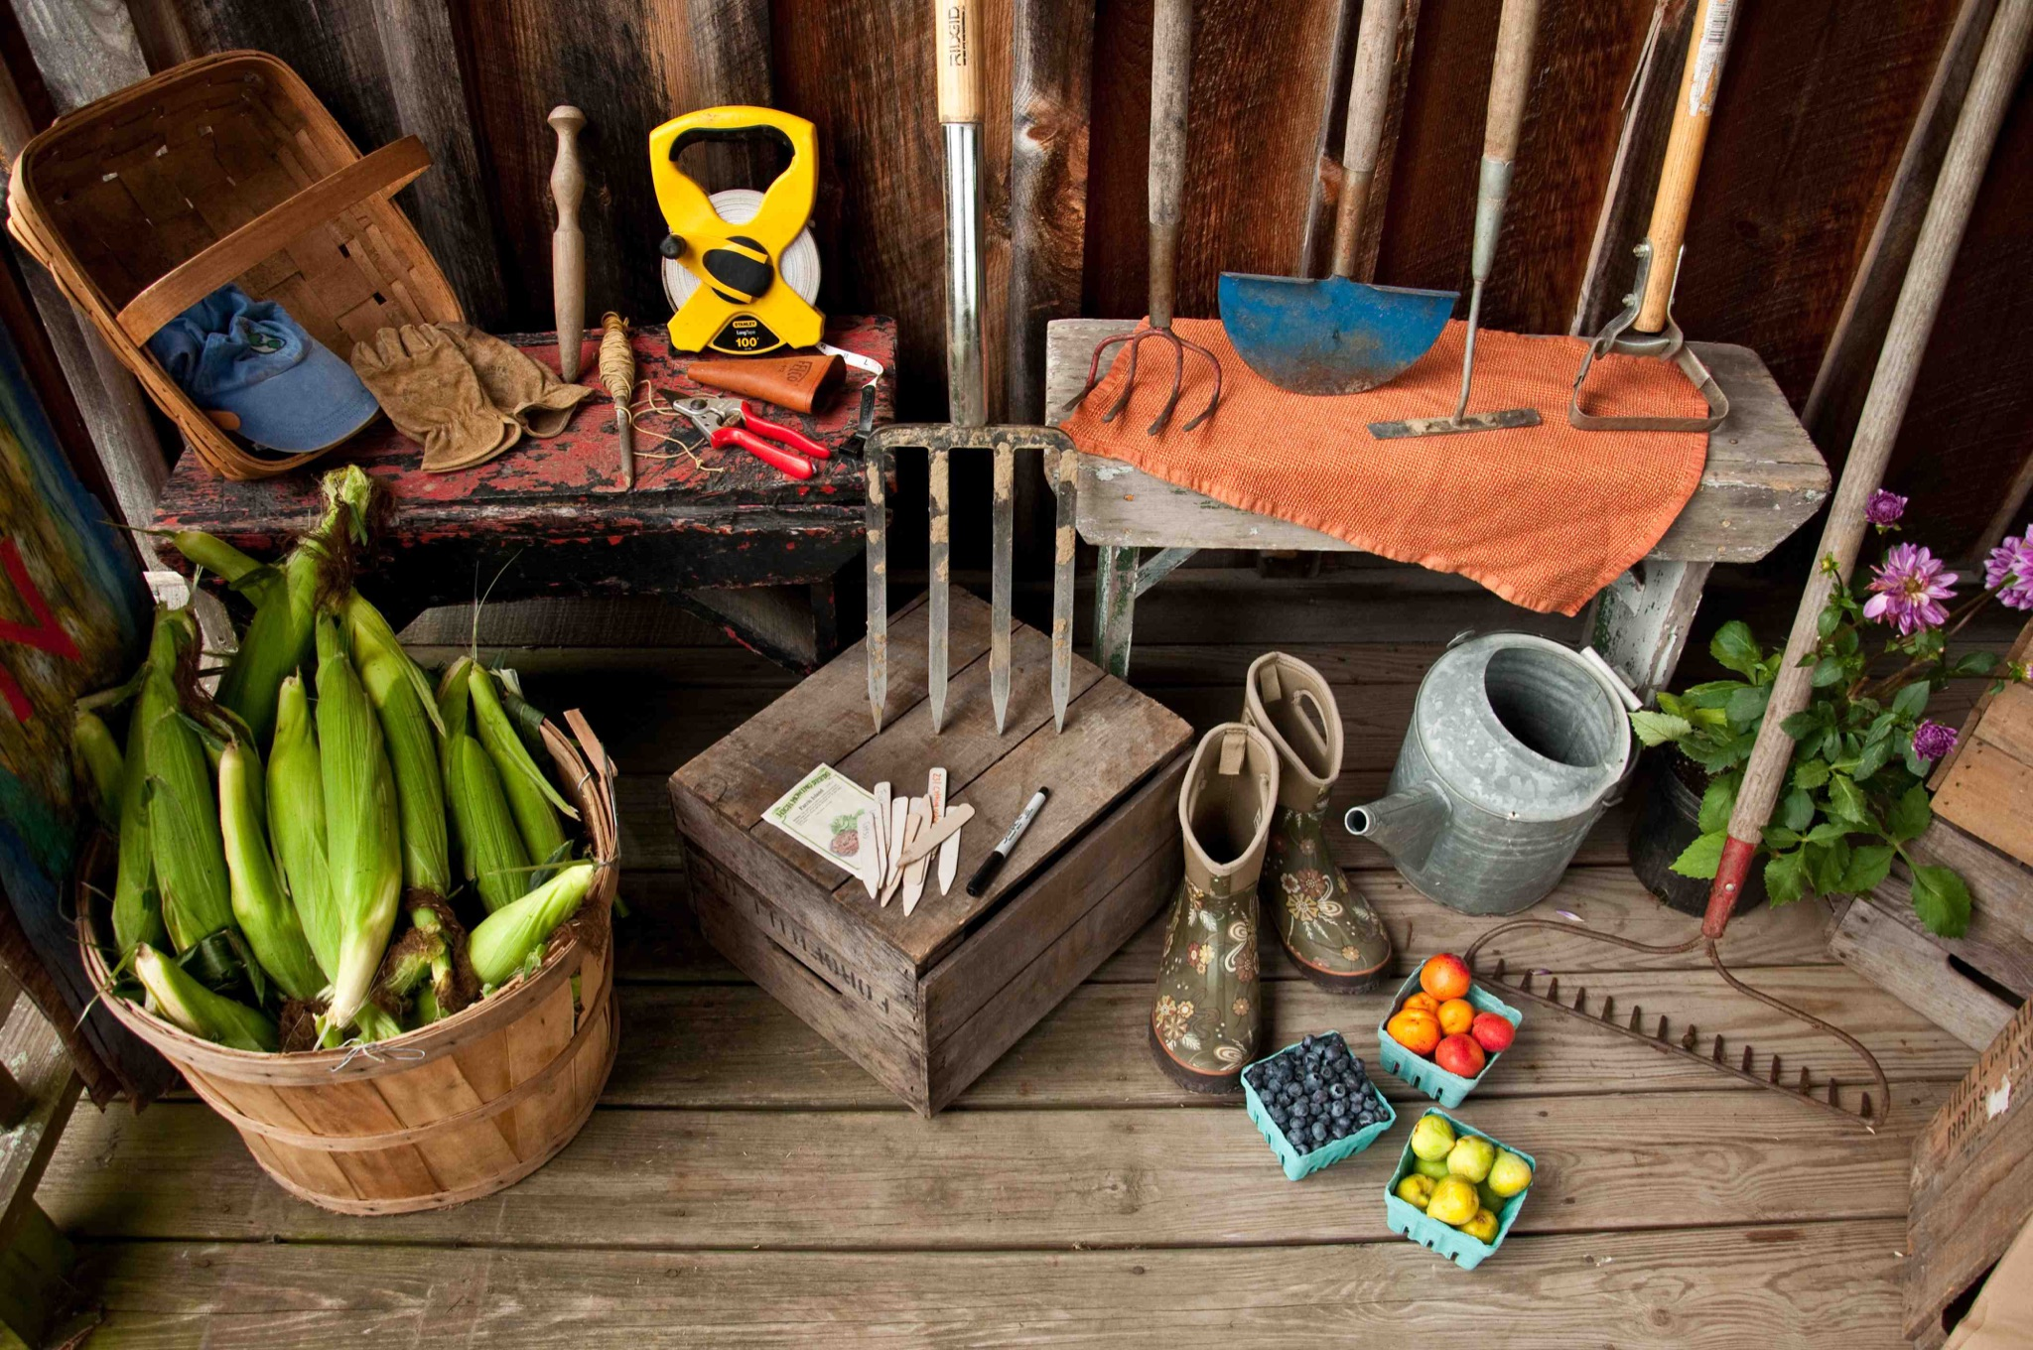
if humanity is going to make it through, the intention of our work must be
to shape every organization as a practice ground for a more thrivable world

Slide 61
Creating sustainable and attractive workplaces
Conclusions and outlook
Torkild Justesen
#SLS22
sustainableleaders.eu

Slide 62
Thank you
#SLS22
sustainableleaders.eu

