Slide 1


Leadership for transformational equality
presentation by
Mirella Visser

Slide 2




Transformative leadership for transformational equality
re-wiring.eu
Mirella Visser , CEC European Managers, 1 June 2023

Slide 3
EU project “Promoting women in management”
Employee
  Human Capital Theory
  Educational credits
    Training choices and opportunities
  Working experience
    Unpaid labour/work-family preferences
    Competencies and skills
Status characteristics theory
Gender bias and confirmation standard
Firm
Working experience
Educational credits
Same entry level but diverging career paths
Senior male gatekeepers controlling training opportunities
Higher burden of proof and overqualification
Discrimination theory
Women who act like women, considered incompetent...
Gender stereotyping
Working mothers not competent, serious, reliable enough…
Women who act like men, not taken seriously..
Male defined benchmarks
Human capital theory
Top management
The ‘glass ceiling’ effect
‘Objective’ corporate barriers
‘Subjective’ cultural and behavioural barriers
Training policies
Promotion policies
Compensation policies
Gender stereotyping
Old boys network maintaining status quo

Slide 4
Multiple challenges at all levels increase complexity of interventions
Individual
Organi-sation
Society
Society
Role expectations and stereotypes
Legislation and policies
Organisation
Individual
Lower self-confidence and ambition
Inadequate support infrastructure
Non-inclusive, masculine culture
Gender bias in HR policies and programs
Double bind issues
Absence of role models
Tokenism
Lack of role models

Slide 5


Good practices at organizational level
Identified good practices at organizational level
We clarified that it is performance that matters, not gender. At the same time we emphasized that it simply cannot be that if you look at performance you always end up with nominating men”.
“To men who were resistant we explained that although their chances for promotion might have become smaller it is a strategic goal for the company we have set, and like all strategic goals we intend to achieve it”. ``
“Companies should be tougher in promoting and pushing women to take the next function. It takes more attention and convincing if you want more women to reach senior management positions.”
“It is not about the numbers but about how to integrate them in the corporate culture. The goal really is to adapt the HR processes and corporate culture in such a way that you will make the numbers in the long run”.
“What’s wrong with us that we do not have at least 30% women at top level?”

Slide 6
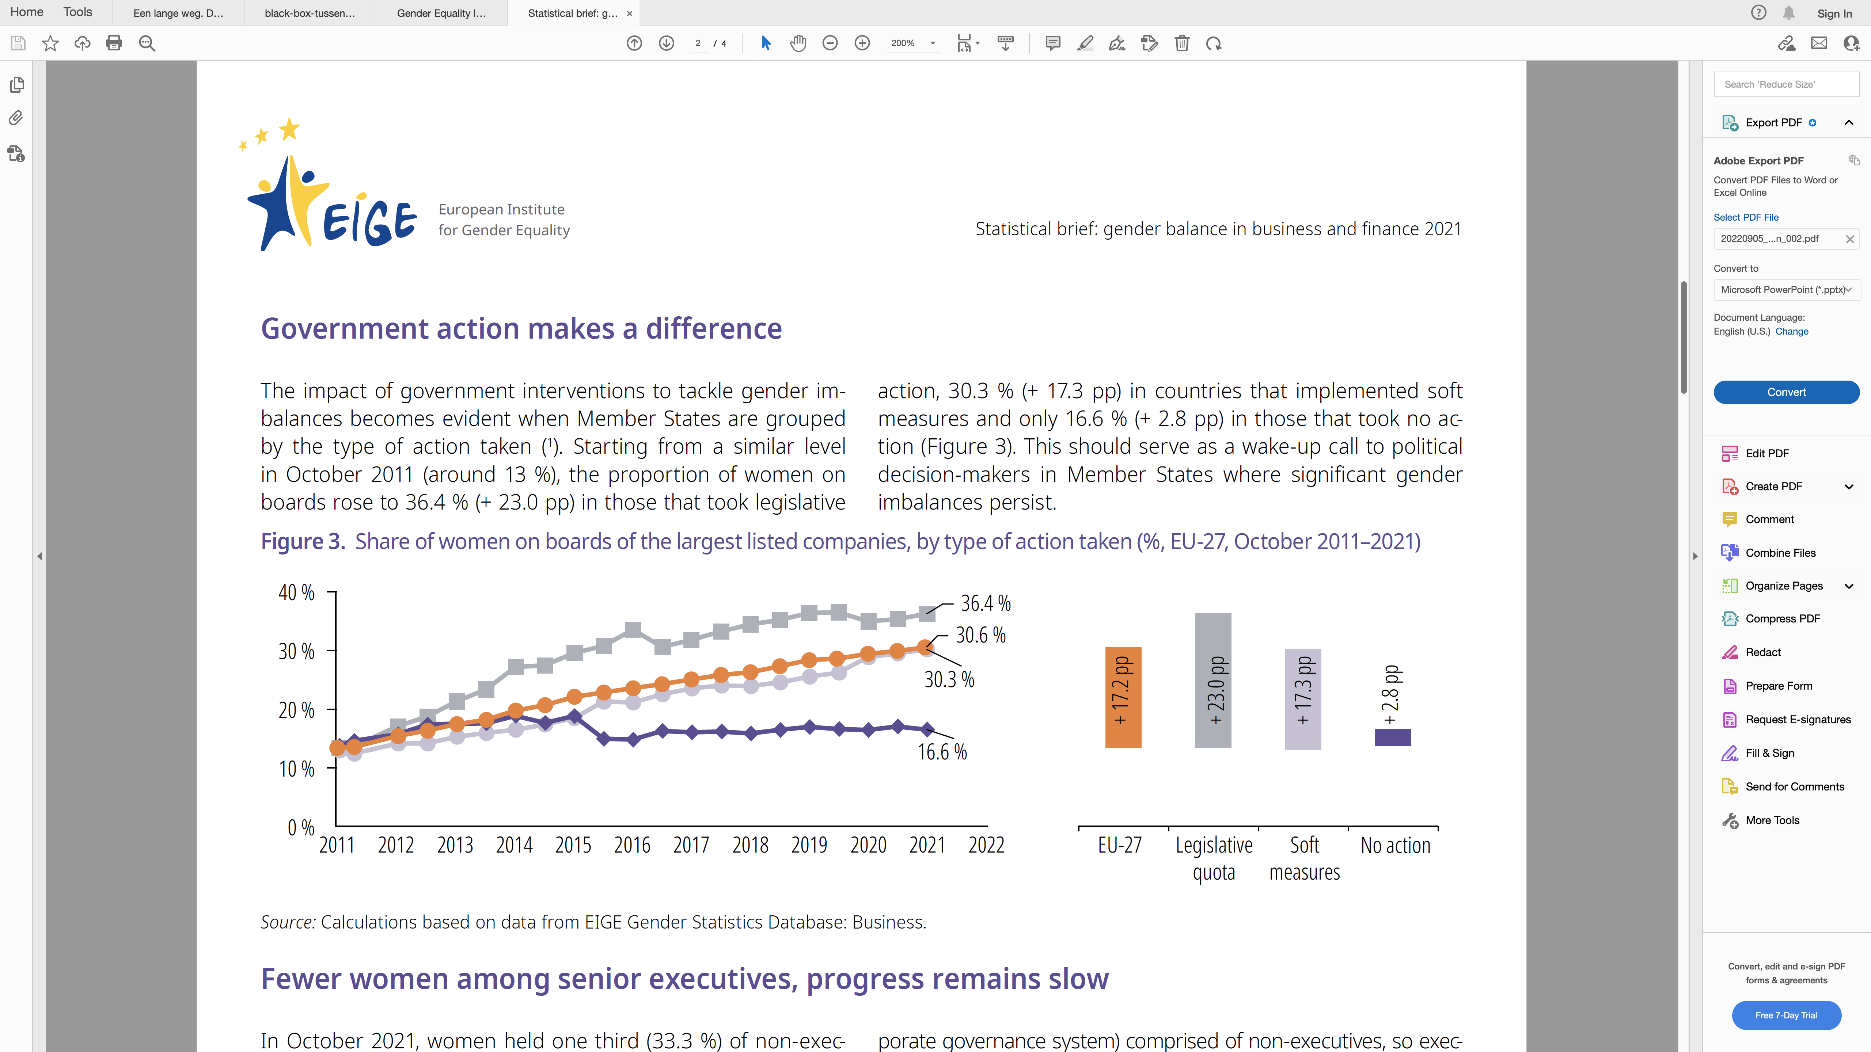
Quota legislation is a game changer
However,
Focus on representation (numbers) in SB
Trickle down effects debated

Slide 7
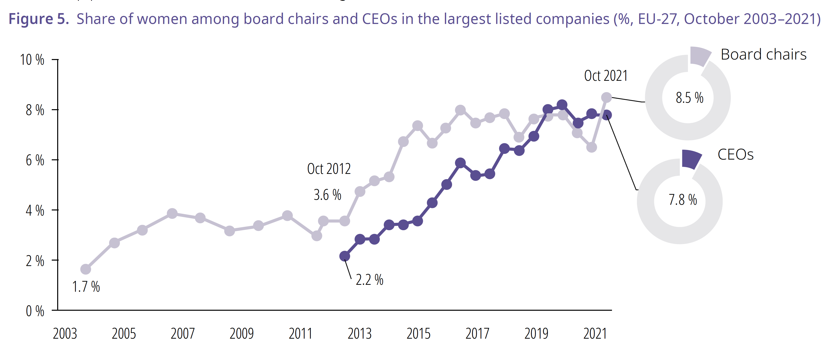
Persistent lack of gender equality in the most powerful positions

Slide 8
The more powerful the position, the fewer women
CEO: 7%
CFO: 15%
COO: 16%
Executives : 19%
C-level total: 15%
Chair: 9%
Committee Chair: 32%
Committee Member: 36%
SB/NED: 35%
Source: EWOB 2021

Slide 9

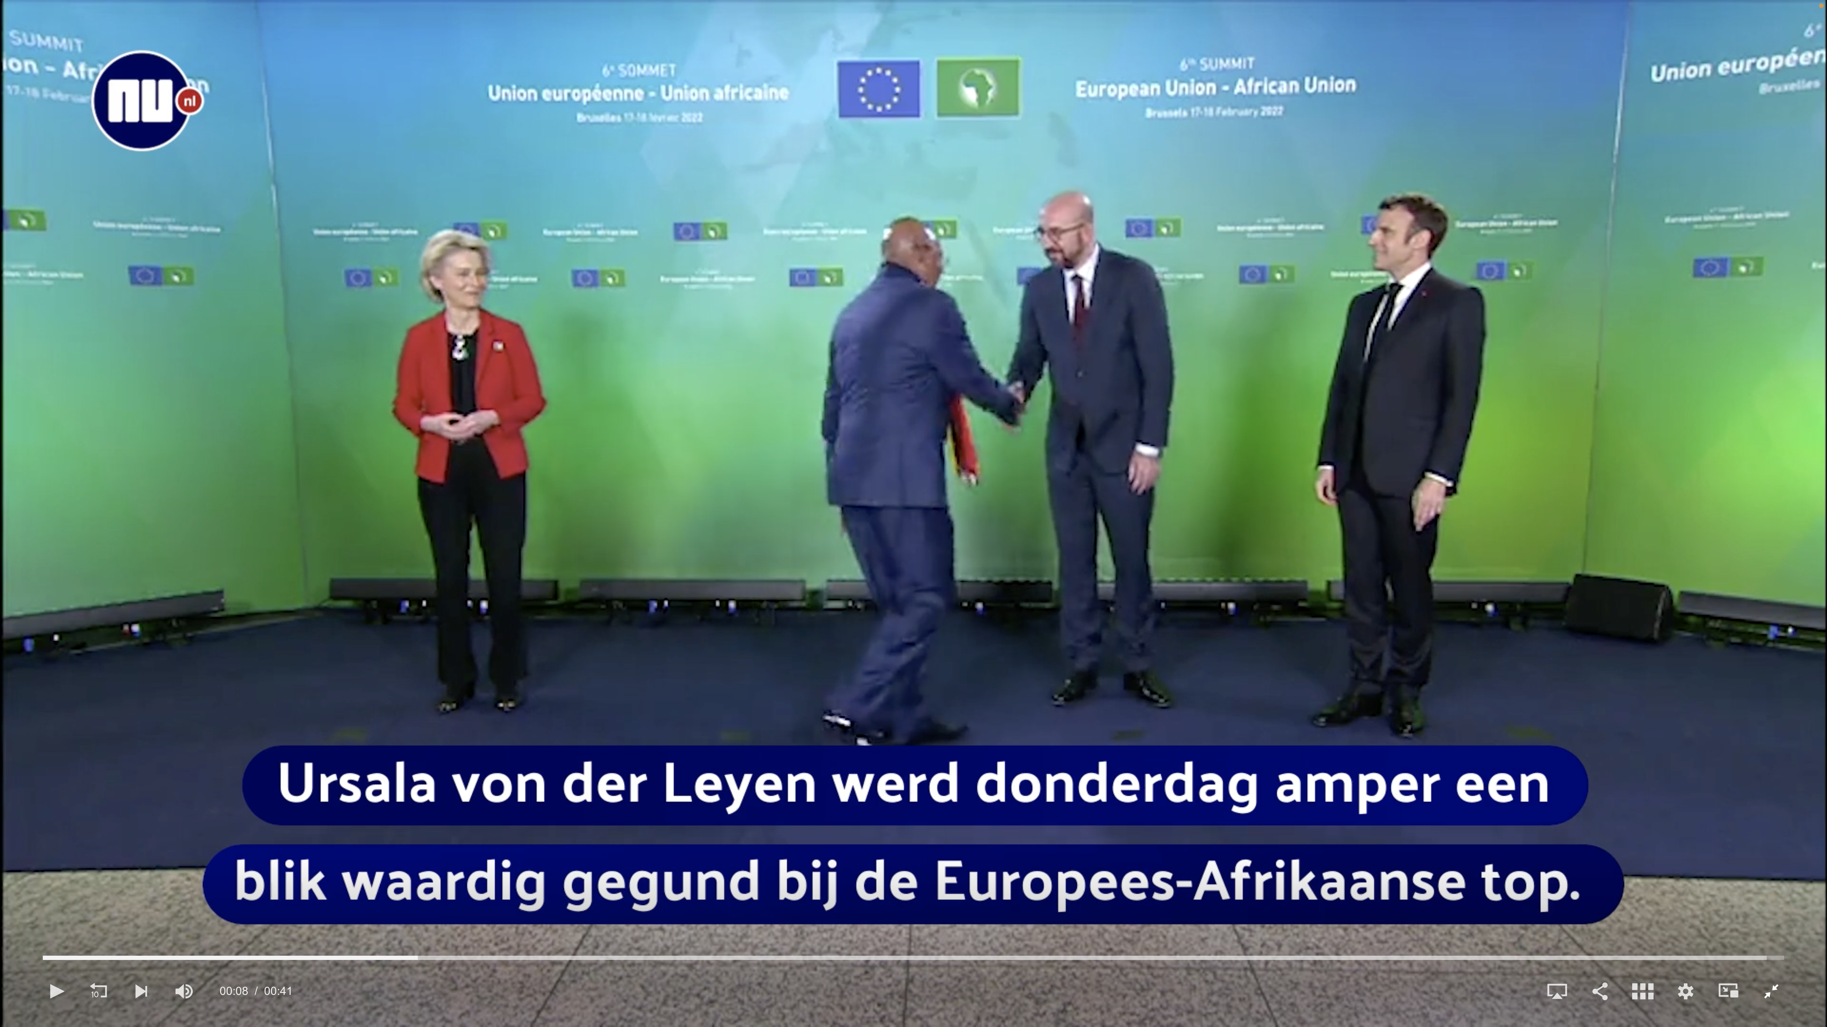
New role models, but double backlash for women leaders still exists
“Von der Leyen again ignored on the stage of world politics.
Ursula von der Leyen was barely given a glance at the European-African summit on Thursday. A minister walked right past the president of the European Commission. The incident was reminiscent of an earlier incident involving Turkish President Recep Tayyip Erdogan.”
https://valtioneuvosto.fi/en/-//10616/prime-minister-marin-submits-government-s-request-for-resignation-government-to-continue-on-a-caretaker-basis

Slide 10
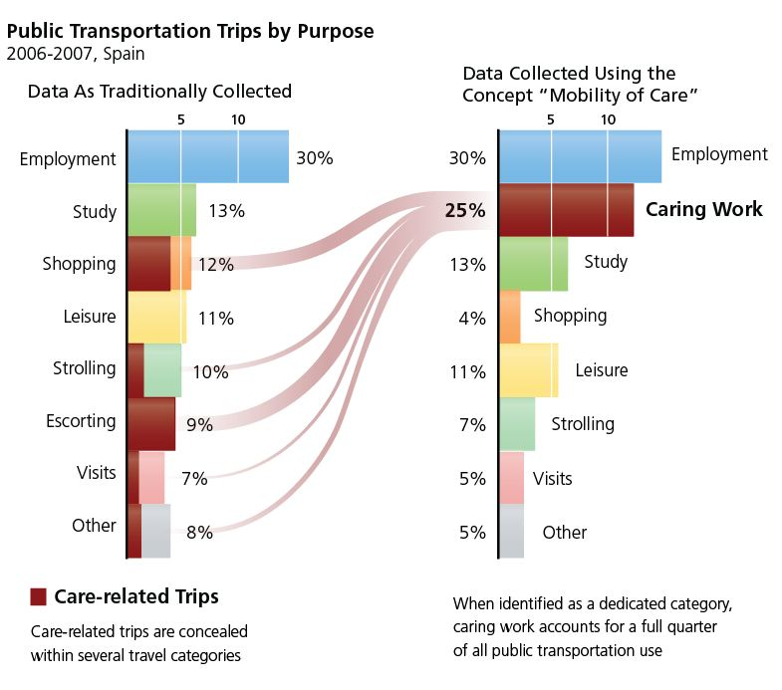
Data has become an enabler of gender-sensitive policies
What is the purpose of your trip?
Traditionally collected data rank employment as most important (30%) and study as second (13%).
Transportation policy is primarily based on the needs of workers and employers.
Source: http://genderedinnovations.stanford.edu/case-studies/transportation.html#tabs-2

Slide 11
Data has become an enabler of gender-sensitive policies
Does the purpose of your trip involve (caring for) another person?
Using the mobility of care concept “caring work” as purpose ranks almost as high as employment (25% vs 30%).
Transportation policy should include needs of “caring workers”.
Source: http://genderedinnovations.stanford.edu/case-studies/transportation.html#tabs-2

Slide 12
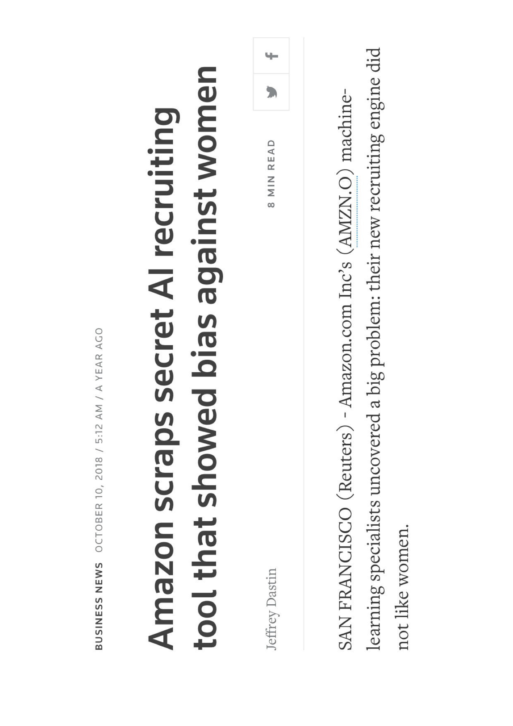
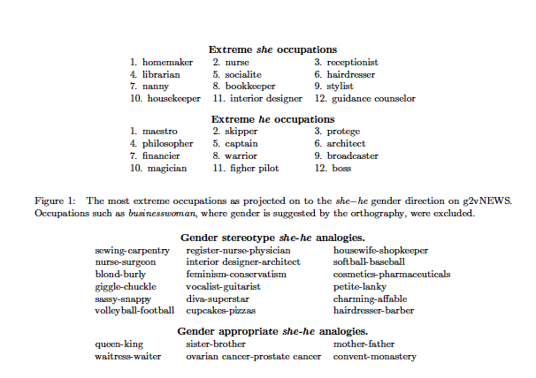
Emergence of “second generation gender bias”

Slide 13
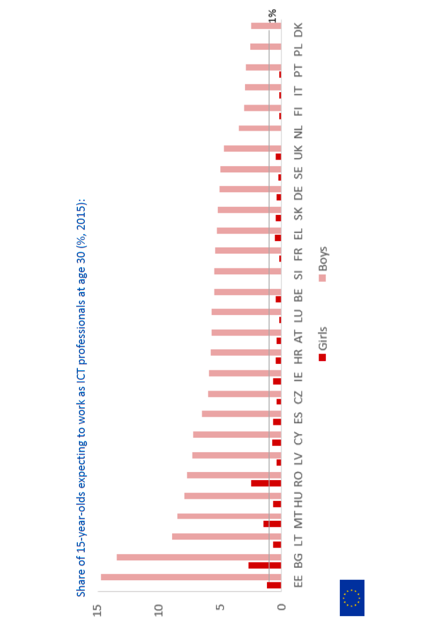
Gender differences in ICT and innovation
Share of women
App-developers (EU) | 9%
Owner of high-tech business (EU) | 5-15%
Patents (EPO) | 8%
Nobel prizes | 6%
Investments in women-led start-ups (NL) | 1,6%
ICT specialists (EU) | 17%
Source: EIGE, Women and men in ICT, 2018

Slide 14
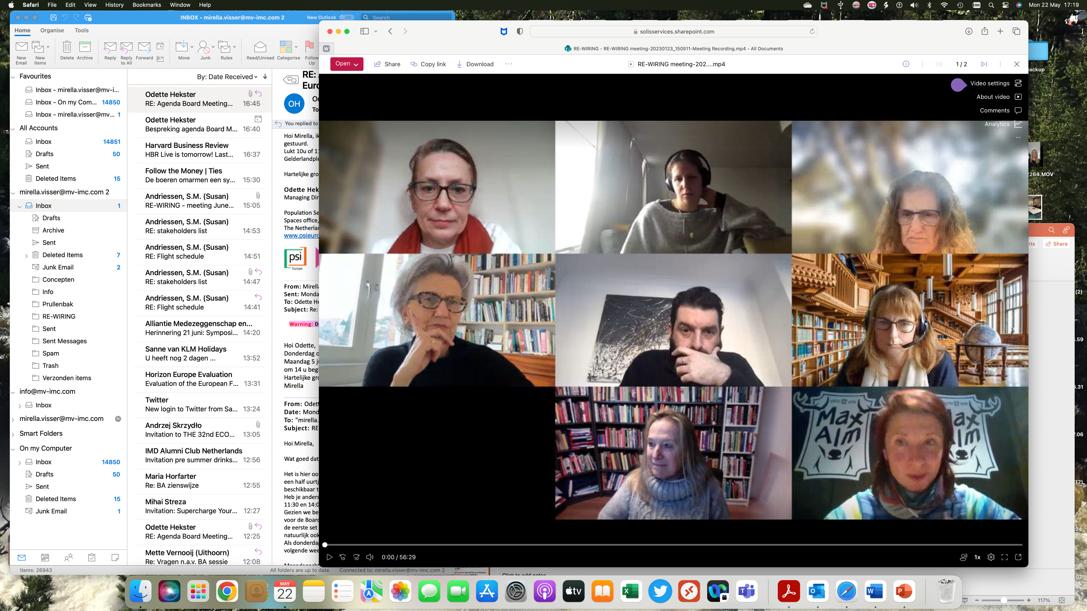
Realising Girls' and Women’s Inclusion, Representation and Empowerment, March 2023 – March 2026
re-wiring.eu
Consortium partners | Country
Utrecht University (UU) - Principal Investigator | NL
Katholieke Universiteit Leuven (KUL) | Belgium
Centre for Inclusive Leadership (CFIL) | NL
University of Portsmouth Higher Education Corporation (UoP) | UK
Universidad de la Iglesia de Deusto Entidad Religiosa (UDEUSTO) | Spain
University of the Western Cape (UWC) | South-Africa
Uniwersytet Gdański (UG) | Poland

Slide 15
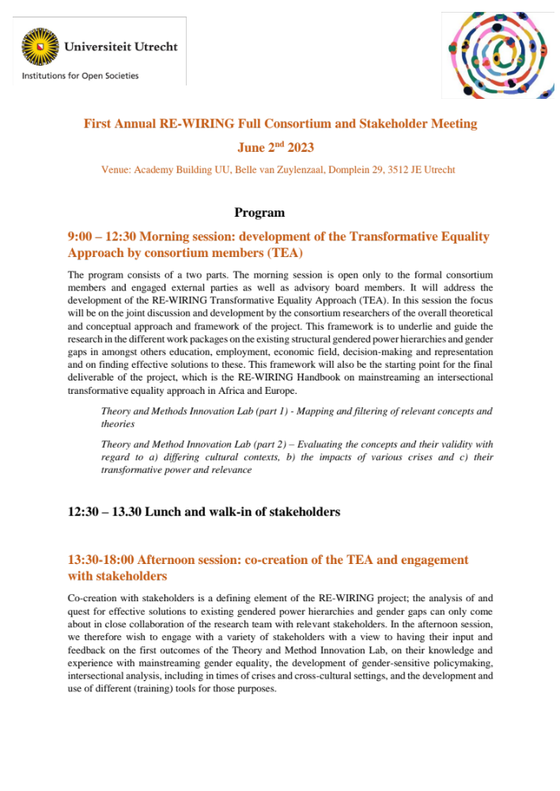
Realising Girls' and Women’s Inclusion, Representation and Empowerment, March 2023 – March 2026
re-wiring.eu

Slide 16
Our aim is to “re-wire” institutions
re-wiring.eu
We aim at contributing to effective change, by a re-design of existing legal, policy and institutional approaches more widely, to secure intrinsic change and behaviour towards transformative equality in all domains of society.
Not only rulemaking, implementation, monitoring and enforcement systems of equality laws and policies as such, but also the policies and actions of all societal stakeholders involved.
‘Institutions’ include not only governments and other public bodies, but also in the private sphere, companies, banks, social partners, health institutions, schools and academia, media and, closer to home, families and other private social constellations, including for instance women’s organizations and religious groups.

Slide 17
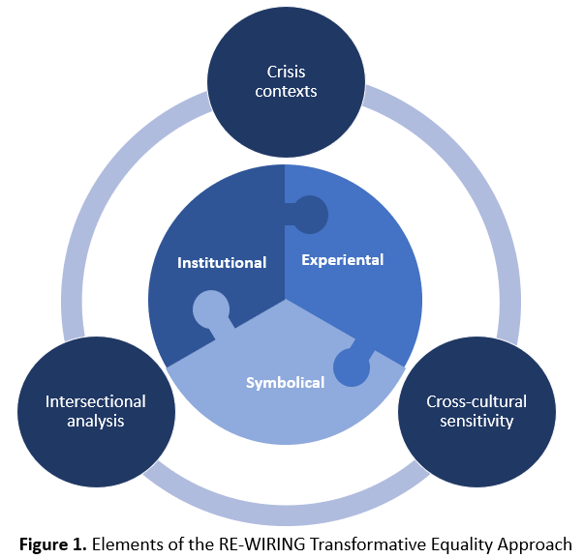
Development of Transformative Equality Approach (TEA)
re-wiring.eu
Theory of gendered organizations (Acker)
Address gendered power hierarchies in a holistic way by engaging both dominant and non-dominant individuals to transform structural barriers and constraining gender norms

Slide 18
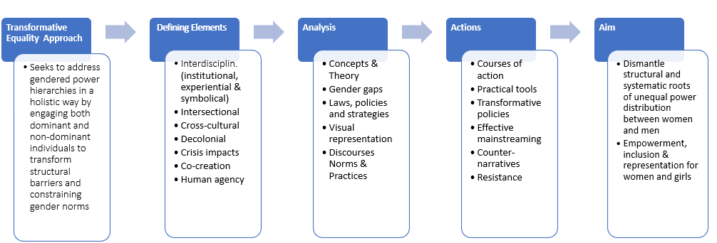
Key elements and process of TEA
re-wiring.eu

Slide 19
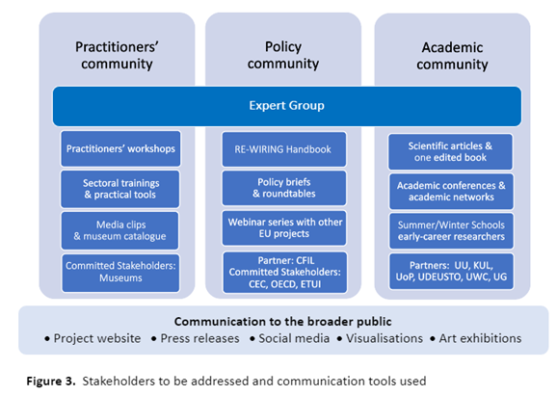
re-wiring.eu

Slide 20
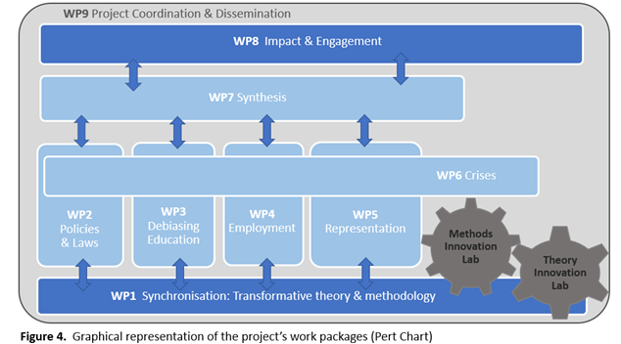
re-wiring.eu

Slide 21
Laws and policies: enhancing womens voice, agency and decision-making power (WP2)
re-wiring.eu
Country-level systematic review of laws, rules and policies to assess their effectiveness in terms of enhancing better representation of women in key areas of decision-making, such as in in government, parliaments, crisis-response teams and on boards of large companies.
To determine the root causes of gendered law- and policymaking processes in the countries under study and how these can be effectively overcome.

Slide 22
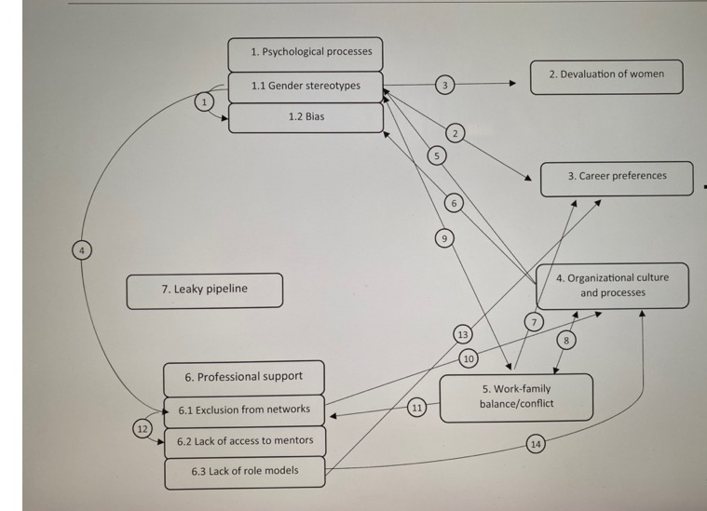
Interrelationships between barriers for representation
re-wiring.eu
Source: “Holistic and integrative review into the barriers to women’s advancement to the corporate top in Europe”, by R.A.van ‘t Foort-Diepeveen, A. Argyrou, T. Lambooy, in Gender in Management 36,4 (2020)

Slide 23
Gender gaps in employment and enterprise (WP4)
re-wiring.eu
Objectives
Explain the continued existence of intersecting gender gaps in employment and enterprise and the continued resistance to EU gender equality laws and policies by looking behind the numbers through a Transformative Equality Approach.
Co-create and co-deliver (with stakeholders) innovative and practical solutions to eliminate intersecting gender gaps in employment and enterprise for the European and African labour markets.
How
Utilising cross-disciplinary insights, we will examine the institutional, symbolical and experiential forces that contribute to the maintenance of these gaps along five axes: representation, pay, work-family roles, sexual harassment and access to finance.

Slide 24
re-wiring.eu
Cross-cutting element: crises
Unequal power relations in societies are sustained and even exacerbated in times of crisis.
Crises can act as a ‘magnifying glass’ of existing inequalities.
Crises as opportunities or sites for lasting transformation.
Focus on the transformative power that crises may (potentially) have for enhancing girls’ and women’s power of definition, at crisis-leadership level and in crises-response measures.
Financial, climate and health & future of work

Slide 25
Health crisis: impact of COVID-19 on work-life balance
re-wiring.eu
Time is gendered and “time cultures” are bound up with power and control.
Work life balance policies based on access to subsidized childcare and/or flexibility.
Distinction between housework, childcare, emotional labor and mental work.
“I have turned into a foreman here at home. I am trying to get clearer oversight over what has to be done and activate my husband to prevent everything from becoming a mess, and I do not want to take care of it all by myself. So, I had a family meeting and put up a clear division of duties.”
“We knew that the division of tasks is rather equal in our everyday life, but now that we are both working from home, it is obvious that he takes his space when he needs to attend to “his” things, and I run, and I sprint from my work much more than he does.”
Source: “I have turned into a foreman here at home”: Families and work-life balance in times of COVID-19 in a gender equality paradise”, by A. Hjalmsdottir, V. Bjarnadottir, 2020.

Slide 26
Some of the deliverables
re-wiring.eu
Work:
Toolkit on Gender Gap in Representation at Work
Best Practice Map on Addressing the Gender Pay Gap
Best Practice Map Addressing the Gender Gap in Work Family Roles
Policy report assessing Gender Inequality in the financial sector
Workshops and podcasts on better practices in protection from sexual harassment in the workplace
Management and leadership:
Working Paper on effective transformative equality processes towards leadership positions
Country-level reports and infographic on gendered nature of law- and policymaking approach
Working Paper: Root causes of gendered law- and policymaking processes and their effective tackling
Development of a policy evaluation checklist to identify and tackle gendered law- and policymaking processes
Practitioners’ toolkit for building gender-sensitive law- and policymaking Processes
Online training module for policymakers

Slide 27
Invitation to CEC to participate
re-wiring.eu
Surveys on company policies, designed to identify, monitor and address gender gaps in pay structures, policies on work-family roles / work-life balance, gender representation in management and policies on sexual harassment.
  At least 2 companies x 3 sectors x 4 countries (Belgium, UK, Poland, Spain).
  Total = at least 24 companies (ideally 48 companies, i.e. 4 per sector and per country)
  Months: 6-24 (September 2023 – March 2025).
1-on-1 interviews with line managers, to discuss company practices re gender pay gap, work- family roles / work-life balance.
  Ideally 4 line managers from companies x 3 sectors x 4 countries (Belgium, UK, Poland, Spain).
  Total = 48 line managers (ideally across 48 companies).
  Months: 6-24 (September 2023 – March 2025).

Slide 28
Invitation to CEC to participate
re-wiring.eu
3. 1-on-1 interviews with bank managers re lending practices towards women entrepreneurs.
  Ideally 3 bank managers (3 different banks) x 4 countries.
  Total: 12 bank managers.
  Months: 6-30 (September 2023 – August 2025).
4. Distribution / promotion / streaming of Project Report and of national / sectoral reports.
  Months: 30-36 (August 2025 – March 2026).
5. Other activities:
  Participation of CEC at 3 annual meetings (first on June 2, 2023), webinars and other events.
  Promotion of the projects’ activities on website(s), on social media etc.

Slide 29
What questions do you have?
re-wiring.eu
Mirella.visser@mv-imc.com
rewiringhorizon@uu.nl

