Slide 1


Leading transformational
equality for future-fit
workplaces
conference

Slide 2
Agenda
8.30 Registration
9.00 Opening by Maxime Legrand and Andreas Miller
9.15 Keynote speech by Caroline Farberger
Understanding gender norms and capturing the value of equality in business
10.15 Presentation by Mirella Visser
Leadership for transformational equality
11.00 Presentation by Fredrik Gustafsson
Future Female Leaders Awards
11.30 Presentation by PhD Anna Thoursie and panel discussion
Ageism excludes managerial talent
With Mirella Visser, Andreas Miller, Maxime Legrand and Anna Thoursie
Moderation: Ludger Ramme (ULA)

Slide 3
Understanding gender norms and capturing the value of equality in business
keynote speech by
Caroline Farberger

Slide 4
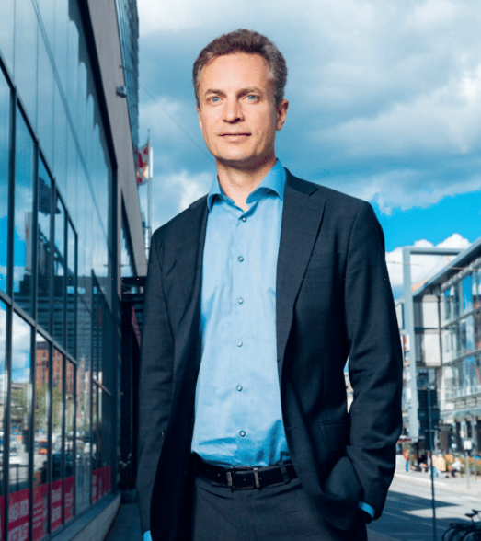

Slide 5
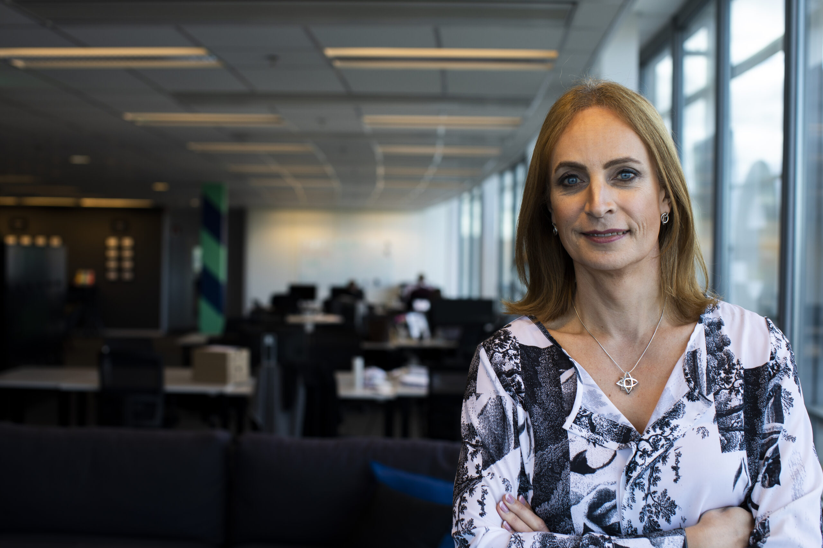
Gender norms and inclusive leadership
Caroline Farberger
Partner & Chairwoman
Wellstreet
Notes:
How many of you (in the audience) feel that you have a good grip on ESG?
And how many of you feel confident about DE&I? Do you know what the letters stand for?
How many of you (in the audience) feel that you have a good grip on ESG?
And how many of you feel confident about DE&I? Do you know what the letters stand for?

Slide 6
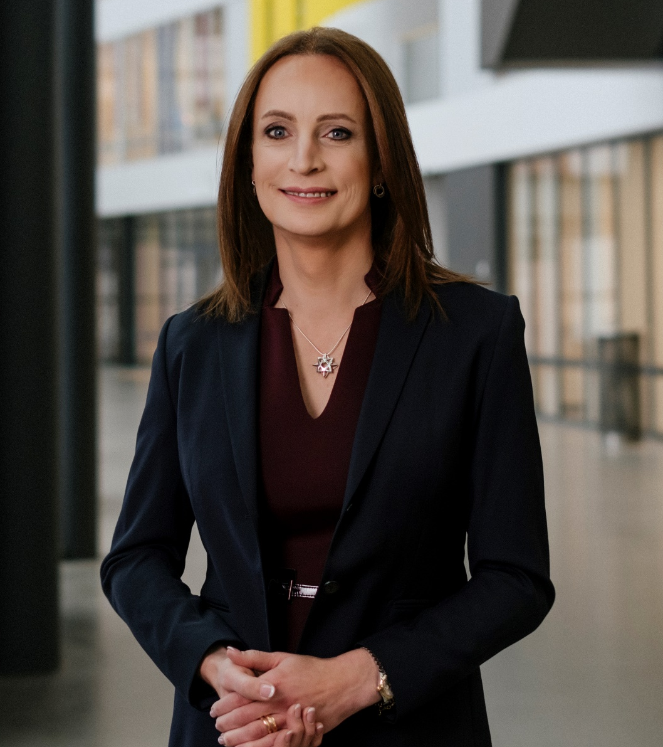

Slide 8
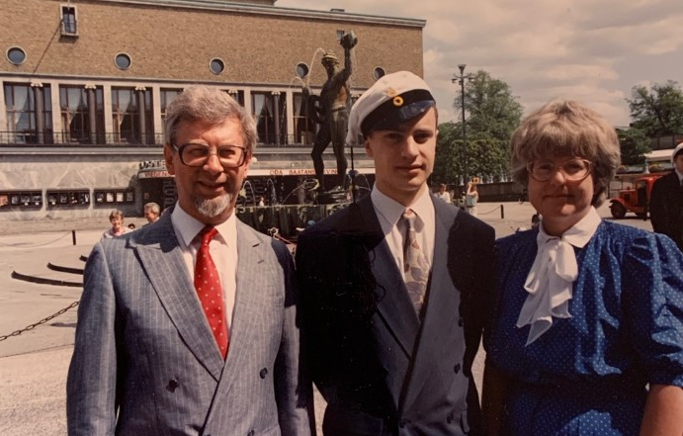

Slide 9
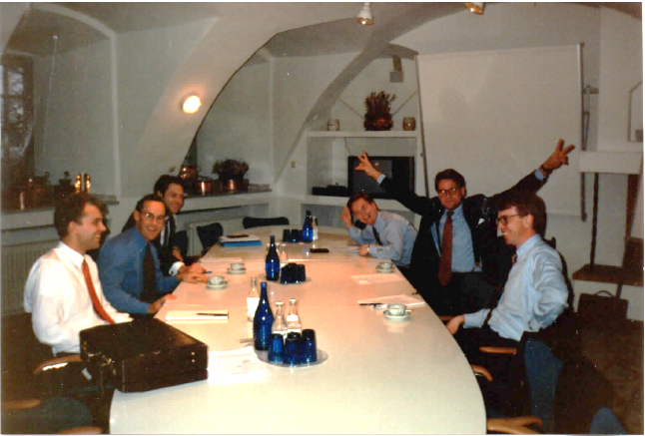

Slide 11
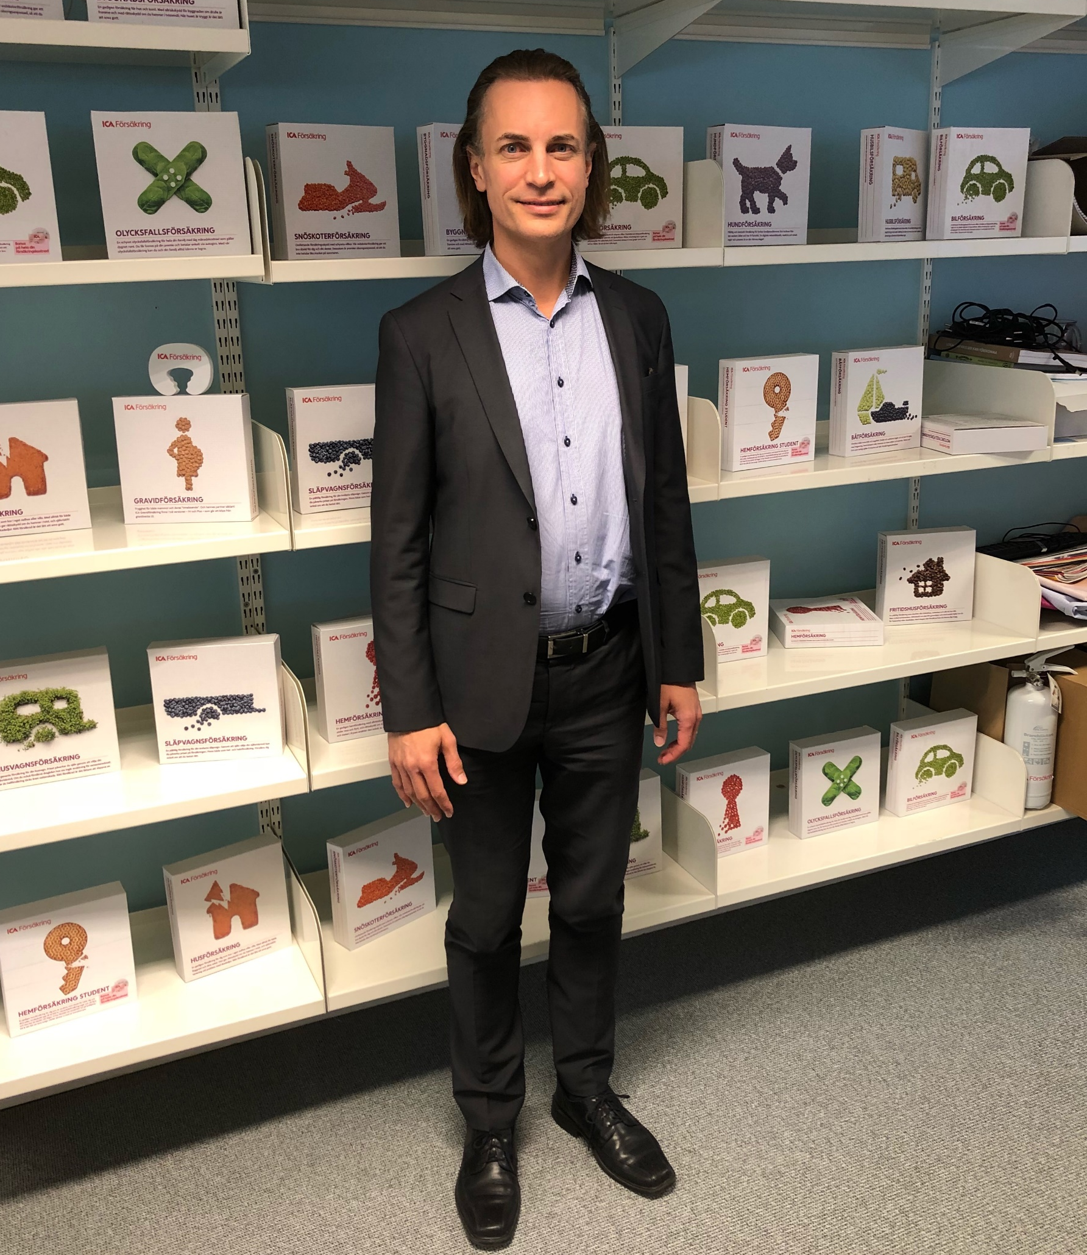
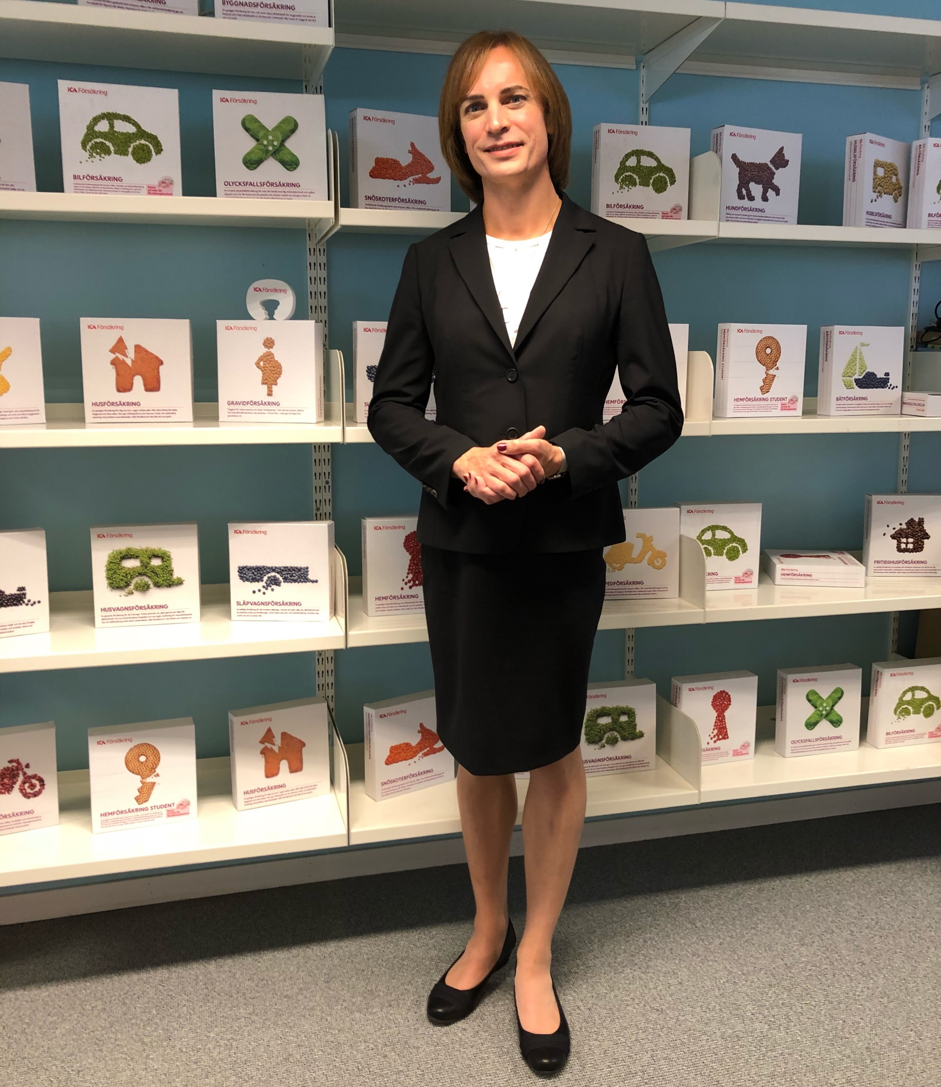

Slide 12
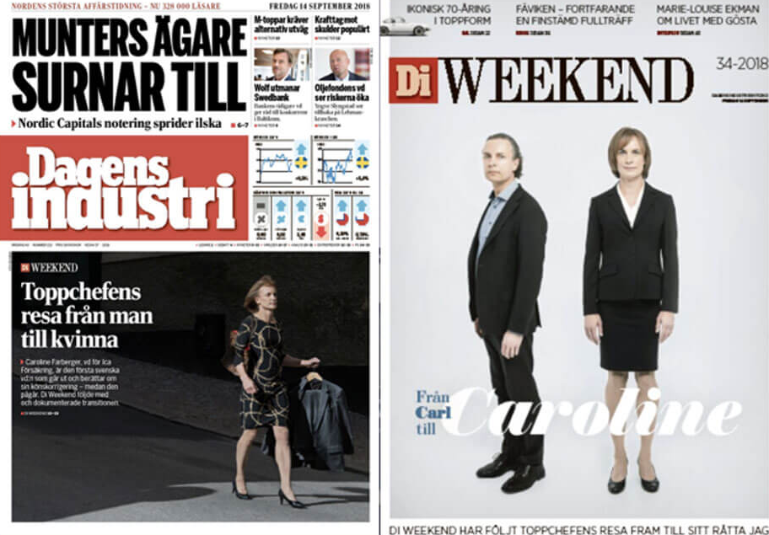

Slide 14
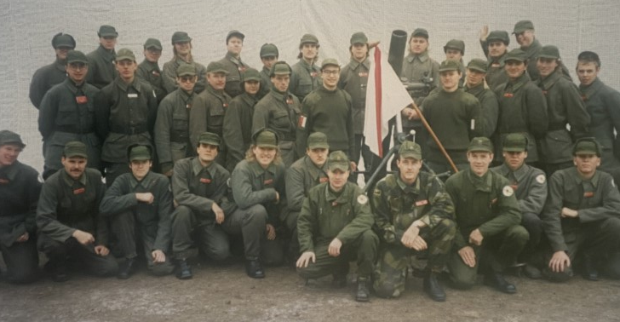
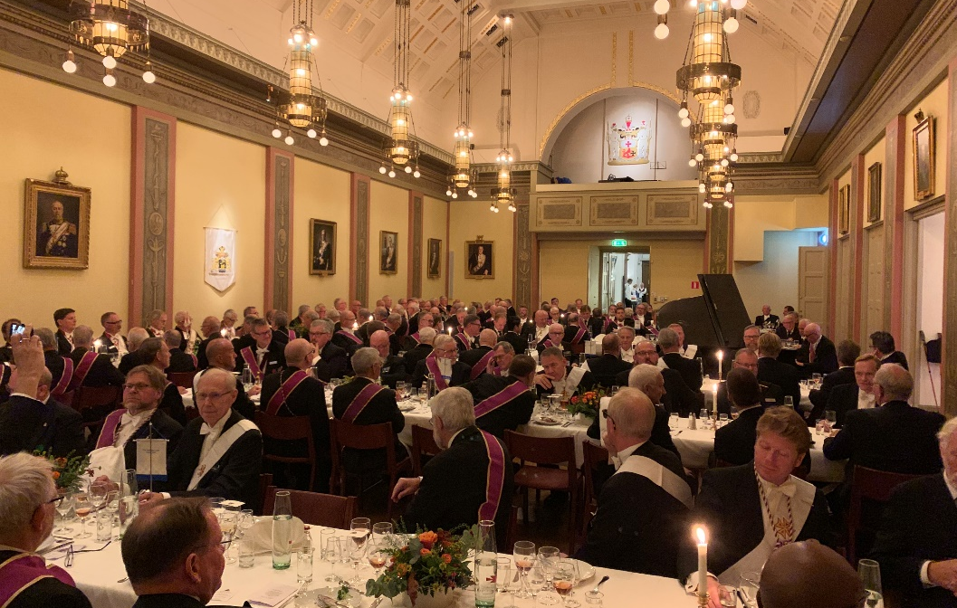
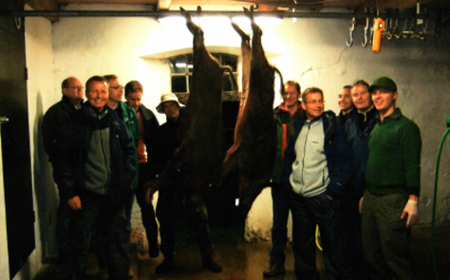

Slide 15
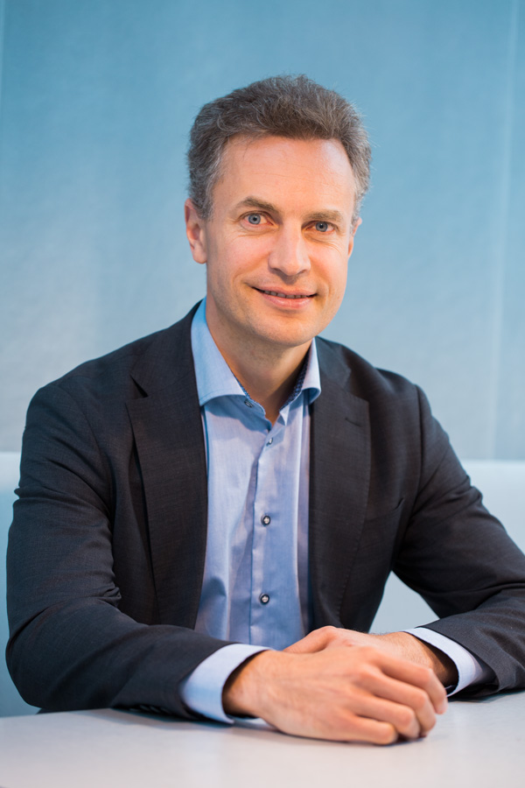
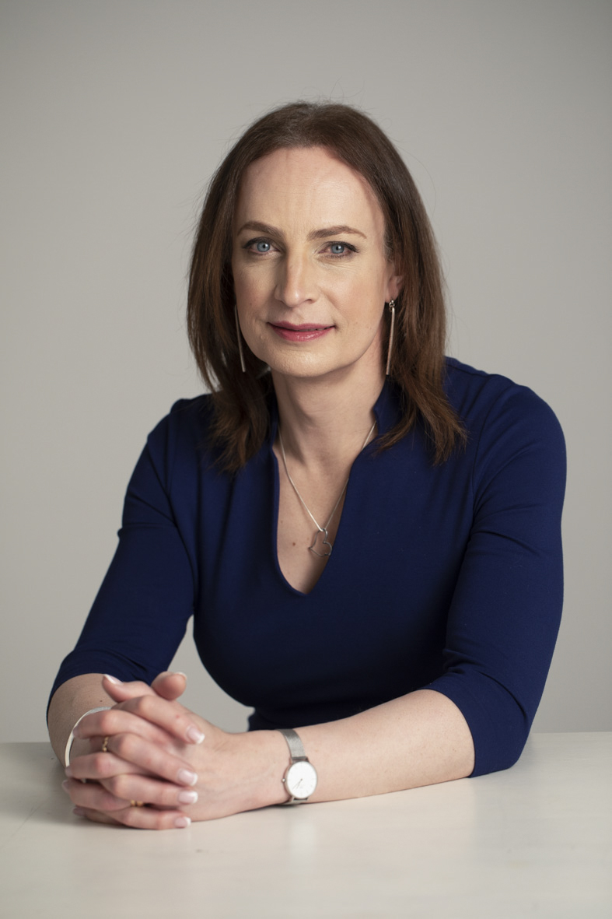

Slide 16
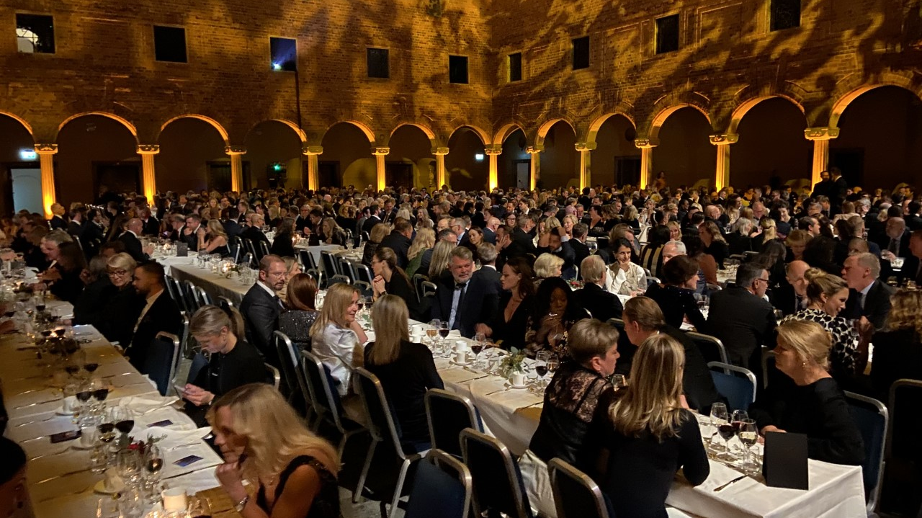

Slide 17
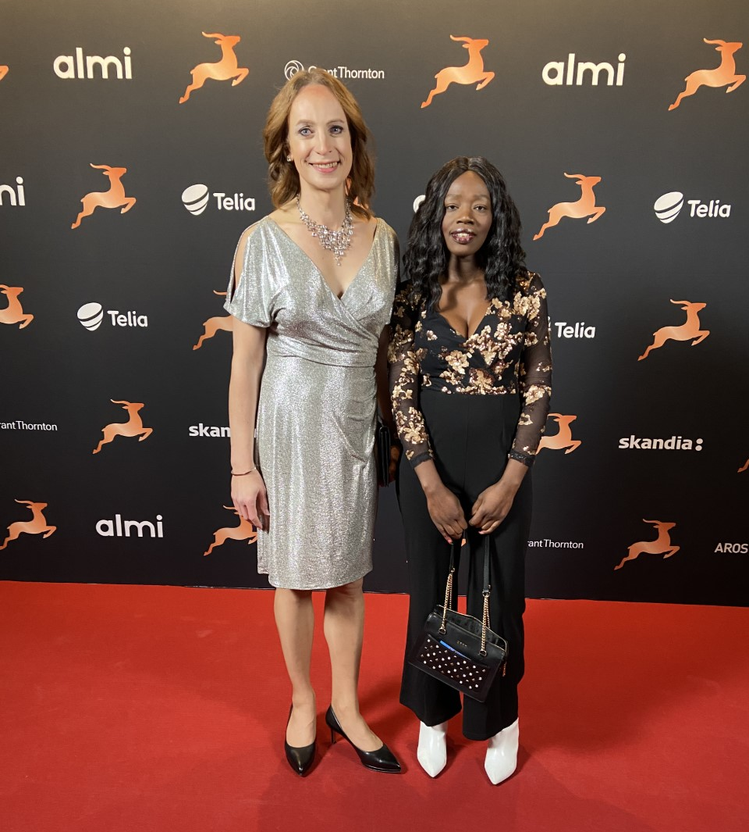

Slide 18
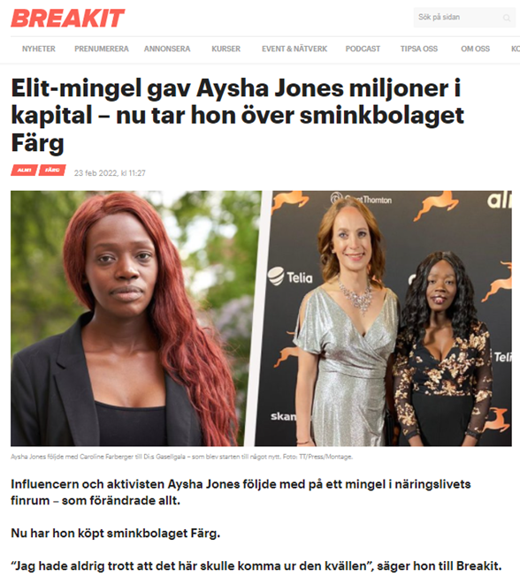
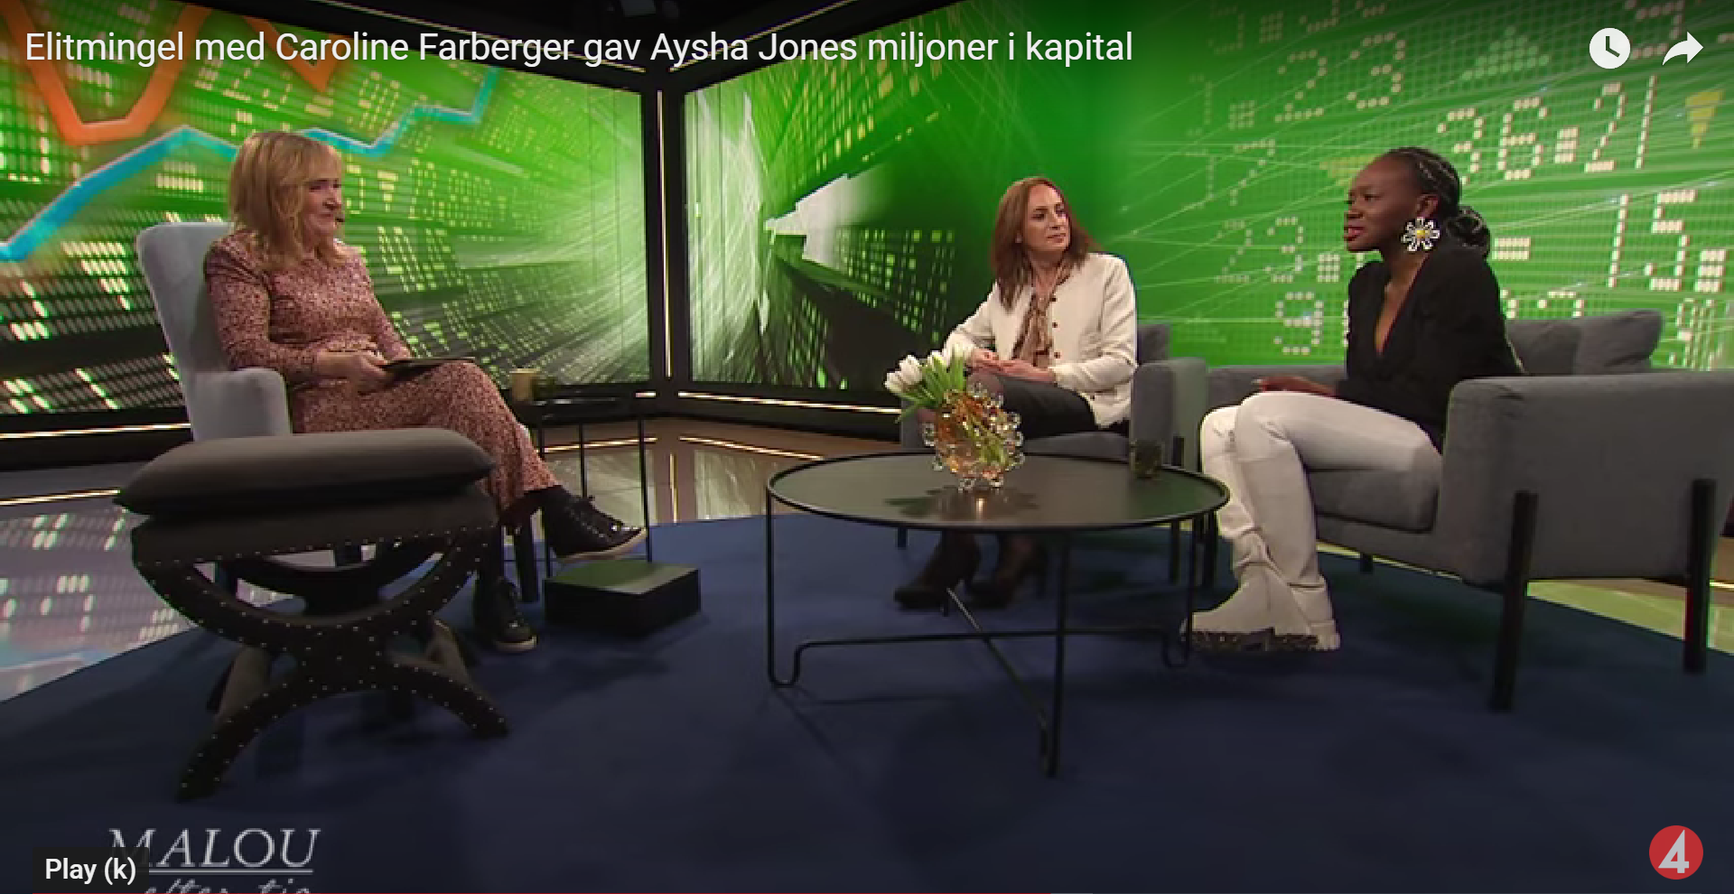
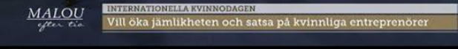

Slide 20
Leadership for transformational equality
presentation by
Mirella Visser

Slide 21




Transformative leadership for transformational equality
re-wiring.eu
Mirella Visser , CEC European Managers, 1 June 2023

Slide 22
EU project “Promoting women in management”
Employee
  Human Capital Theory
  Educational credits
    Training choices and opportunities
  Working experience
    Unpaid labour/work-family preferences
    Competencies and skills
Status characteristics theory
Gender bias and confirmation standard
Firm
Working experience
Educational credits
Same entry level but diverging career paths
Senior male gatekeepers controlling training opportunities
Higher burden of proof and overqualification
Discrimination theory
Women who act like women, considered incompetent...
Gender stereotyping
Working mothers not competent, serious, reliable enough…
Women who act like men, not taken seriously..
Male defined benchmarks
Human capital theory
Top management
The ‘glass ceiling’ effect
‘Objective’ corporate barriers
‘Subjective’ cultural and behavioural barriers
Training policies
Promotion policies
Compensation policies
Gender stereotyping
Old boys network maintaining status quo

Slide 23
Multiple challenges at all levels increase complexity of interventions
Individual
Organi-sation
Society
Society
Role expectations and stereotypes
Legislation and policies
Organisation
Individual
Lower self-confidence and ambition
Inadequate support infrastructure
Non-inclusive, masculine culture
Gender bias in HR policies and programs
Double bind issues
Absence of role models
Tokenism
Lack of role models

Slide 24


Good practices at organizational level
Identified good practices at organizational level
We clarified that it is performance that matters, not gender. At the same time we emphasized that it simply cannot be that if you look at performance you always end up with nominating men”.
“To men who were resistant we explained that although their chances for promotion might have become smaller it is a strategic goal for the company we have set, and like all strategic goals we intend to achieve it”. ``
“Companies should be tougher in promoting and pushing women to take the next function. It takes more attention and convincing if you want more women to reach senior management positions.”
“It is not about the numbers but about how to integrate them in the corporate culture. The goal really is to adapt the HR processes and corporate culture in such a way that you will make the numbers in the long run”.
“What’s wrong with us that we do not have at least 30% women at top level?”

Slide 25
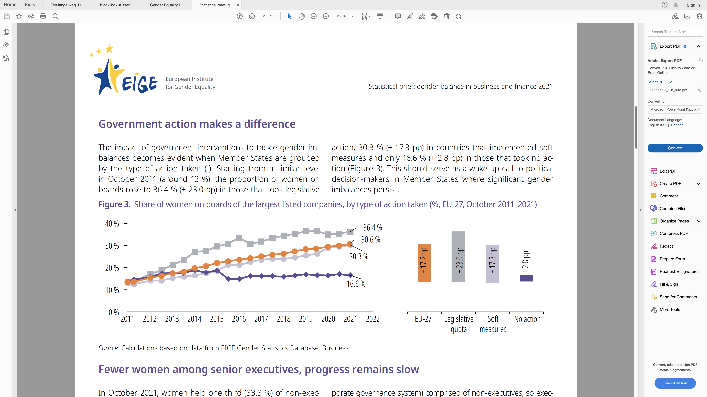
Quota legislation is a game changer
However,
Focus on representation (numbers) in SB
Trickle down effects debated

Slide 26
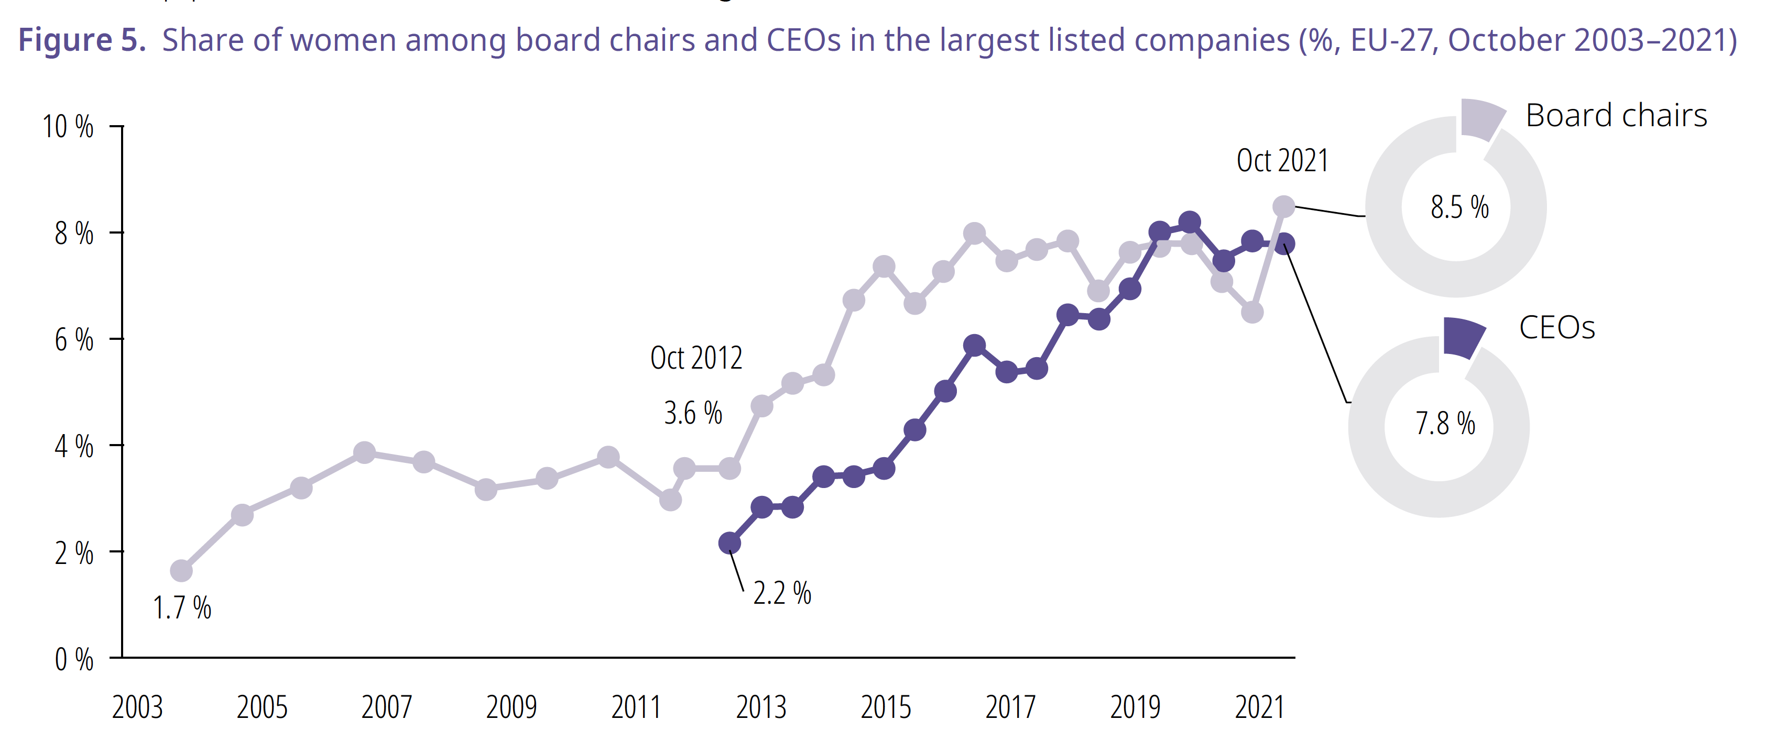
Persistent lack of gender equality in the most powerful positions

Slide 27
The more powerful the position, the fewer women
CEO: 7%
CFO: 15%
COO: 16%
Executives : 19%
C-level total: 15%
Chair: 9%
Committee Chair: 32%
Committee Member: 36%
SB/NED: 35%
Source: EWOB 2021

Slide 28
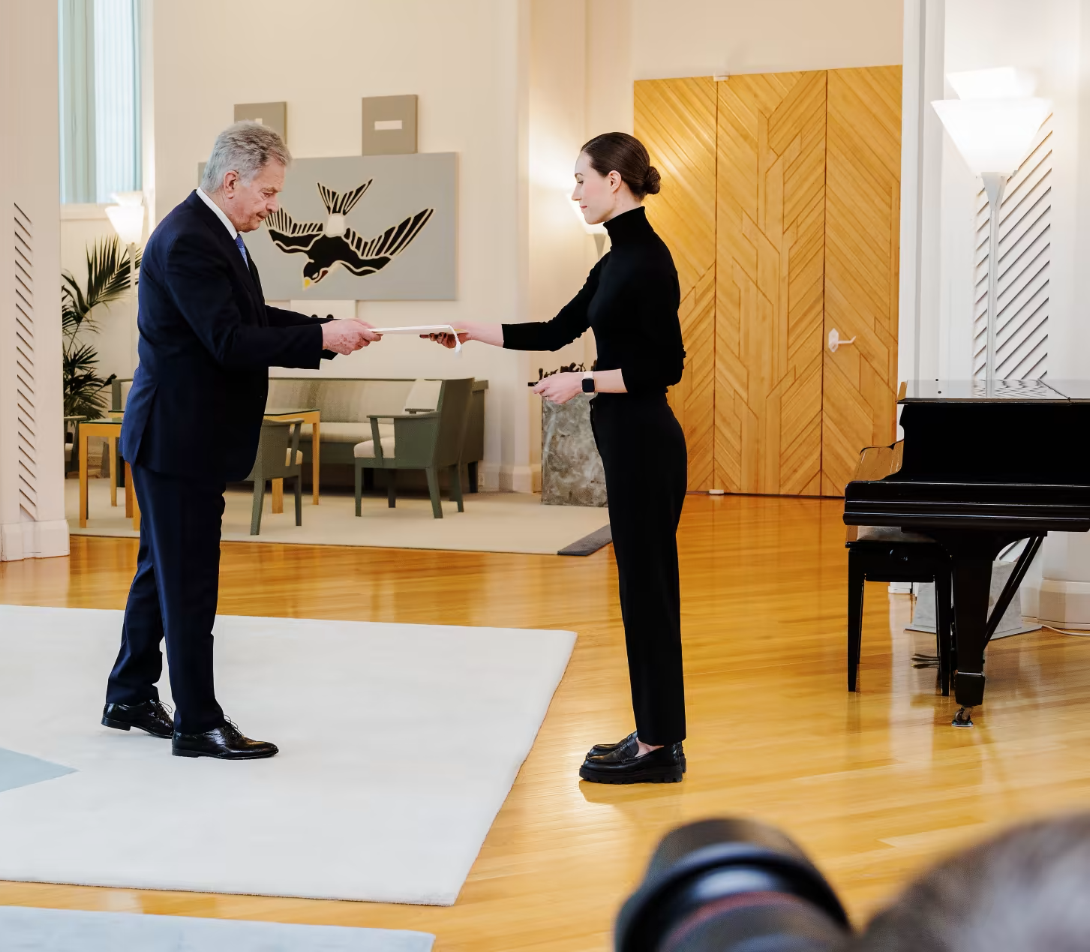
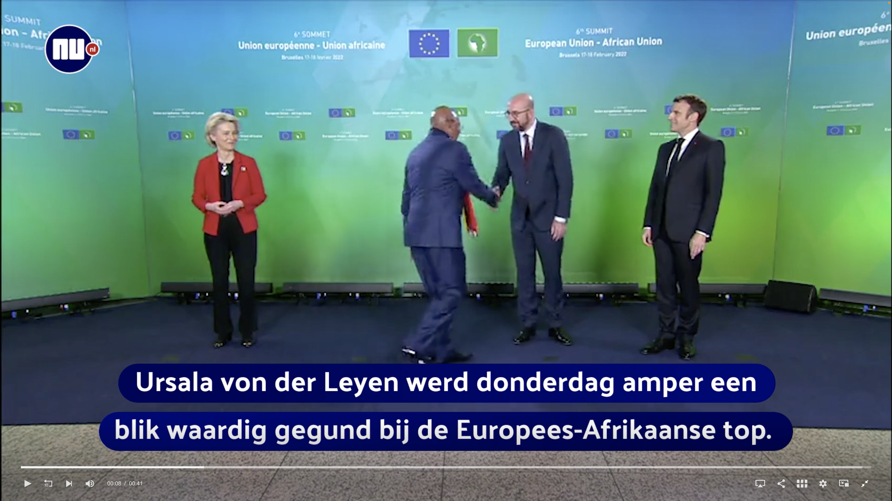
New role models, but double backlash for women leaders still exists
“Von der Leyen again ignored on the stage of world politics.
Ursula von der Leyen was barely given a glance at the European-African summit on Thursday. A minister walked right past the president of the European Commission. The incident was reminiscent of an earlier incident involving Turkish President Recep Tayyip Erdogan.”
https://valtioneuvosto.fi/en/-//10616/prime-minister-marin-submits-government-s-request-for-resignation-government-to-continue-on-a-caretaker-basis

Slide 29
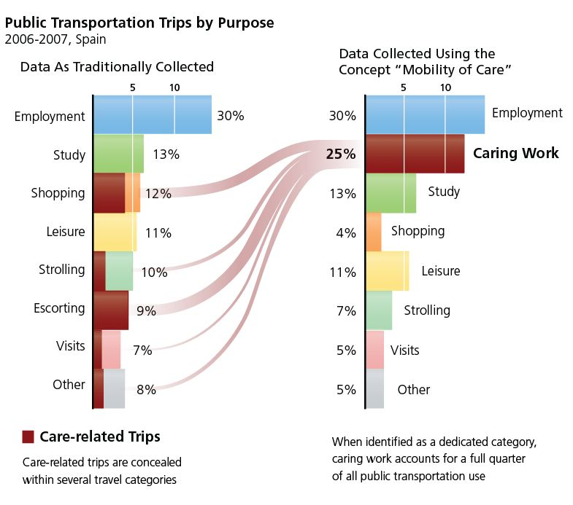
Data has become an enabler of gender-sensitive policies
What is the purpose of your trip?
Traditionally collected data rank employment as most important (30%) and study as second (13%).
Transportation policy is primarily based on the needs of workers and employers.
Source: http://genderedinnovations.stanford.edu/case-studies/transportation.html#tabs-2

Slide 30
Data has become an enabler of gender-sensitive policies
Does the purpose of your trip involve (caring for) another person?
Using the mobility of care concept “caring work” as purpose ranks almost as high as employment (25% vs 30%).
Transportation policy should include needs of “caring workers”.
Source: http://genderedinnovations.stanford.edu/case-studies/transportation.html#tabs-2

Slide 31
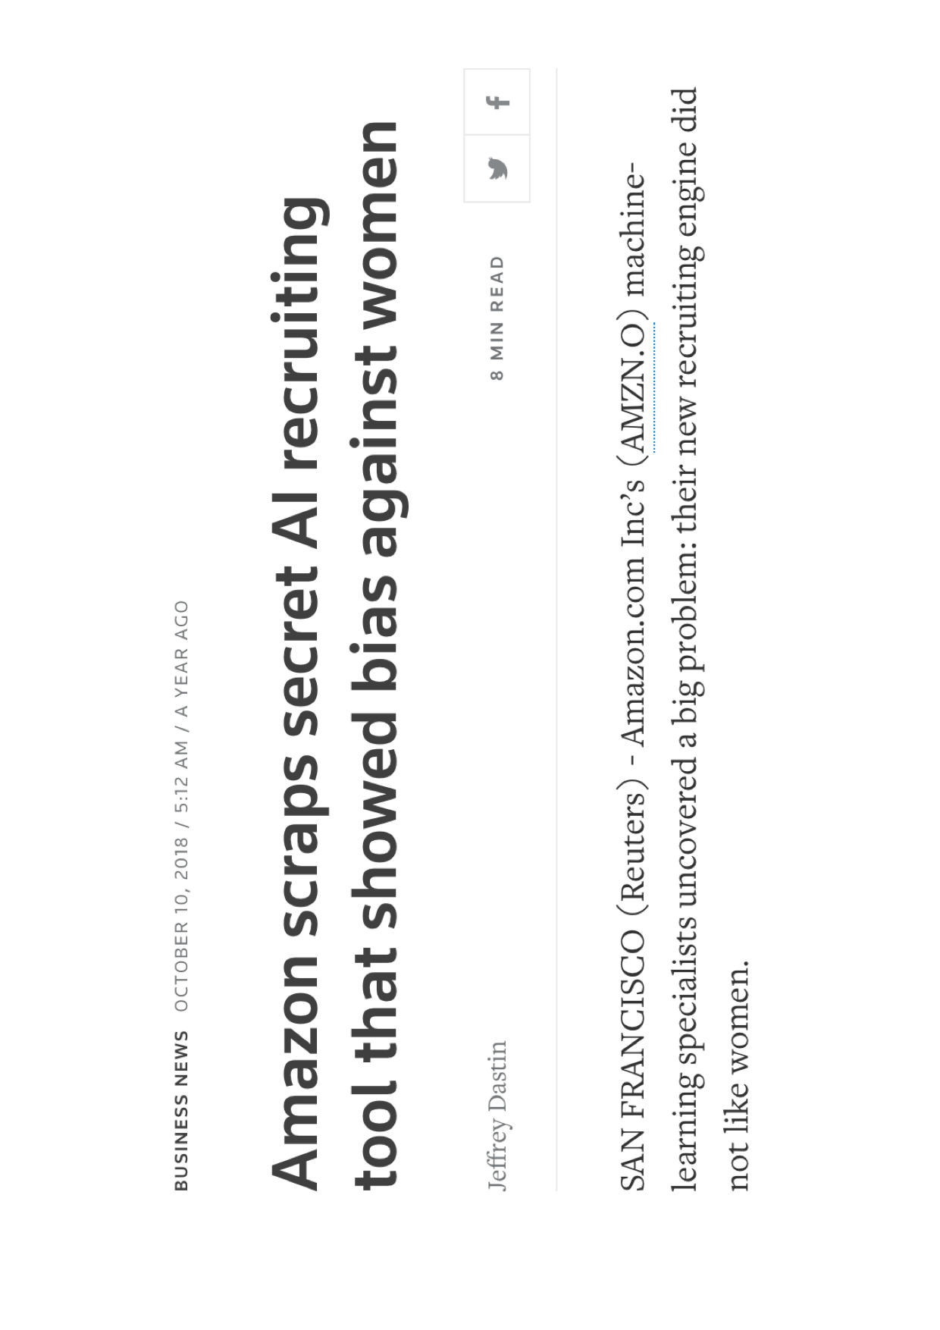
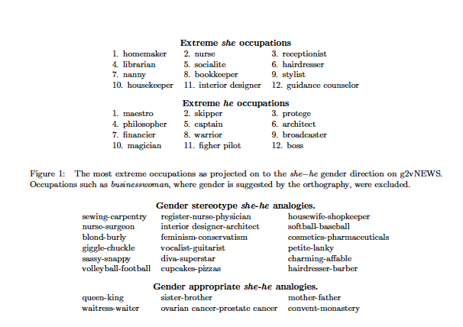
Emergence of “second generation gender bias”

Slide 32
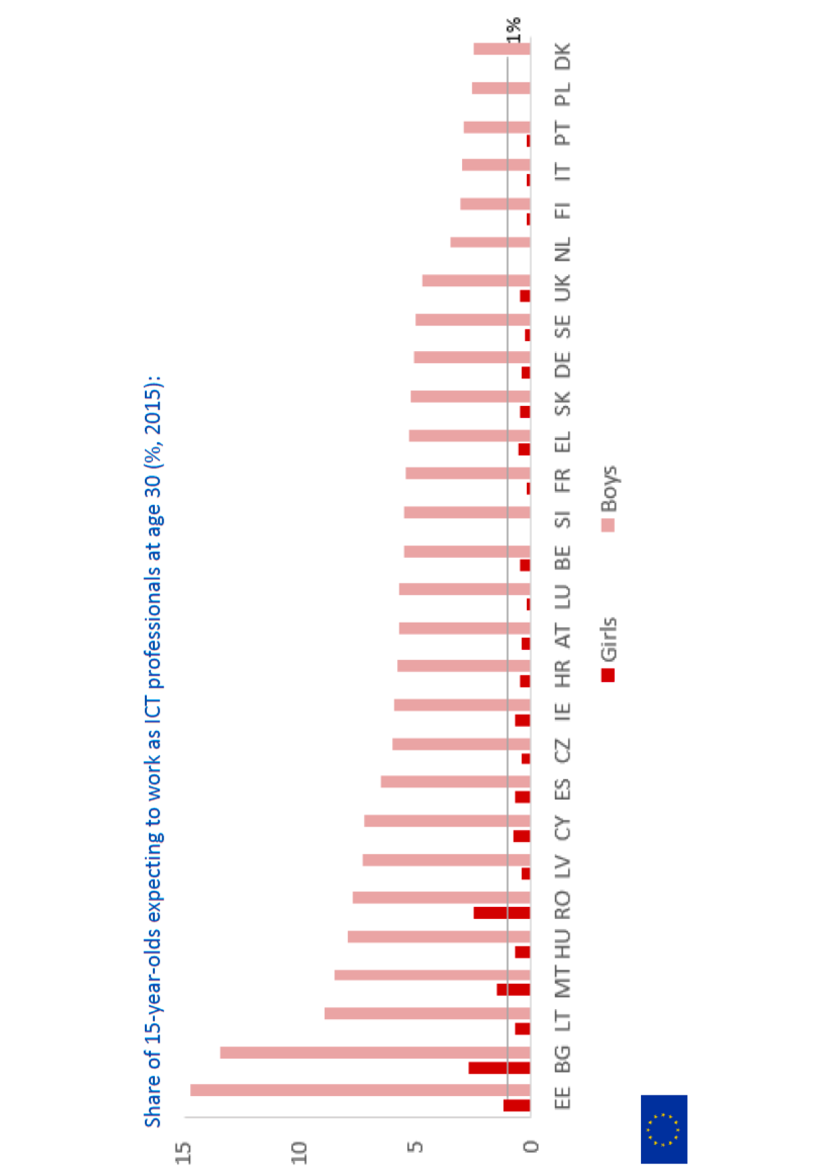
Gender differences in ICT and innovation
Share of women
App-developers (EU) | 9%
Owner of high-tech business (EU) | 5-15%
Patents (EPO) | 8%
Nobel prizes | 6%
Investments in women-led start-ups (NL) | 1,6%
ICT specialists (EU) | 17%
Source: EIGE, Women and men in ICT, 2018

Slide 33
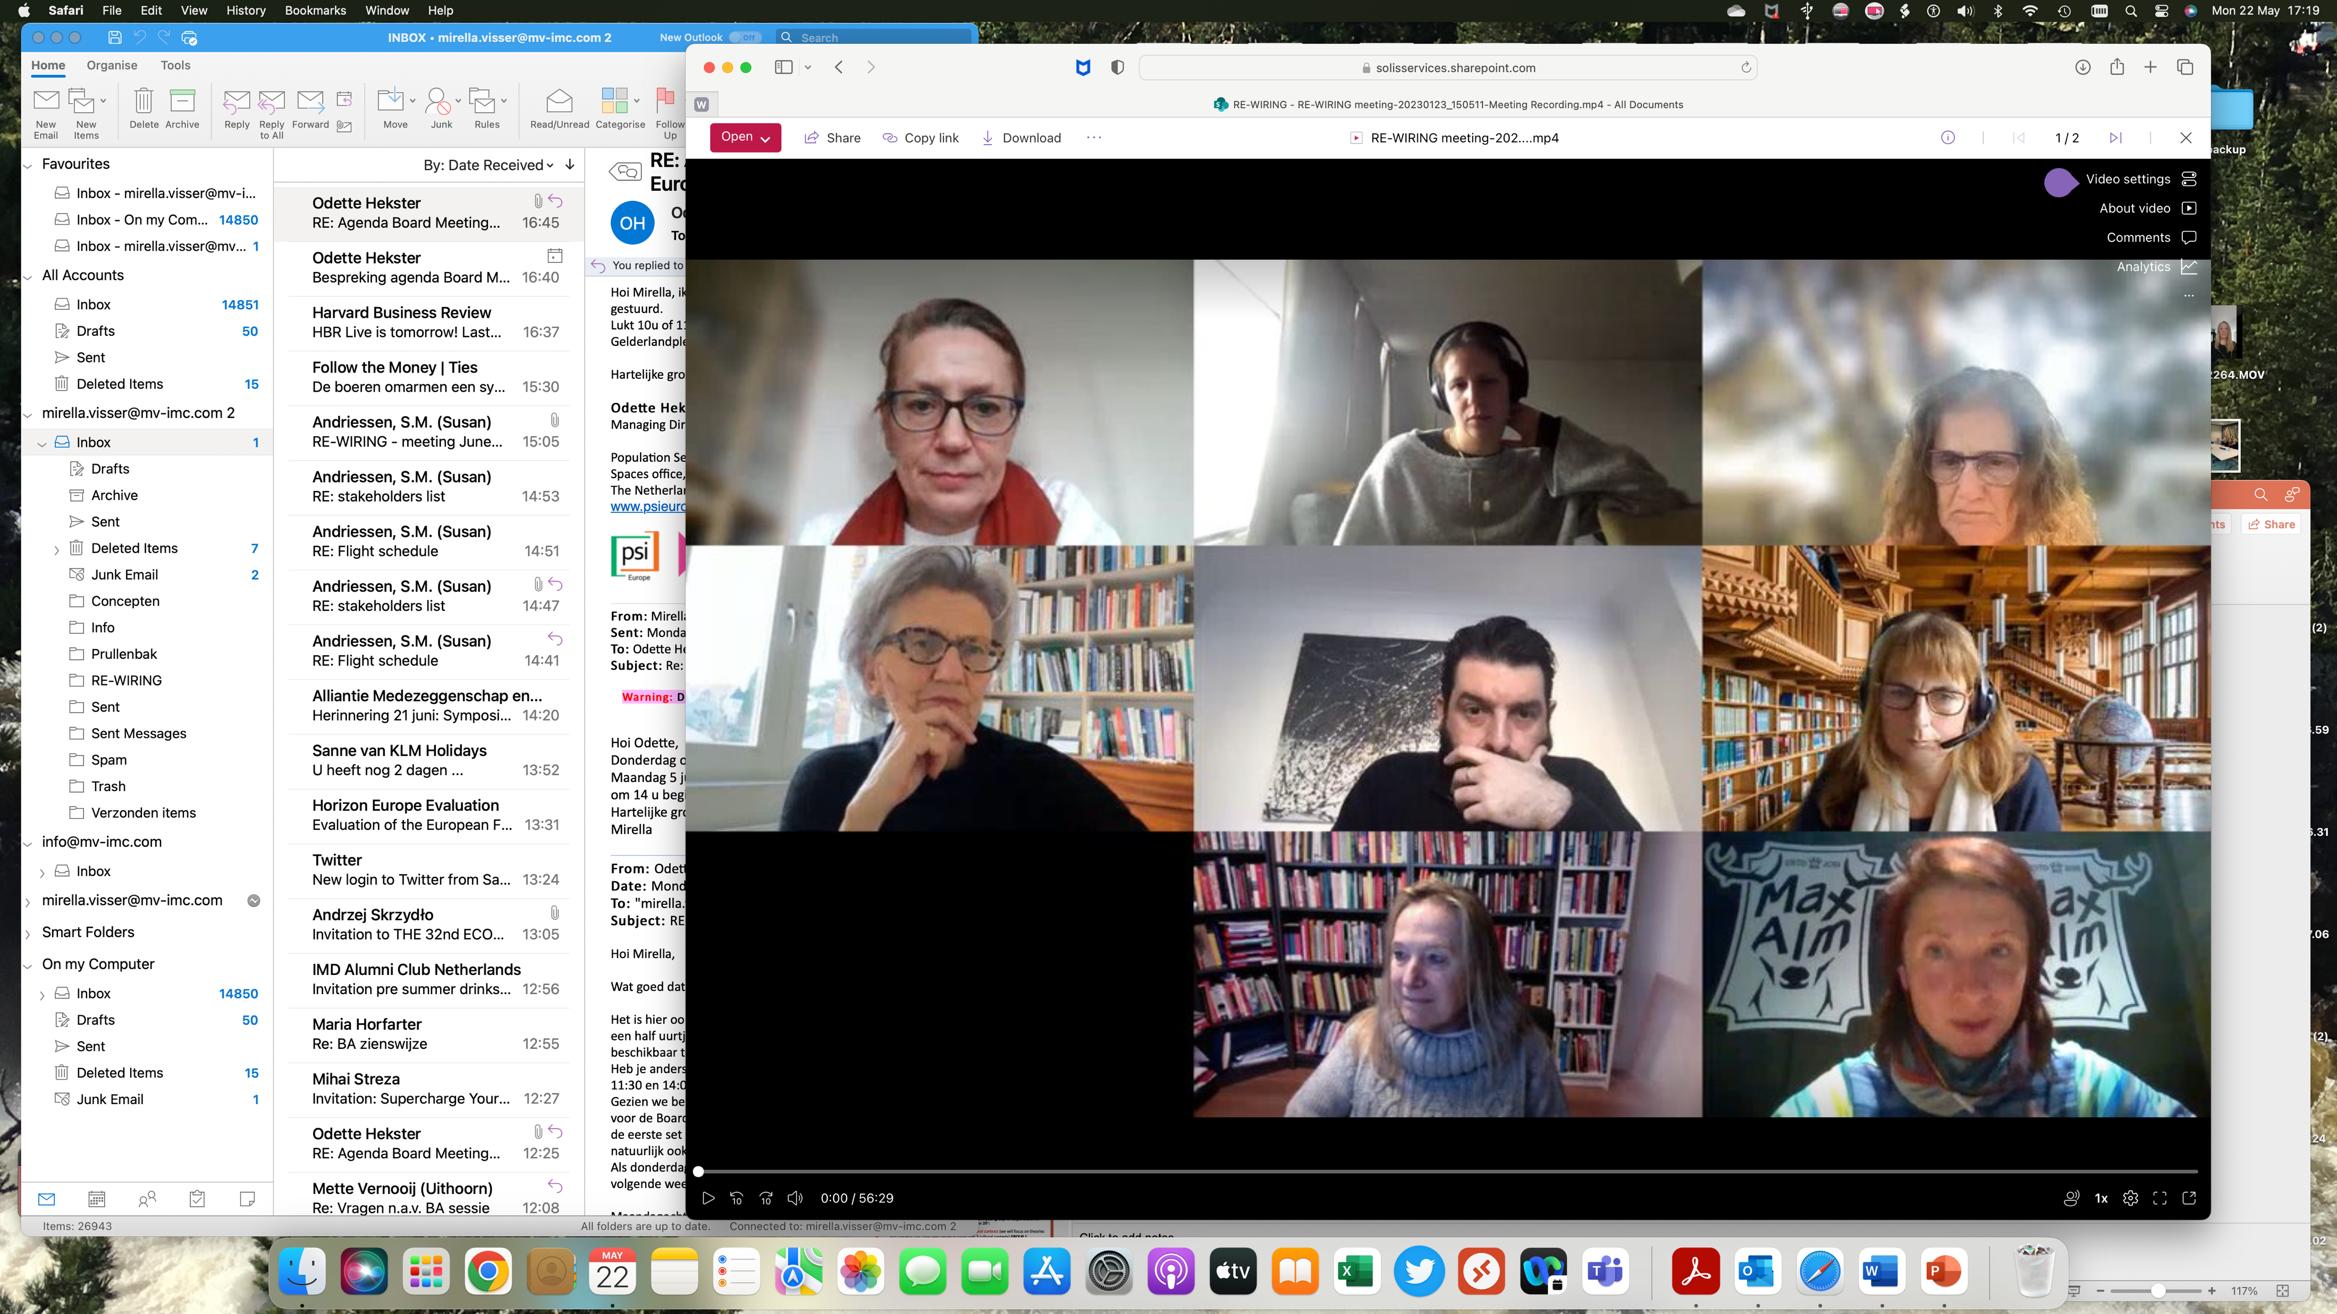
Realising Girls' and Women’s Inclusion, Representation and Empowerment, March 2023 – March 2026
re-wiring.eu
Consortium partners | Country
Utrecht University (UU) - Principal Investigator | NL
Katholieke Universiteit Leuven (KUL) | Belgium
Centre for Inclusive Leadership (CFIL) | NL
University of Portsmouth Higher Education Corporation (UoP) | UK
Universidad de la Iglesia de Deusto Entidad Religiosa (UDEUSTO) | Spain
University of the Western Cape (UWC) | South-Africa
Uniwersytet Gdański (UG) | Poland

Slide 34
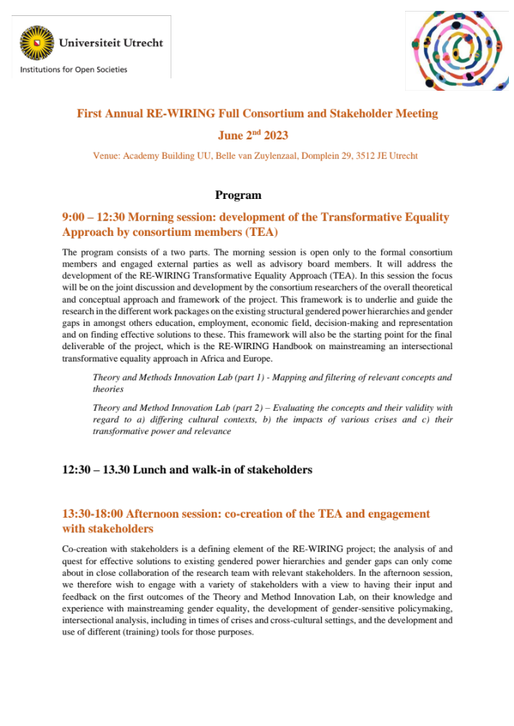
Realising Girls' and Women’s Inclusion, Representation and Empowerment, March 2023 – March 2026
re-wiring.eu

Slide 35
Our aim is to “re-wire” institutions
re-wiring.eu
We aim at contributing to effective change, by a re-design of existing legal, policy and institutional approaches more widely, to secure intrinsic change and behaviour towards transformative equality in all domains of society.
Not only rulemaking, implementation, monitoring and enforcement systems of equality laws and policies as such, but also the policies and actions of all societal stakeholders involved.
‘Institutions’ include not only governments and other public bodies, but also in the private sphere, companies, banks, social partners, health institutions, schools and academia, media and, closer to home, families and other private social constellations, including for instance women’s organizations and religious groups.

Slide 36
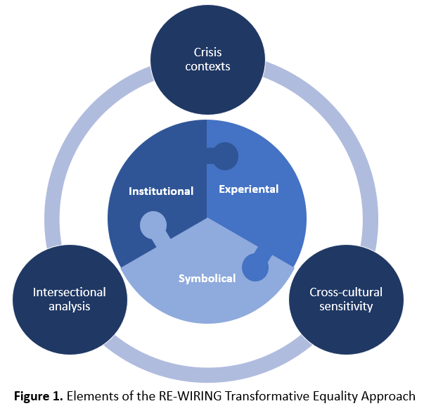
Development of Transformative Equality Approach (TEA)
re-wiring.eu
Theory of gendered organizations (Acker)
Address gendered power hierarchies in a holistic way by engaging both dominant and non-dominant individuals to transform structural barriers and constraining gender norms

Slide 37
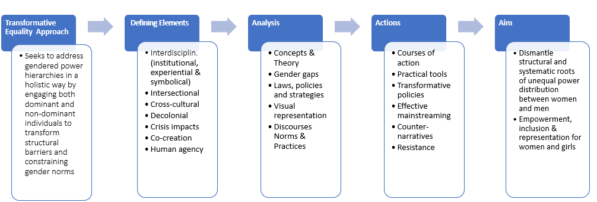
Key elements and process of TEA
re-wiring.eu

Slide 38
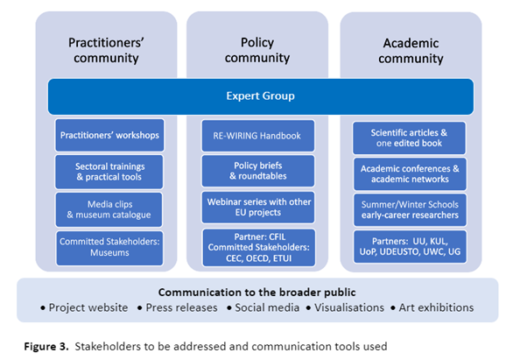
re-wiring.eu

Slide 39
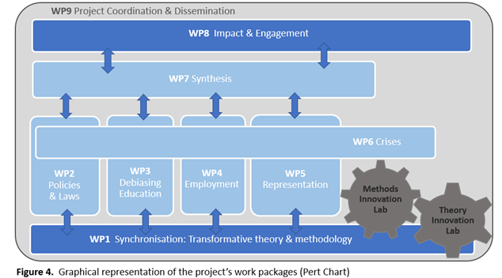
re-wiring.eu

Slide 40
Laws and policies: enhancing womens voice, agency and decision-making power (WP2)
re-wiring.eu
Country-level systematic review of laws, rules and policies to assess their effectiveness in terms of enhancing better representation of women in key areas of decision-making, such as in in government, parliaments, crisis-response teams and on boards of large companies.
To determine the root causes of gendered law- and policymaking processes in the countries under study and how these can be effectively overcome.

Slide 41
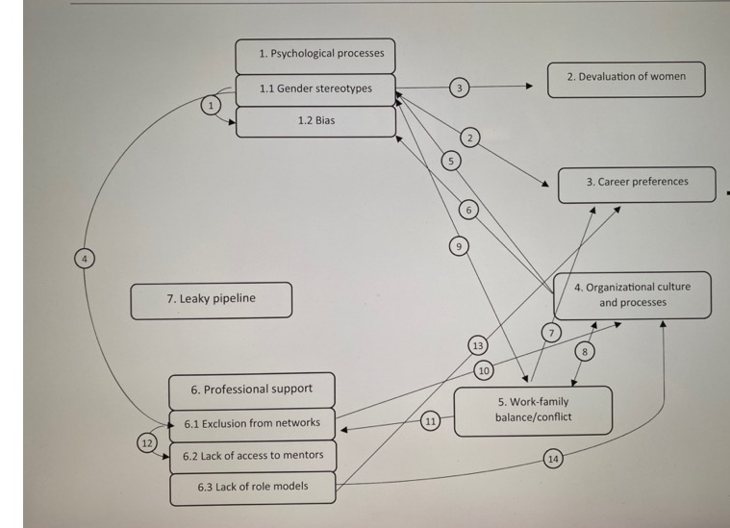
Interrelationships between barriers for representation
re-wiring.eu
Source: “Holistic and integrative review into the barriers to women’s advancement to the corporate top in Europe”, by R.A.van ‘t Foort-Diepeveen, A. Argyrou, T. Lambooy, in Gender in Management 36,4 (2020)

Slide 42
Gender gaps in employment and enterprise (WP4)
re-wiring.eu
Objectives
Explain the continued existence of intersecting gender gaps in employment and enterprise and the continued resistance to EU gender equality laws and policies by looking behind the numbers through a Transformative Equality Approach.
Co-create and co-deliver (with stakeholders) innovative and practical solutions to eliminate intersecting gender gaps in employment and enterprise for the European and African labour markets.
How
Utilising cross-disciplinary insights, we will examine the institutional, symbolical and experiential forces that contribute to the maintenance of these gaps along five axes: representation, pay, work-family roles, sexual harassment and access to finance.

Slide 43
re-wiring.eu
Cross-cutting element: crises
Unequal power relations in societies are sustained and even exacerbated in times of crisis.
Crises can act as a ‘magnifying glass’ of existing inequalities.
Crises as opportunities or sites for lasting transformation.
Focus on the transformative power that crises may (potentially) have for enhancing girls’ and women’s power of definition, at crisis-leadership level and in crises-response measures.
Financial, climate and health & future of work

Slide 44
Health crisis: impact of COVID-19 on work-life balance
re-wiring.eu
Time is gendered and “time cultures” are bound up with power and control.
Work life balance policies based on access to subsidized childcare and/or flexibility.
Distinction between housework, childcare, emotional labor and mental work.
“I have turned into a foreman here at home. I am trying to get clearer oversight over what has to be done and activate my husband to prevent everything from becoming a mess, and I do not want to take care of it all by myself. So, I had a family meeting and put up a clear division of duties.”
“We knew that the division of tasks is rather equal in our everyday life, but now that we are both working from home, it is obvious that he takes his space when he needs to attend to “his” things, and I run, and I sprint from my work much more than he does.”
Source: “I have turned into a foreman here at home”: Families and work-life balance in times of COVID-19 in a gender equality paradise”, by A. Hjalmsdottir, V. Bjarnadottir, 2020.

Slide 45
Some of the deliverables
re-wiring.eu
Work:
Toolkit on Gender Gap in Representation at Work
Best Practice Map on Addressing the Gender Pay Gap
Best Practice Map Addressing the Gender Gap in Work Family Roles
Policy report assessing Gender Inequality in the financial sector
Workshops and podcasts on better practices in protection from sexual harassment in the workplace
Management and leadership:
Working Paper on effective transformative equality processes towards leadership positions
Country-level reports and infographic on gendered nature of law- and policymaking approach
Working Paper: Root causes of gendered law- and policymaking processes and their effective tackling
Development of a policy evaluation checklist to identify and tackle gendered law- and policymaking processes
Practitioners’ toolkit for building gender-sensitive law- and policymaking Processes
Online training module for policymakers

Slide 46
Invitation to CEC to participate
re-wiring.eu
Surveys on company policies, designed to identify, monitor and address gender gaps in pay structures, policies on work-family roles / work-life balance, gender representation in management and policies on sexual harassment.
  At least 2 companies x 3 sectors x 4 countries (Belgium, UK, Poland, Spain).
  Total = at least 24 companies (ideally 48 companies, i.e. 4 per sector and per country)
  Months: 6-24 (September 2023 – March 2025).
1-on-1 interviews with line managers, to discuss company practices re gender pay gap, work- family roles / work-life balance.
  Ideally 4 line managers from companies x 3 sectors x 4 countries (Belgium, UK, Poland, Spain).
  Total = 48 line managers (ideally across 48 companies).
  Months: 6-24 (September 2023 – March 2025).

Slide 47
Invitation to CEC to participate
re-wiring.eu
3. 1-on-1 interviews with bank managers re lending practices towards women entrepreneurs.
  Ideally 3 bank managers (3 different banks) x 4 countries.
  Total: 12 bank managers.
  Months: 6-30 (September 2023 – August 2025).
4. Distribution / promotion / streaming of Project Report and of national / sectoral reports.
  Months: 30-36 (August 2025 – March 2026).
5. Other activities:
  Participation of CEC at 3 annual meetings (first on June 2, 2023), webinars and other events.
  Promotion of the projects’ activities on website(s), on social media etc.

Slide 48
What questions do you have?
re-wiring.eu
Mirella.visser@mv-imc.com
rewiringhorizon@uu.nl

Slide 49
Future Female Leaders Awards
presentation by
Fredrik Gustafsson

Slide 50

Behind the Scenes
Fredrik Gustafsson
Chairman, FKL and PR Specialist

Slide 51
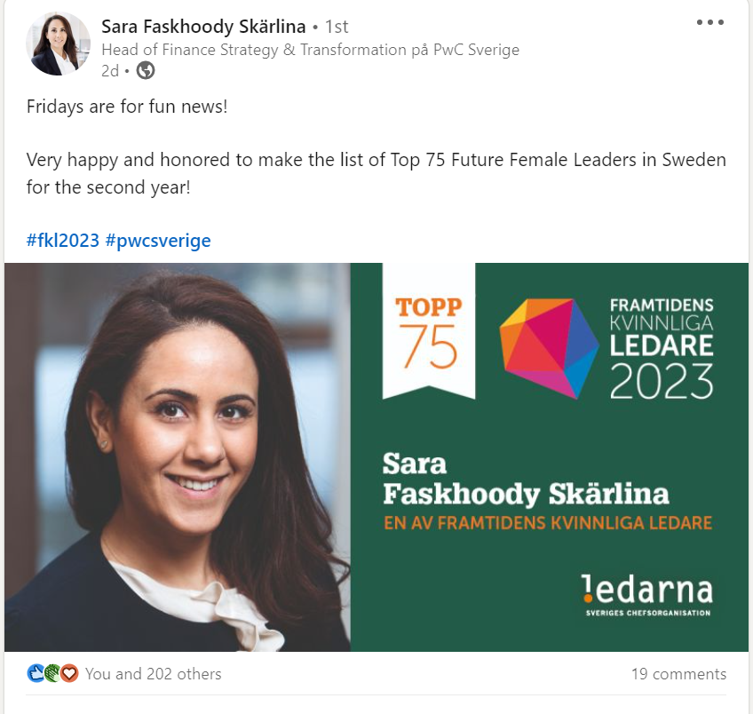
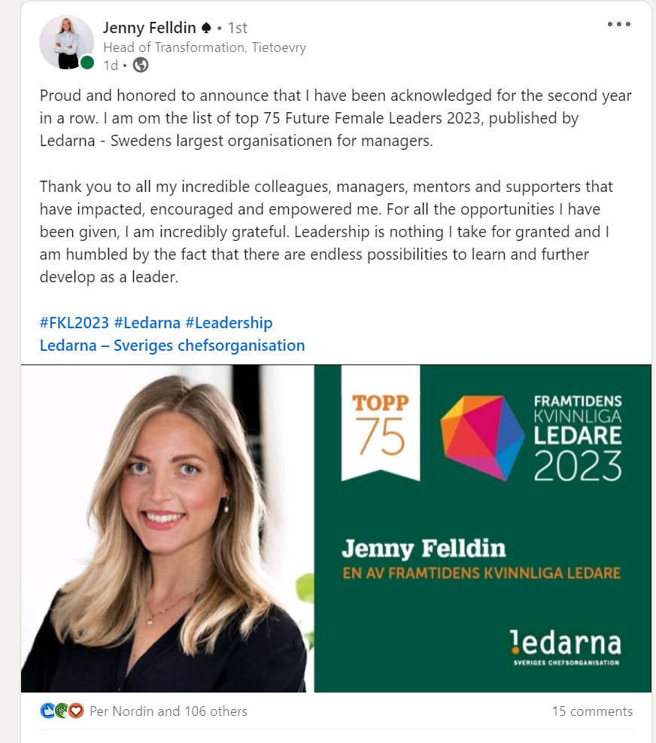
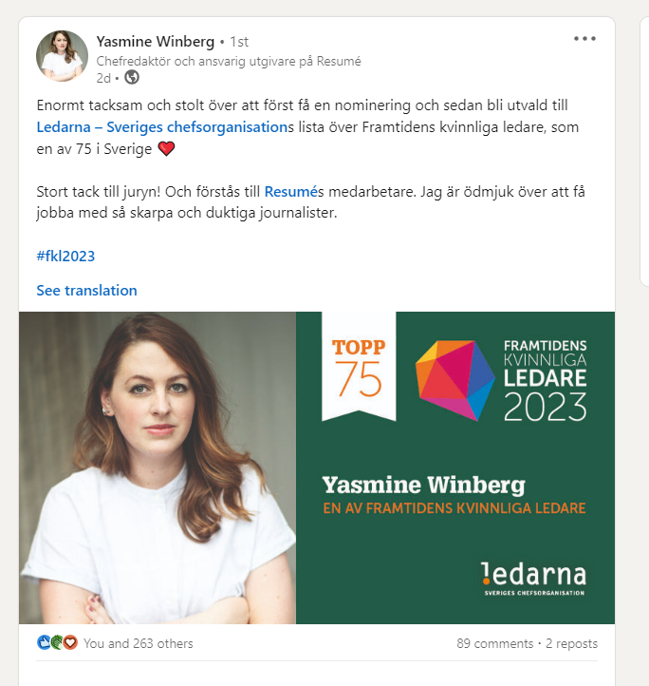

Slide 52
Why Framtidens kvinnliga ledare?
Since 2007, the Framtidens kvinnliga ledare list compiles 75 top executives from a wide range of sectors. Not limited to Sweden, many of the candidates work for international companies and are stationed abroad. They are The Female Leaders of the Future.
The purpose of the activity is to turn the notion of leadership as a male arena upside down, meanwhile highlighting top talent and strong leadership. These women become role models, and the list generates tons of national and industry coverage where each and every one share their individual success story.
To qualify for the list, the candidate may not be older than 35 and have a managerial position. Coming from different sectors, the annual list award’s the previous year’s achievements.

Slide 53
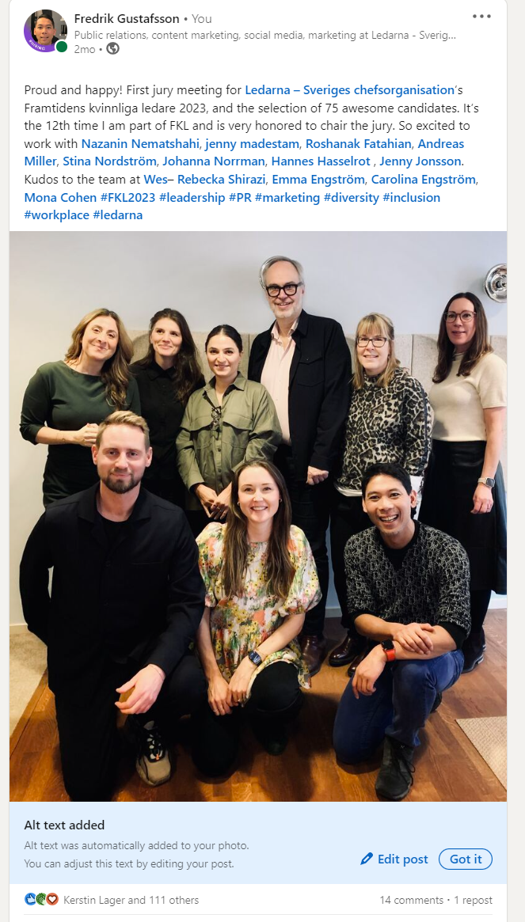
The 2023 Jury
Andreas Miller, Chairman Ledarna
Fredrik Gustafsson, PR Specialist Ledarna and deputy Chairman of the Jury
Hannes Hasselrot, GM Oriola
Jenny Jonsson, GM ByggVesta and the FKL 2022 Winner
Jenny Madestam, docent in political science and lecturer in public administration
Nazanin Nematshahi, SMC Director Microsoft
Roshanak Fatahian, Diversity & Inclusion Director Nord DDB
Stina Nordström, GS Reumatikerförbundet Ledarna board member

Slide 54
Criteria
Competency Leadership
Demonstrates transparent and inclusive leadership that promotes results through the development of employees' potential. Has successfully managed significant leadership challenges.
Results
Is responsible for results and has the power to develop and lead a business or drive important societal change. For instance, is the manager of several employees, has financial responsibility, has worked with business development, operational responsibility and/or has shown outstanding results in relation to the mission of the business.
Potential
Leads the business forward based on a vision of a sustainable society. Shows innovative thinking in handling complex issues. Has the ability to take on larger roles.

Slide 55
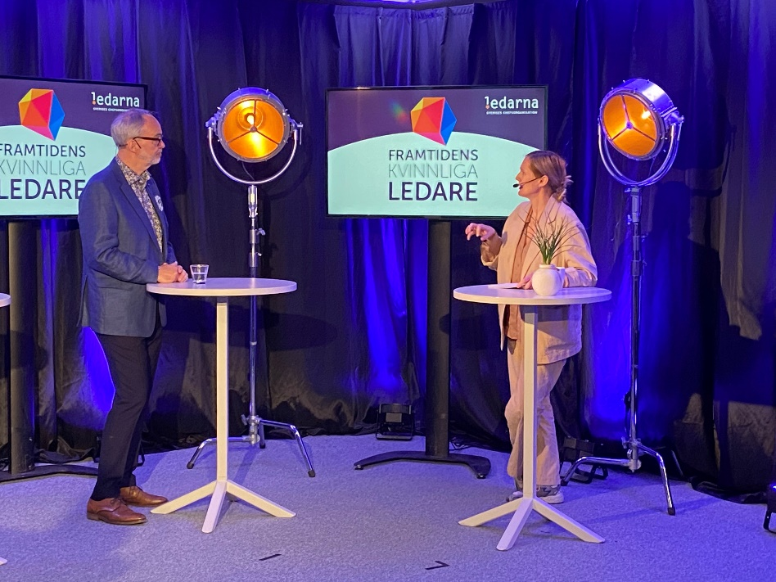
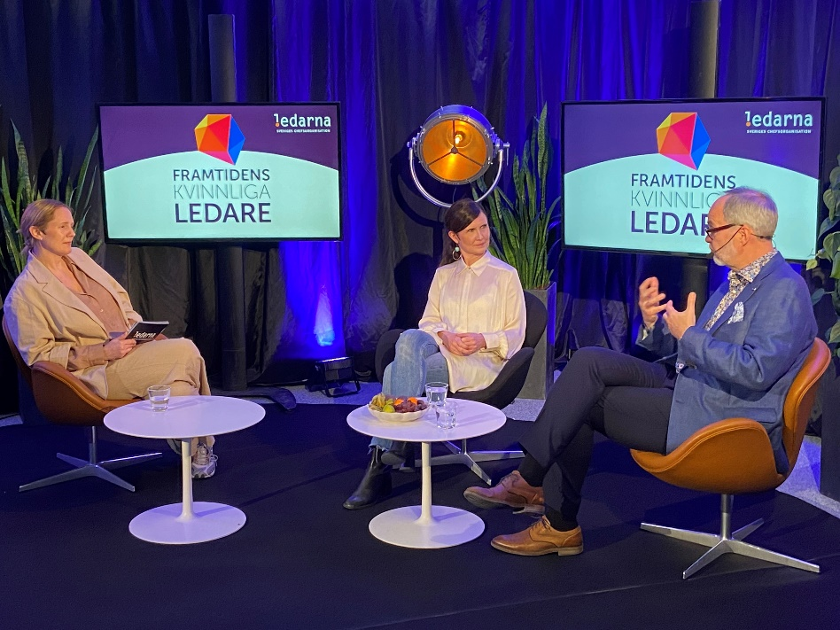
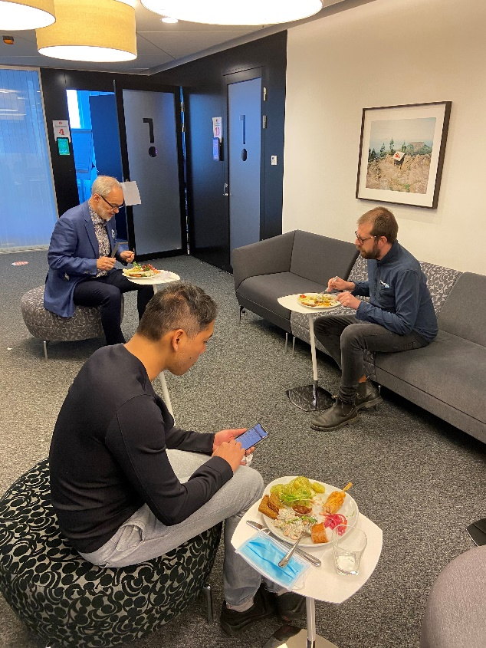
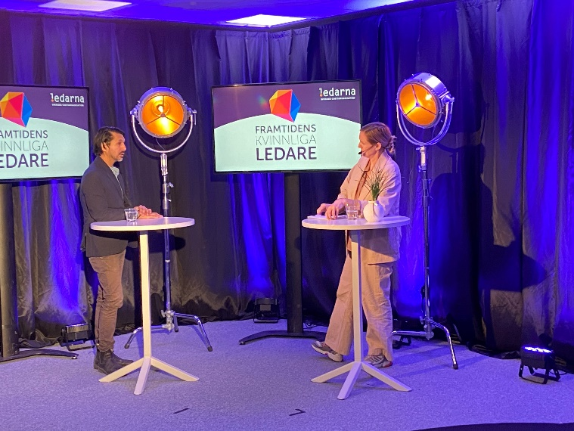
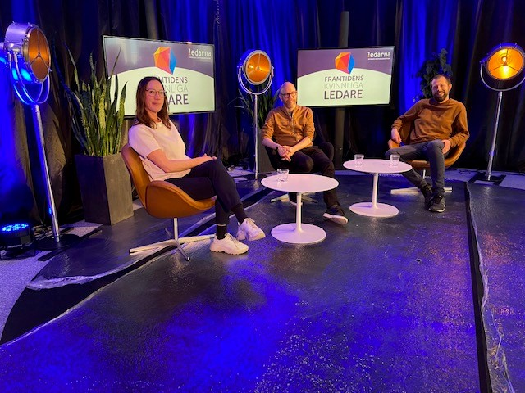

Slide 56
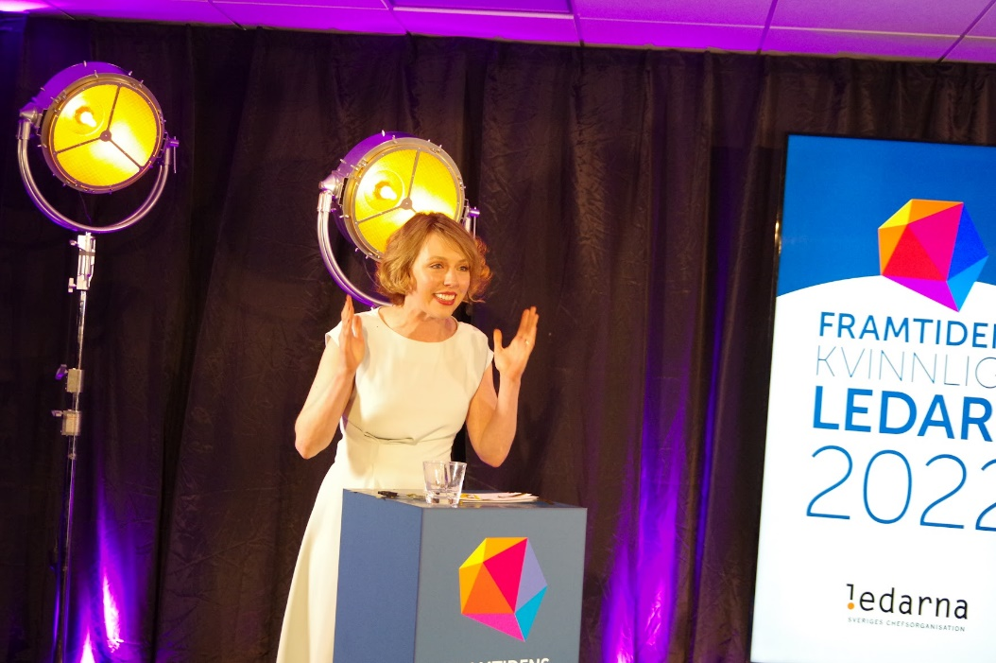
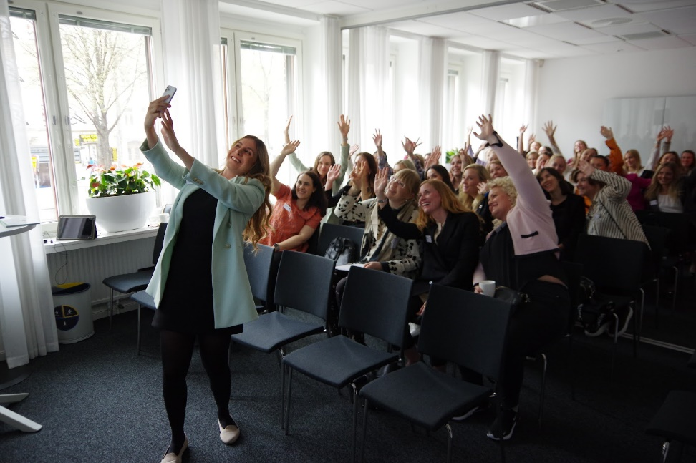
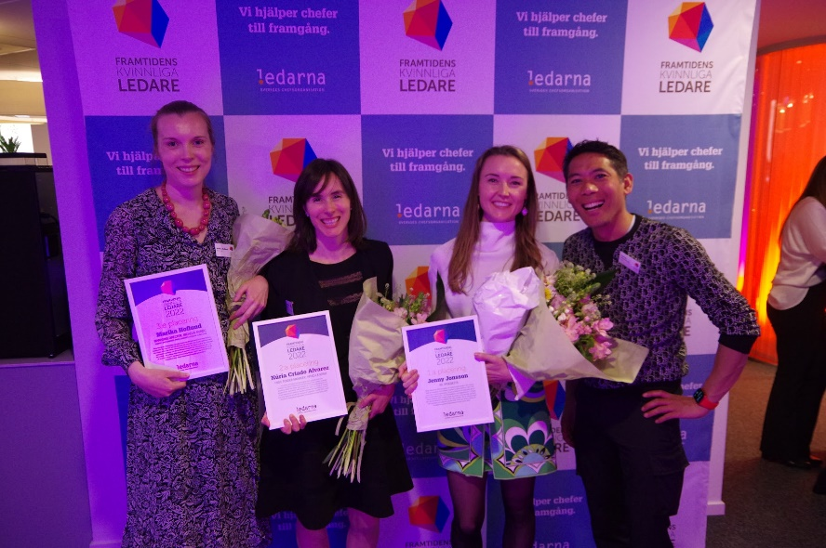
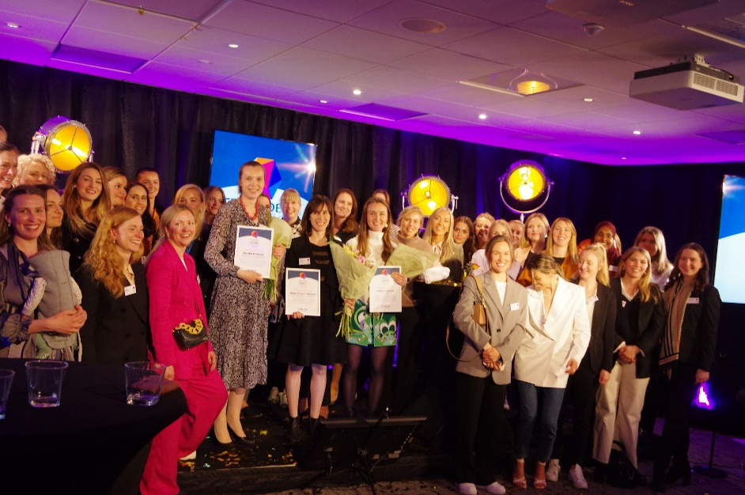

Slide 57
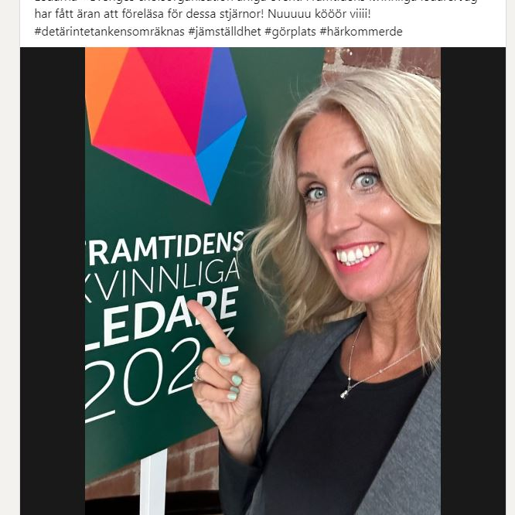
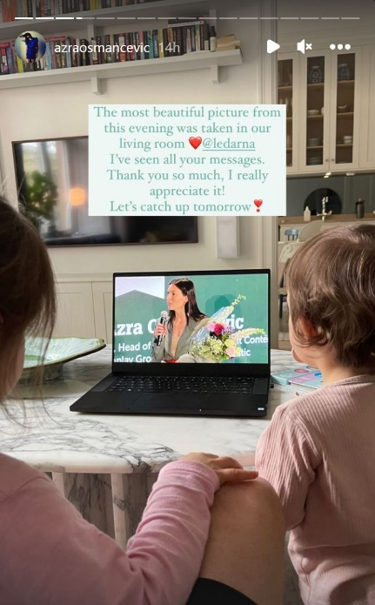
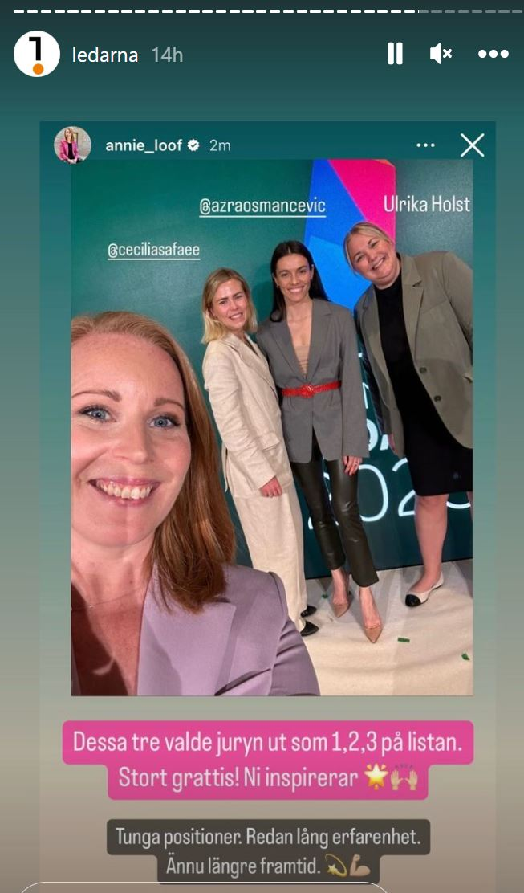
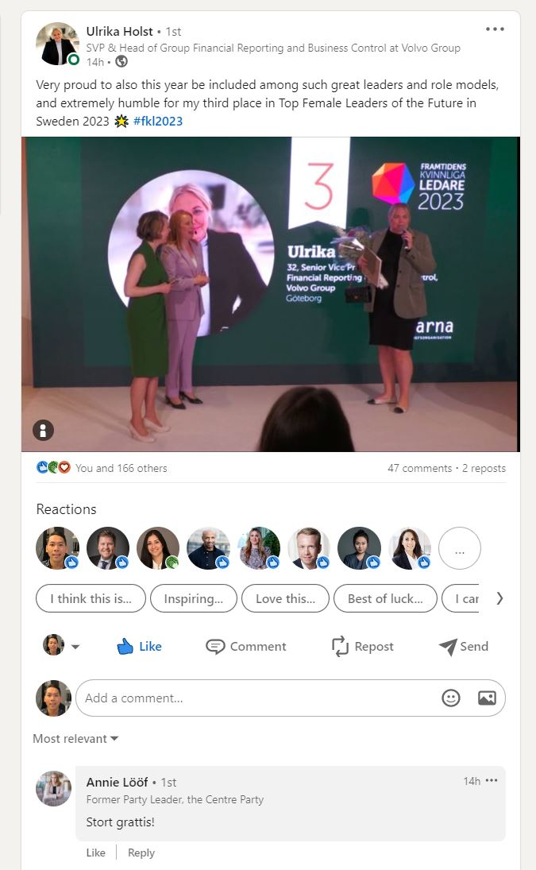





Slide 59
Ageism excludes managerial talent
presentation by Anna Thoursie, PhD

Slide 61
Ageism in the Swedish Labour Market?
Is there a ”best-after age” as well as a ”best-before age” for managers?
Ageism against women in child-bearing ages: Are they negatively affected by a generous parental leave system?
CEC
1 June 2023
Anna Thoursie
Chief Economist, PhD

Slide 62

What Ledarna offers its members
The focus of the report is to learn more about:
Managers' attitudes towards older individuals compared to younger individuals in the labor market
Opportunities for managers and their employees, aged 60+, to work into higher ages
The prevalence of age discrimination in recruitment and competence development, both possible own experiences, and instances where managers themselves have discriminated against older individuals
The issue of possible own experiences also addresses discrimination against young managers
CHEF MAGAZINE
COURSES & SEMINARS
LEDARNA PLAY
MANEGERIAL SERVICE
COACHING
CAREER COUNSELING
STATISTICS, MANAGERS’ SALARIES

Slide 63
What Ledarna offers its members
The data :
This report relies on data collected from Ledarna's panel of participants, consisting exclusively of managers, through web interviews conducted by Novus
In the autumn of 2020, Novus undertook a series of web interviews, with over 1 500 managers responding (1 504 to be precise), resulting in a response rate of 50 percent
CHEF MAGAZINE
COURSES & SEMINARS
LEDARNA PLAY
MANEGERIAL SERVICE
COACHING
CAREER COUNSELING
STATISTICS, MANAGERS’ SALARIES

Slide 64

How do managers generally perceive the abilities of older individuals (55 years or older) and younger individuals (35 years or younger) in their own workplaces?

Slide 65


Managers 60+: Has my employer implemented any measures in the workplace to facilitate my continued work as a manager at a higher age?
Managers: Has my employer implemented any measures in the workplace to facilitate my employees' continued work at higher ages?

Slide 66

What changes in managers’* own workplaces could make them
consider working until at least 67 years or longer?
* The managers who were 60 or older, and who responded that they wanted to work until 66 years or shorter.

Slide 67


The proportion of managers who perceive themselves to have been discriminated against due to their age during a recruitment or promotion process
The proportion of managers who perceive themselves to have been discriminated against due to their age regarding opportunities for competence development

Slide 68


The proportion of managers who respond that they have, in at least one recruitment process, rejected a person whom they considered too old to handle the job tasks effectively
The proportion of managers who respond that they have chosen to invest less in competence development for employees who are expected to retire within a few years

Slide 69

Conclusions:
Ageism is alive and kicking in the Swedish labour market
There is a ”best-before age” for many jobs
In contrast to most other occupations, there also seems to
be a ”best-after age” for managers
Ageism cannot be counteracted solely through the protection against age discrimination afforded by legislation but requires other broader measures
Age-aware leadership is key to ensuring that employees of all ages feel satisfied about their jobs as well as in their jobs and thus make valuable contributions to the results of the business

Slide 70
Ageism against women in child-bearing ages: Are they negatively affected by a generous parental leave system?

Slide 71
Some milestones in the Swedish parental leave system,
paid and unpaid
Year Length
180 days
1975 210 days
280 days
1979 Employment protected leave until child is 18 months
Right to work 75% of original working hours until child is 8 years
360 days (270 + 90)
1987 450 days (360 + 90)
360 days plus ”child allowance” 1-3 years if staying at home
1994 450 days (360 + 90) and abolishing ”child allowance”
1995 30 reserved days for each parent, no extension
2002 480 days (390+90) with 60 reserved days for each parent
2016 90 reserved days for each parent, no extension

Slide 72
What Ledarna offers its members
Mothers’ and fathers’ use of paid parental leave 1974 – 2022
CHEF MAGAZINE
COURSES & SEMINARS
LEDARNA PLAY
MANEGERIAL SERVICE
COACHING
CAREER COUNSELING
STATISTICS, MANAGERS’ SALARIES
Source: Swedish Social Insurance Agency

Slide 73
I will now ask you to decide whether these two statements are true or not:
The majority of employers prefer that the employees are present rather than absent from work
2. It is impossible for an employer to have correct and complete information about the future absence from work for every individual that the employer considers hiring or promoting
If you agree with both these statements, you agree that statistical discrimination between women and men exists to some extent

Slide 74
Statistical discrimination
An individual is attributed the behaviour which is the
most common in the group to which s/he belongs
In this case it means that every woman or man carries
the average risk of absence due to parental leave
pertaining to the groups ”mothers” or ”fathers”
This is the rational thing to do for employers, their ”best guess”
That a woman in childbearing ages automatically is seen
as more risky to hire or promote occurs independently of
her productivity at work
She cannot influence this by her own actions

Slide 75
Conclusion:
If statistical discrimination between women and men exists, we must make our priorities clear
Which goal do we value the most:
Parents’ individual rights to choose how they will allocate the days on a generous tax-paid parental allowance and a generous employment protected parental leave between themselves
Womens’ right to the same opportunities as men on the labour market

Slide 76
Thank you for your attention!

Slide 77
Beyond ageism
panel discussion with Mirella Visser, Andreas Miller, PhD Anna Thoursie and Maxime Legrand

